Slide 1
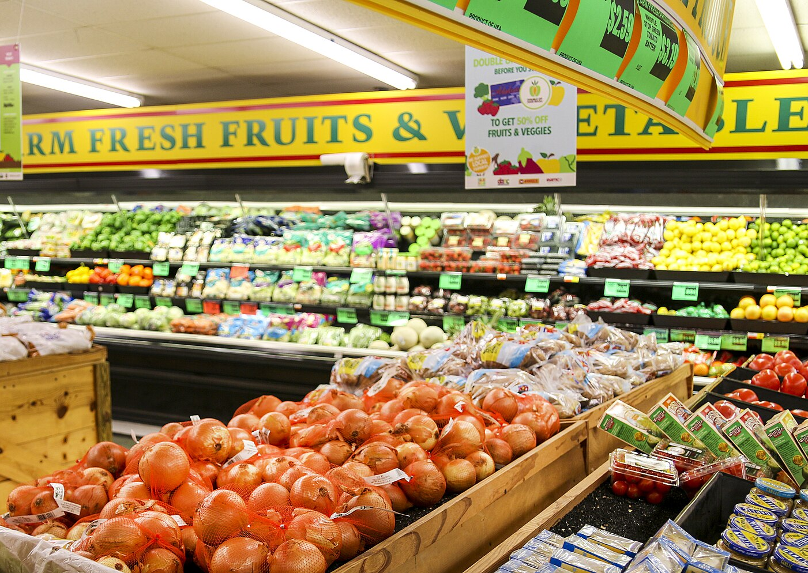


Community Co-op Conversions:
An Exit Strategy that Preserves Rural Grocery Access
Tracy McIntyre
Montana Cooperative Development Center
Leslie Watson
Cooperative Development Services
Notes:
LESLIE -- Welcome and introduce myself, then turn to Tracy . . .

Slide 2

What is your Why?
Notes:
TRACY – polls the room, why you are here, popcorn style

Slide 3

Our Why:
Rural Grocery stores are a lifeline for communities health and vibrancy
Kansas Data has 25% of grocery store owners planning on retiring in 1 to 5 years, 70% without a plan
2020 Statewide survey of Rural Groceries in Minnesota found 49% were concerned about going out of business.
Notes:
Tracy – if it helps:
A 2020 statewide survey of rural groceries found that 49% of rural grocers in MN were concerned about going out of business

Slide 4
What is a cooperative?
A business that is owned and controlled by the people who use it and that exists to meet their needs.
Notes:
TRACY

Slide 5
What is a co-op?
Member Equity
Members have a financial stake
Member Equity
Essential
Features of
a Cooperative
Member Control
Members contribute to decision-making
ESSENTIAL FEATURES
OF A COOPERATIVE
Member Benefit
Co-op meets members' needs
Member Control
Member Benefit
Notes:
TRACY:
One way to think about co-ops is to focus on three essential features necessary for them to function well—when these three "legs" are strong, then you have a very sturdy stool: (1) Member equity – members having “skin in the game” in the form of their own capital i the co-op; (2) member control—genuine say over the co-op, by electing representatives who listen to members; and (3) member benefit—clear sense of what the co-op is there to deliver for its members.

Slide 6
The Structure and Benefits
A Cooperative is owned and democratically controlled by the members who use it.
Members can accomplish more collectively than they could individually .
A cooperative can be state or federal chartered business
It is an organized and operated corporation under applicable state or federal laws.
The life of a cooperative can be perpetual. Members can routinely join or resign without disrupting ongoing operations.
They are not charitable in nature
Benefits of a Cooperative:
Access to quality supplies and services
Increased buying power and leverage
Share in earnings
Effective Political Action
Greater Impact on the local economy
Democratic Control
Notes:
Handout from MCDC on the 7 guiding principles
Co-op 101 Handout?

Slide 7
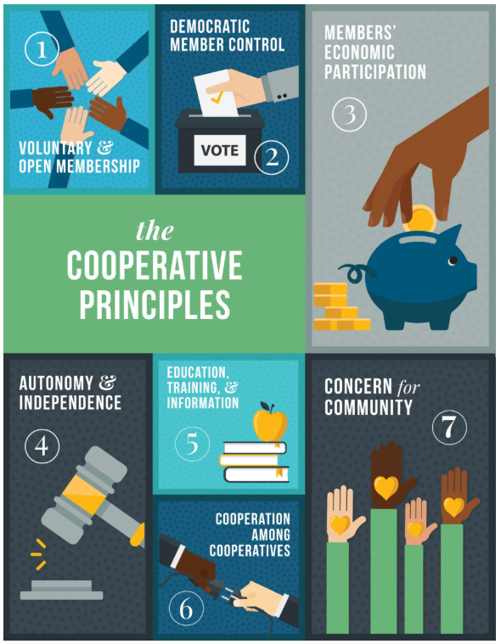
Seven Guiding Principles
Voluntary & Open Membership
Democratic Member Control
Members' Economic Participation
Autonomy & Independence
Education, Training and Information
Cooperation among Cooperatives
Concern for Community
https://www.ica.coop
Notes:
TRACY

Slide 8
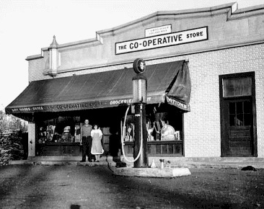
About Grocery Co-ops
The Basics:
Consumers own and govern the store
Not a nonprofit—must pay its own way
Member-elected board + paid management
MN Historical Society
Notes:
Tracy introduced co-ops generally. Multiple types and industries, and I want to just add a little detail on grocery co-ops in particular:
Most grocery co-ops in the US are consumer co-ops, owned and governed by their customers
For-profit entities—not 501c3s
They are governed by a member-elected board, and typically have paid professional management—although in smaller co-ops, volunteer member labor is still sometimes part of the mix.

Slide 9
About Grocery Co-ops
More than Granola!
First successful consumer co-op: Rochdale, England, 1844
Consumer-owned conventional grocery stores have existed in the US for over a century
Finland Co-op in rural MN has been open 113 years!
MN Historical Society
Notes:
They are also nothing new, and—while in the US we sometimes think of them as being natural and organic stores founded by hippies, that's just not the case!
The first successful consumer grocery opened in 1844 in England
They have been in the US for over a century—picture here is the Finland Grocery Co-op in rural Minnesota—113 year and counting!

Slide 10

Owner Benefits of a Cooperative Conversion
What to Expect:
Exit option when business is viable but outside buyers aren’t interested
Fair price + flexible deal structure
Potential tax advantages for seller
Store stays in community and legacy lives on
Notes:
[TRANSITION]
upsides to a succession that involves selling your business to the community:
CLICK for EACH
An option when private equity may not be interested, and yet the business is viable. Can be highly practical where conventional buyers might not exist.
Can still allow a financially rewarding exit path
There can be flexibility in the deal structure, including seller financing
In cestain cases, potential tax benefits for selling owner(s)
A lasting legacy for the selling owner(s). It's your creation, that you have nurtured and care about it, and being a steward of its succession in this way can be profoundly meaningful to some.

Slide 11
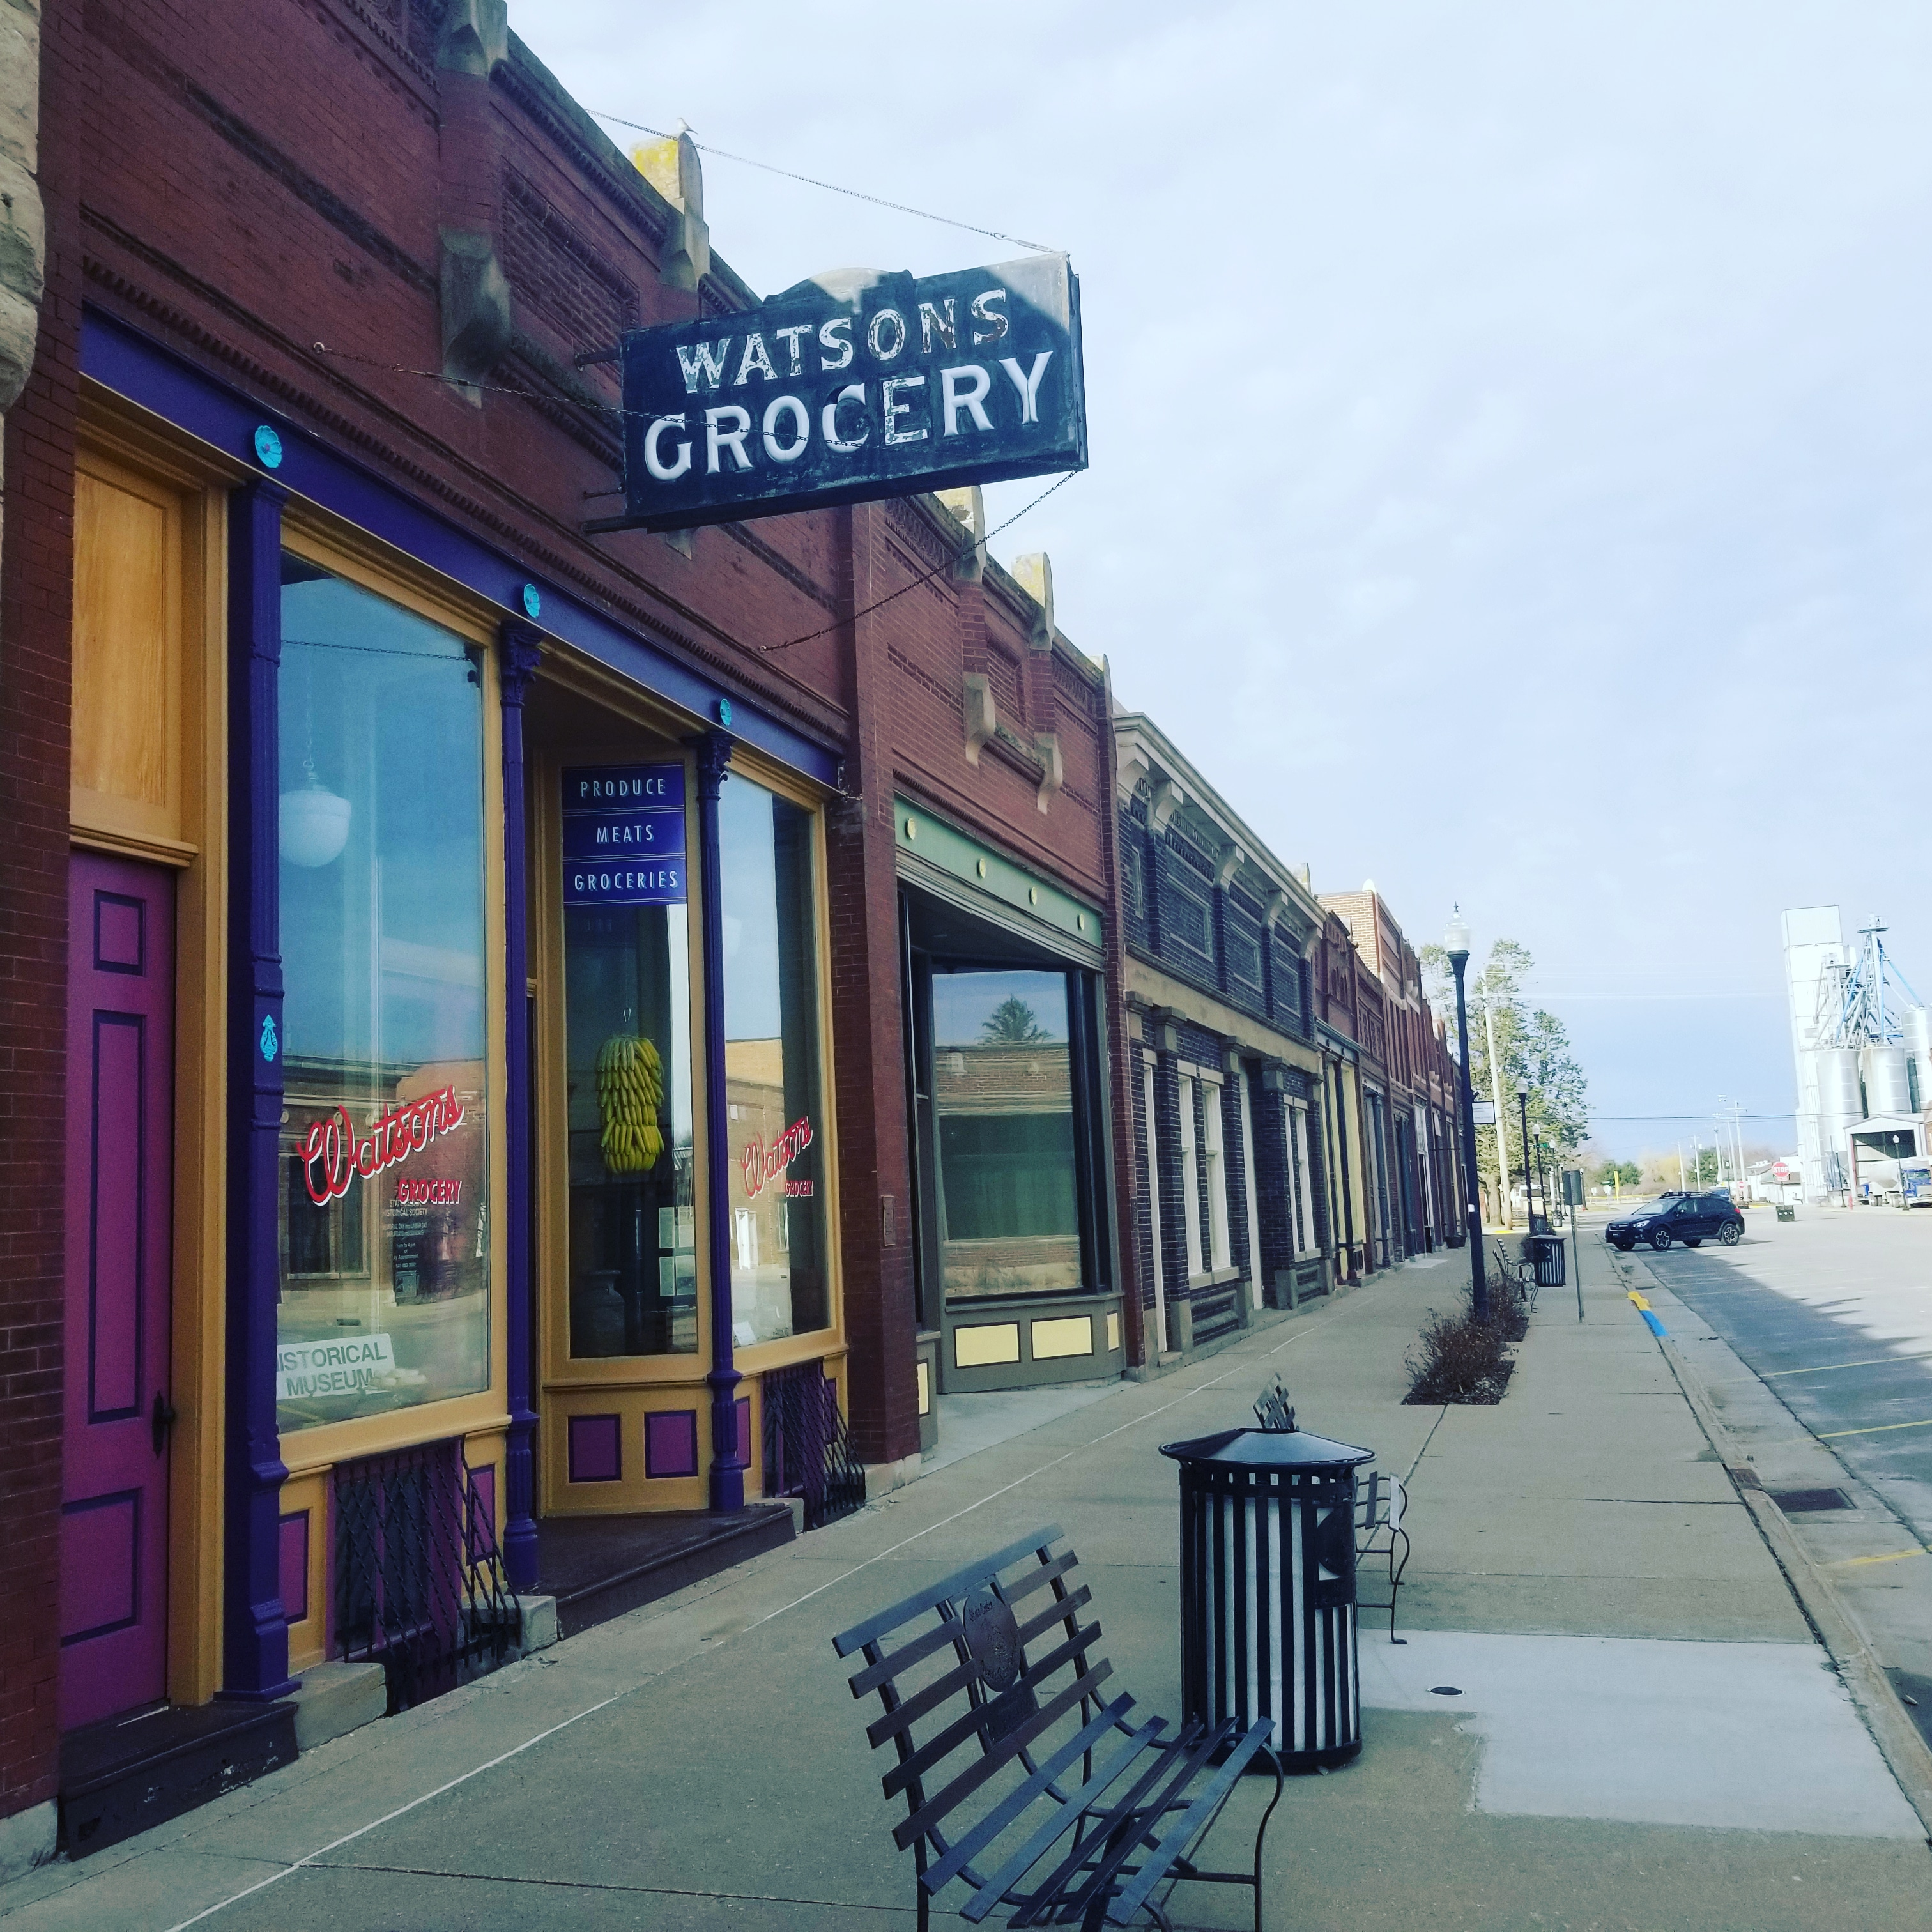
Community Benefits of a Cooperative Conversion
What to Expect:
Keeps essential services on Main Street
Supports local farmers and food producers
Rooted in your community’s identity and history
Builds on what’s there—easier than starting from scratch!
Notes:
Wikimedia image – Watson’s grocery store Museum in State Center, IA
On the companion side, and building on that last point—there are obvious benefits to the community:
CLICK FOR EACH:
Essential services
Markets for local food producers
Preserve community identify
A conversion is easier than a startup

Slide 12

The Window of Opportunity
Notes:
Creative Commons image
And that brings me to my next point: The benefit of all parties understanding the nature of the window . . . .
The earlier the conversation starts, the better the outcome — for you, your employees, and for your community.
Conversions are harder once a store closes and the operation falls into dormancy, for reasons you can probably imagine. And it is not an instantaneous process, requires time and care—fortunately, also not a process you hae to create anew, as it has been done by others . . .
Tracy is going to start us off on the steps in a standard process. . . .

Slide 13
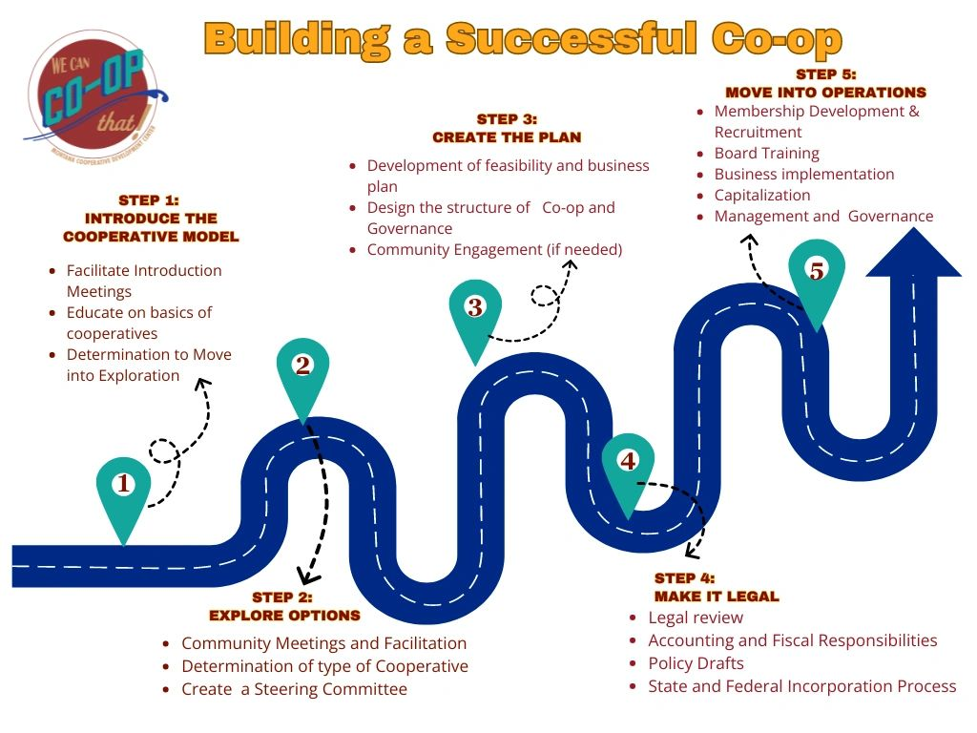
Getting Started

Slide 14
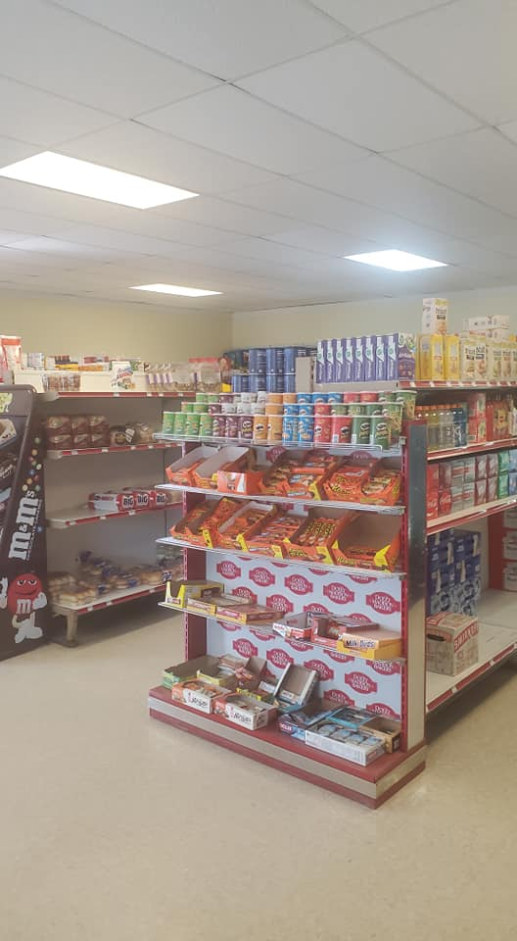
For the Business Owner
Plan Early
Explore Options
Be willing to engage
Be transparent
Are your BUSINESS FINANCIALS in ORDER
Detangle personal from business ahead of time
Be ready to support through the transition

Slide 15
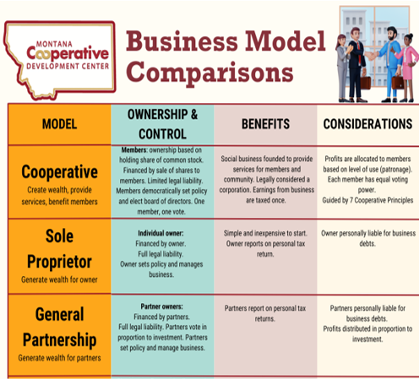
For the Community
Understand the position of the store
Talk, don't assume
Explore options
Build a timeline that coordinates with Owner
Identify a steering committee and champions
Understand the community assets before assuming the aeed
Contact a Co-op Developer (MCDC, CDS, FCI)

Slide 16

Role of a Steering Committee
Led by a champion (but not solely!)
Benefits from an intentional mix of skills, relationships, community credibility
Should align early with owner on expectations
The steering committee's job: Assess feasibility and serve the future owners
Notes:
Tracy mentioned steering committees a minute ago, and I want to take just a moment to talk about that—they are typically the way that communities organize to explore the opportunity for a conversion with a grocery store owner.
CLICK:
A champion is important but cannot do this work alone
A steering committee needs people with the right skills and there should be intentional recruitment for those, to make sure there is a mix of business and financial knowledge, as well as trustworthiness in the community (so that their assessment is credible)
Part of the work is to collaborate with owner and get into alignment on expectations for both parties, which require cultivating a sense of the vision/expectations of the community– as well as how to balance confidentiality with the need to make the eventual opportunity public to gauge and grow community support.
The job is not to make sure the conversion happens—it is to assess its feasibility and make a recommendation to the people in the community who will step up with capital and commitment, if it moves forward.
Mention Handout on steering committees

Slide 17

Feasibility Assessment
For the owner: Does it align with financial goals and timing?
For the community: Does an objective review of facility, past performance, market, and financial forecast show viability?
Is community engaged with growing support throughout?
A Go/No Go decision deserves honest, objective guidance
Notes:
Feasibility has two distinct dimensions:
CLICK:
As things move along, owner assess if financial goals and timing of a conversion make sense – may also be watching to see if SC has its act together and is credible.
Meanwhile, SC will need to bring an objective lens to the business's viability: review—or bring in outside help to make sure it is done adequately-- equipment, the financials, the market, and a financial pro forma, a sources and uses for the acquisition sketch out a business plan.
Growing community enthusiasm is another dimension of feasibility—they will need to (continue to) shop while stepping in to more responsibility than just being customers.
Culminating in that final go /no go decision: Does it make sense, is business viable, are owner expectations aligned with community's to allow for a deal to be struck, do we have a sense of the amount of capital that will be needed and how we will secure it?

Slide 18

Deal Structure and Sources of Capital
The Deal
Seller’s financial goals
Business valuation realities
Acceptable concessions
Contingencies (and their timing)
The Money:
Community investment via loans or shares
Mission-focused financing , such as co-op friendly CDFIs
Traditional financing
Donations or grants
Seller financing
Notes:
Photo: Wikimedia Commons
Like any business deal, it will have to balance owners’ financial goals, the actual value of the business. The acceptable concessions to all parties – if real estate is involved, might show up in lease versus sale. Contingencies are certain; the acceptable timing for meeting them or not is up for discussion
CLICK One key contingency will be the community’s ability to pull together capital:
Owner investment, through loans or shares
Mission-focused financing, from CDFIs, co-op lenders
Traditional financing—local banks
Donations or grants – increasingly part of the mix
And owner financing

Slide 19

Reality Check:
Significant time and volunteer hours required
Timelines can stretch
Management talent is hard to find
Co-op grocery is still grocery
No perfect map — but you're not alone

Slide 20
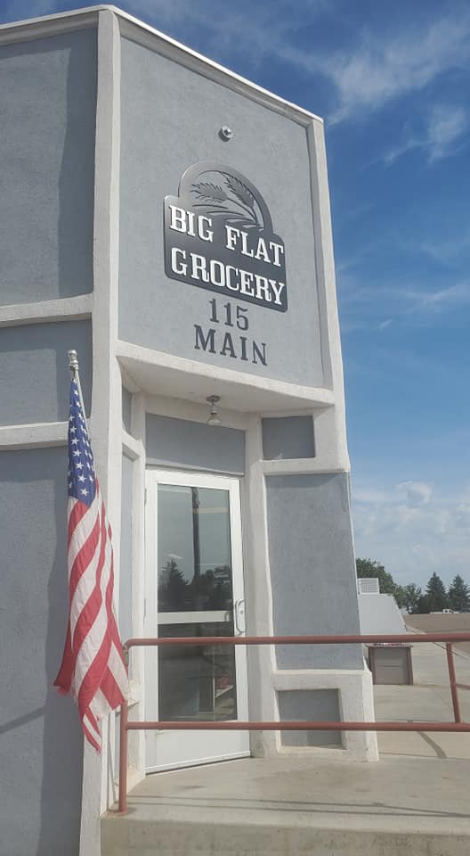
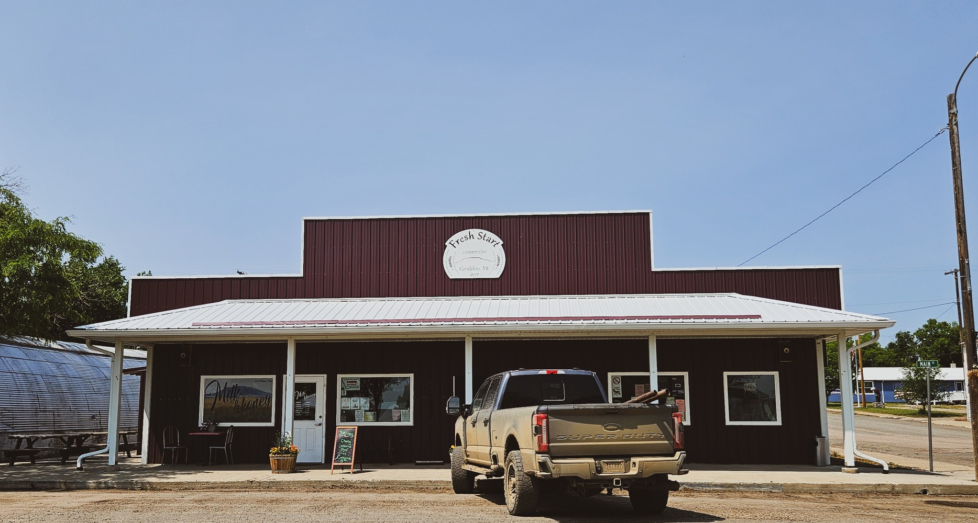
Stories from the Field
Big Flat Grocery, Turner, MT
Fresh Start Co-op, Geraldine, MT

Slide 21
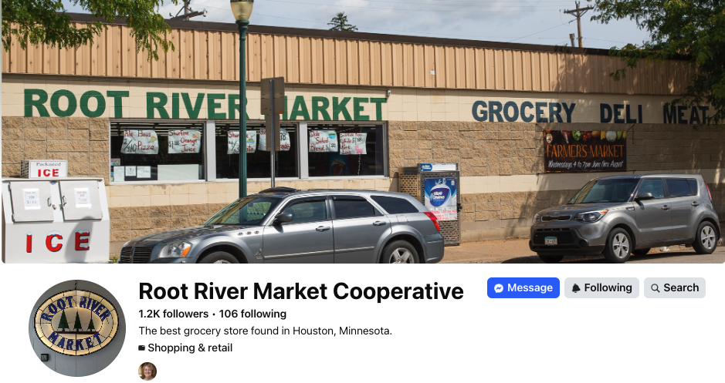
Stories from the Field
Notes:
Community organized to reopen the store after the local IGA closed in 1998.
Efforts to recruit another store were unsuccessful, so they formed a co-op
Share of $100 + notes of $1000 (many now forgiven)
$400K cost, funded by $180K in member capital and primary financing in partnership with now Shared Capital, National Co-op Bank, and a local bank.
Opened in November 2000 – so 2t years strong
Full service grocery: Butcher several times a week, efforts to stock local products, delivery to the local senior home.
https://fillmorecountyjournal.com/root-river-market-cooperative-a-grocery-store-for-houston/
https://www.rd.usda.gov/sites/default/files/RR208.pdf

Slide 22
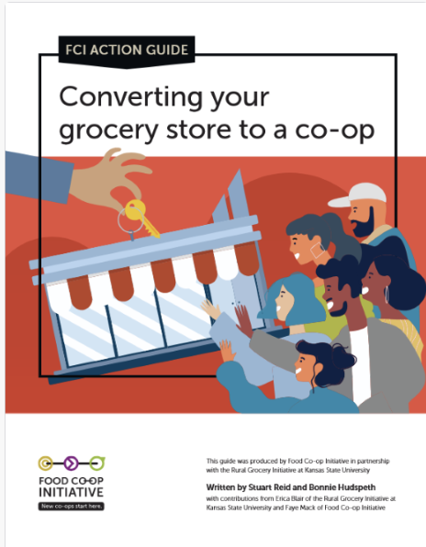
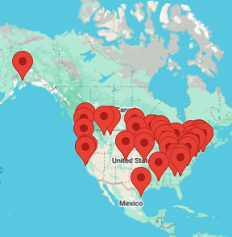
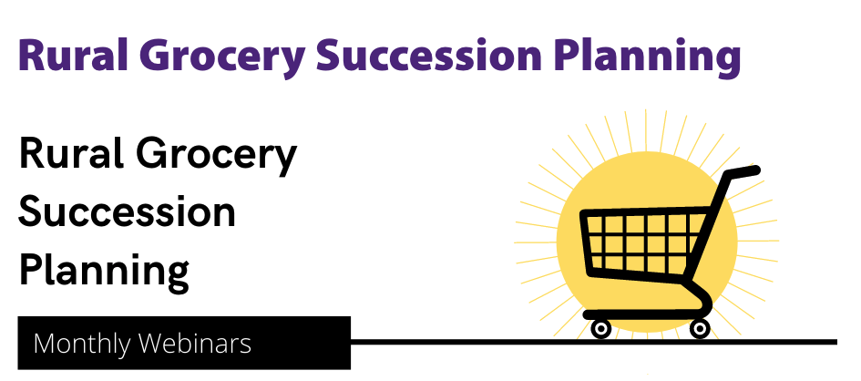

Resources to Learn More
Rural Grocery Initiative resources, including recorded webinars
CooperationWorks! Member Directory
(for co-op developers nationwide)
Food Co-op Initiative Action Guide
(Including us!)
Notes:
FCI
NCBA or CW on Co-op Developers
MCDC/MCOC
CDS
Rural grocery Initiative

Slide 23
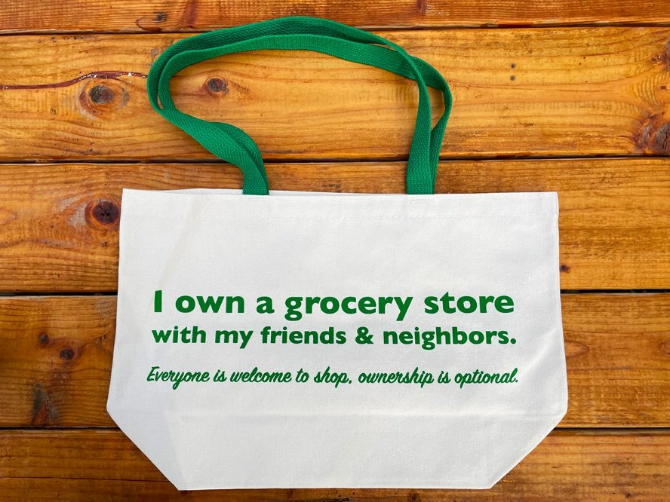
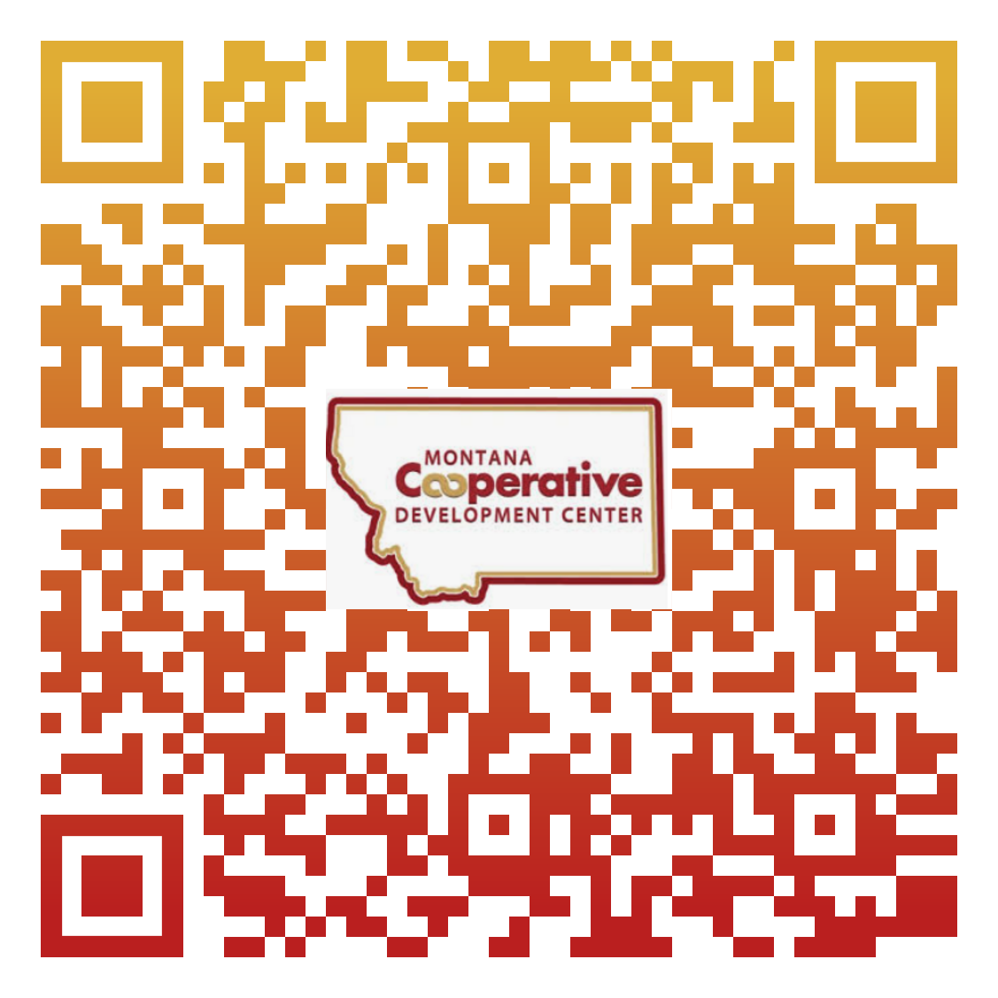
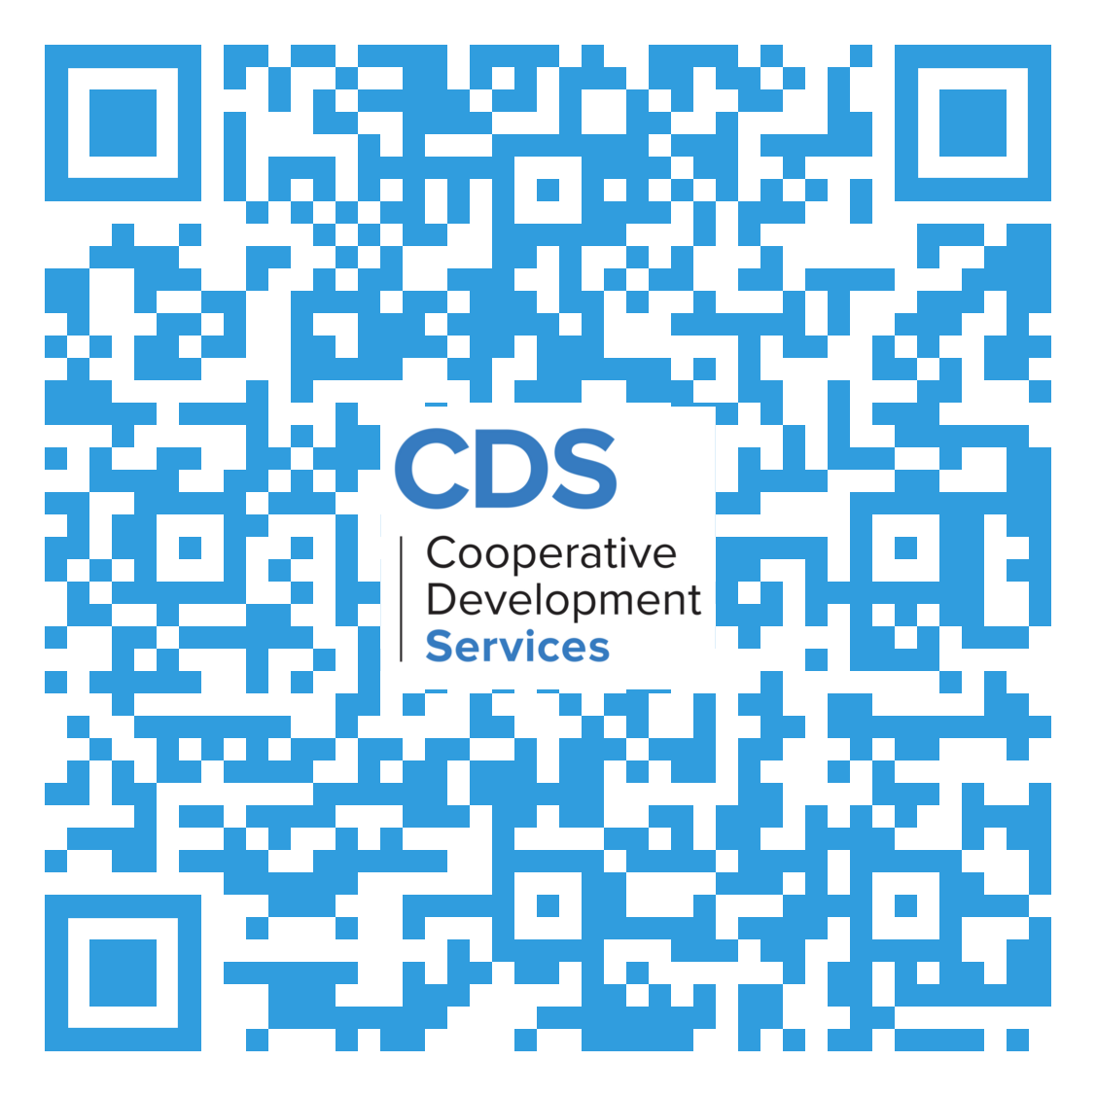
Thank you!
Tracy McIntyre
Tracy@mcdc.coop
Leslie Watson
lwatson@cdsus.coop

