Slide 1

Proven Ideas for
Local & Regional Sourcing
Insights for Independents
Allan Reetz allanreetz@outlook.com +1-603-469-3141
Notes:
My background
My familiarity with the topic and this UPDATED Version
WHO IS IN THE ROOM
Consider these tips and observations through your experience and vendor landscape. Remembering that one size fits one.

Slide 2
Concern for Community Matters.
Shifting from “Local Food” to Community-based Systems
The term “local food” refers to the attributes of a given food item—How far did this tomato travel?—rather than the more systemic issues: What type of food system brought food to us? What is its impact? What kind of food system do we want to build? Framing this work as building community food systems is more effective.
Ken Meter, Building Community Food Webs
Notes:
Plan for 58 minutes
Hold questions — Land this plane on time. Slides available
Pause partway through
Couple minutes Q&A and 5 minutes for Crowd-sourcing

Slide 3
Insights from the food shed
Committed partners
Anson Tebbetts, Vt. Secretary of Agriculture
Jacob Vincent, Hanover Co-op Associate Director of Merchandising
Jon Richardson, Hanover Co-op Receiving Manager and former dairy manager
Liz McNamara, McNamara Dairy, Plainfield, NH
Lauren Stevens, Co-owner & Founder, Brownsville Butcher & Pantry
Karin Ciofi, Executive Director, Vermont Specialty Foods Association
Annie Harlow, Local Food Systems Consultant
Notes:
100- miles, 400-miles, Four-state region
One size fits one

Slide 4
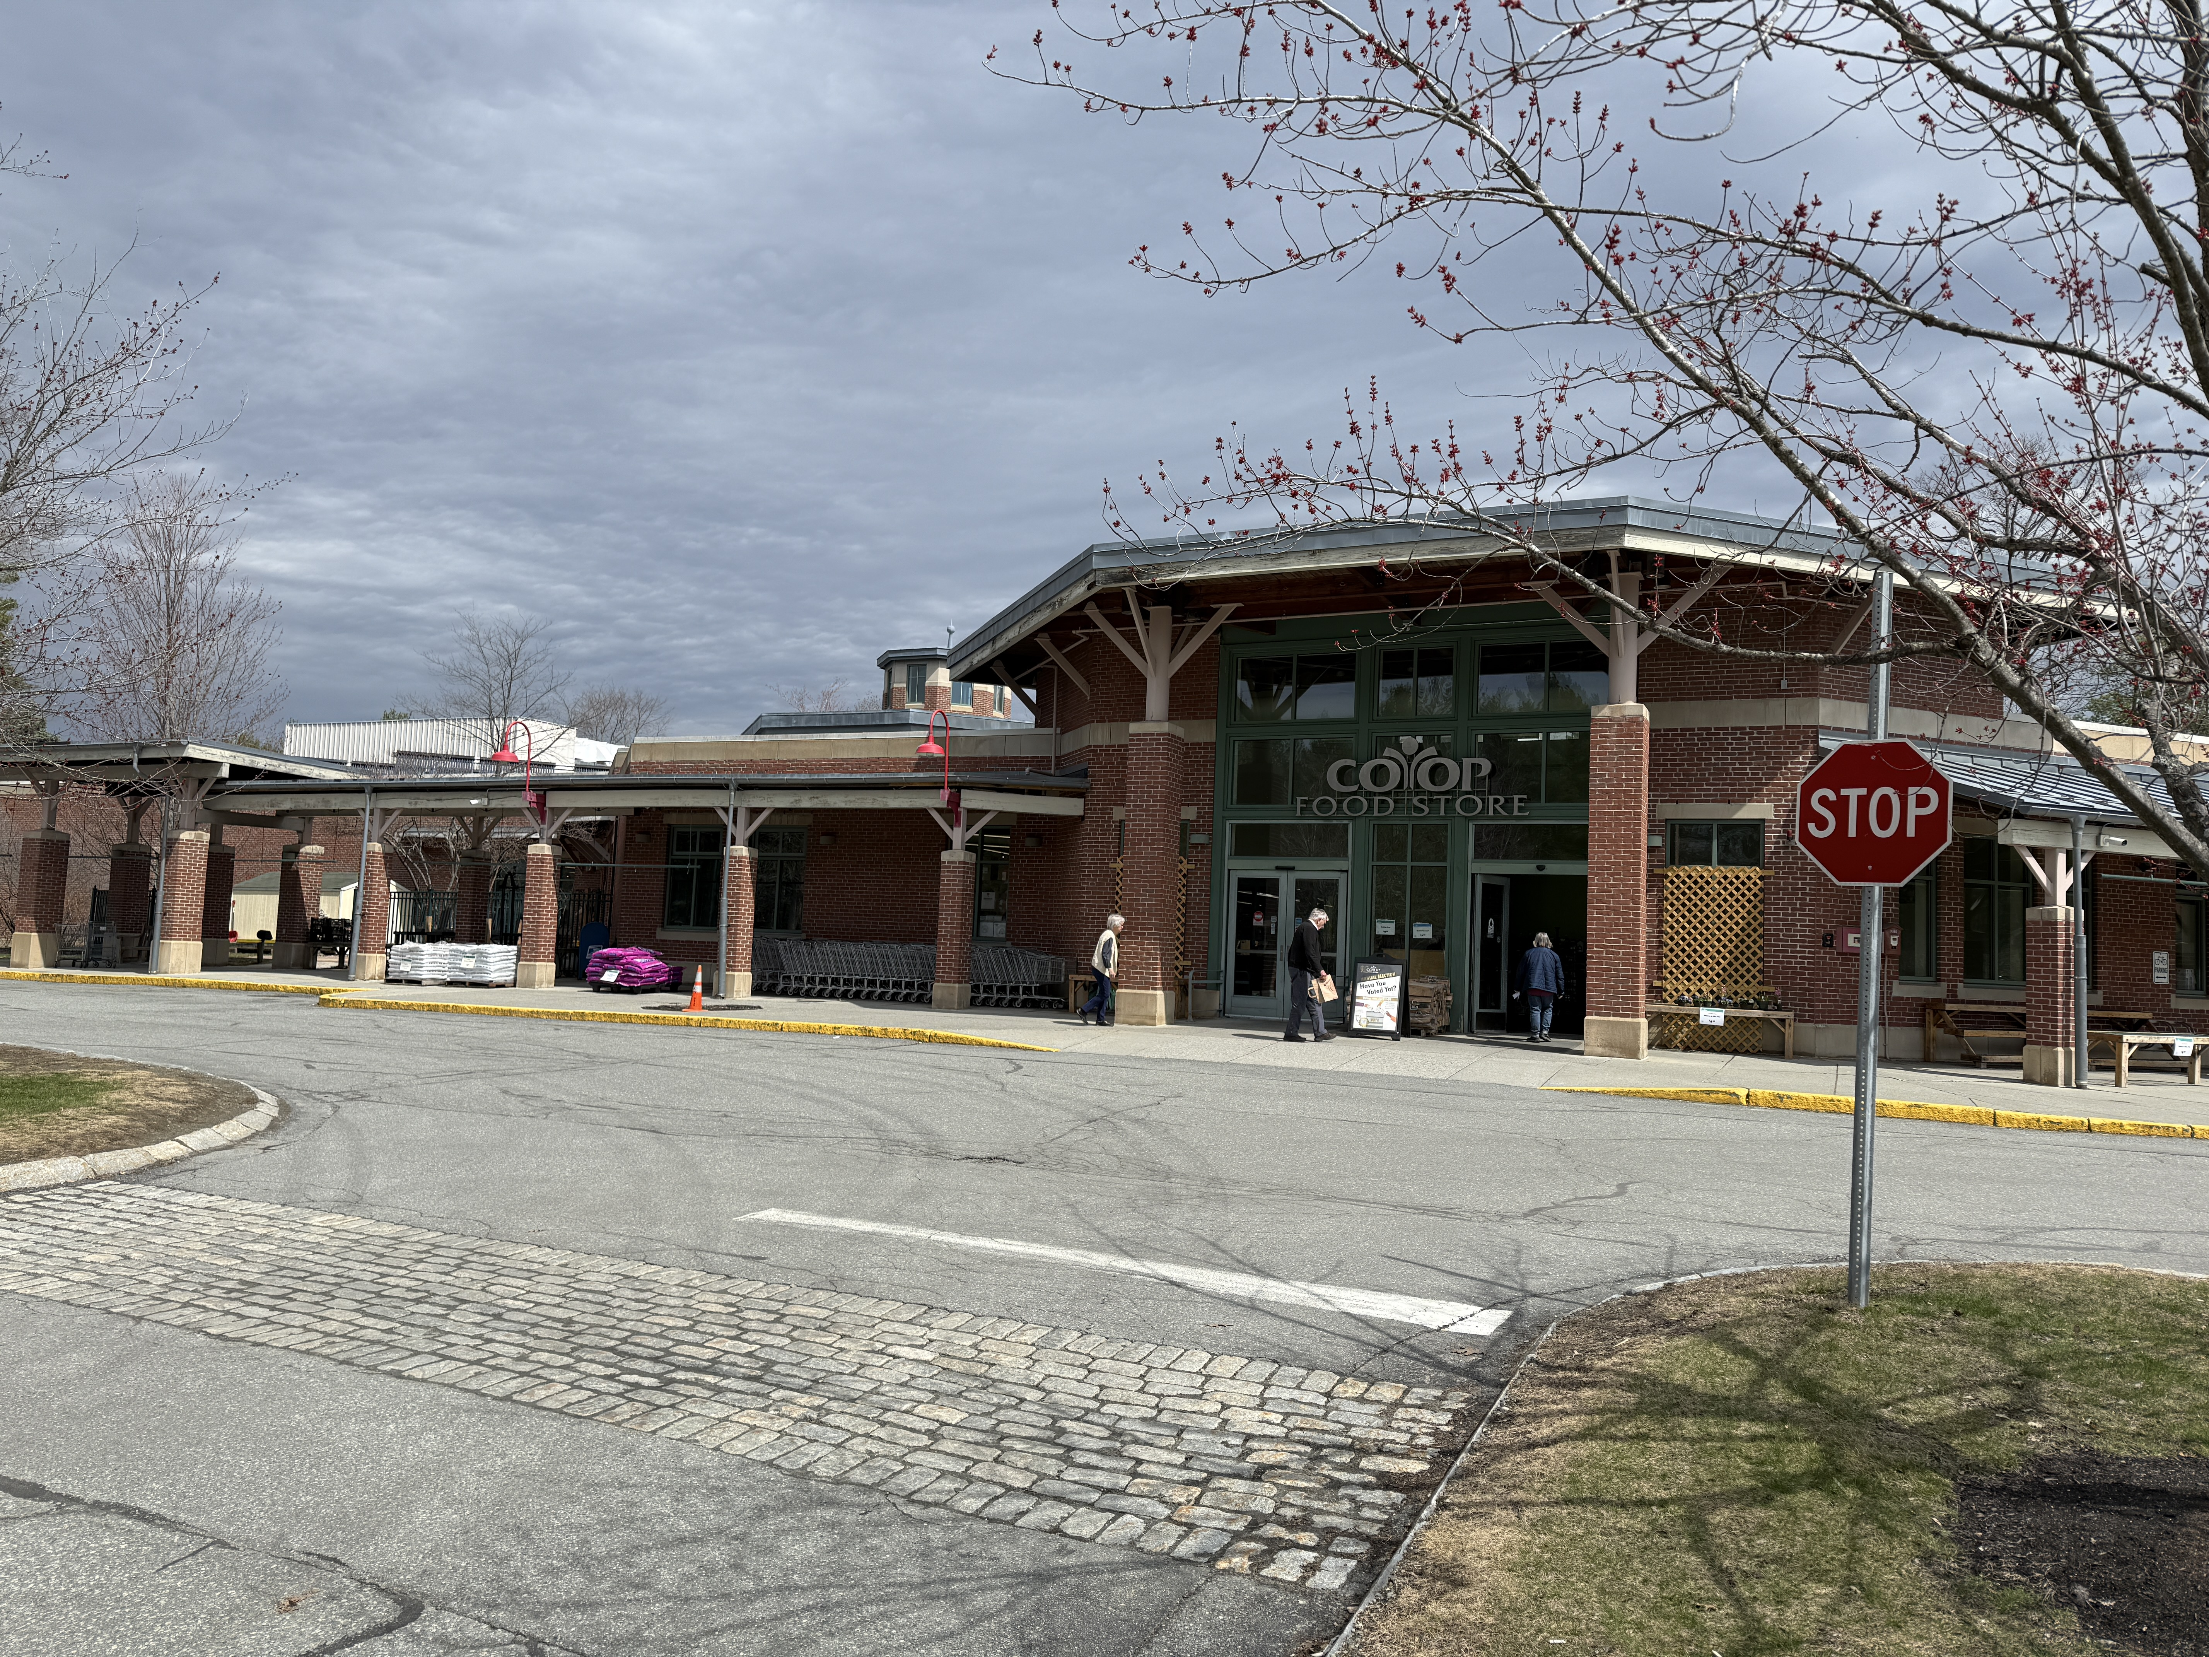
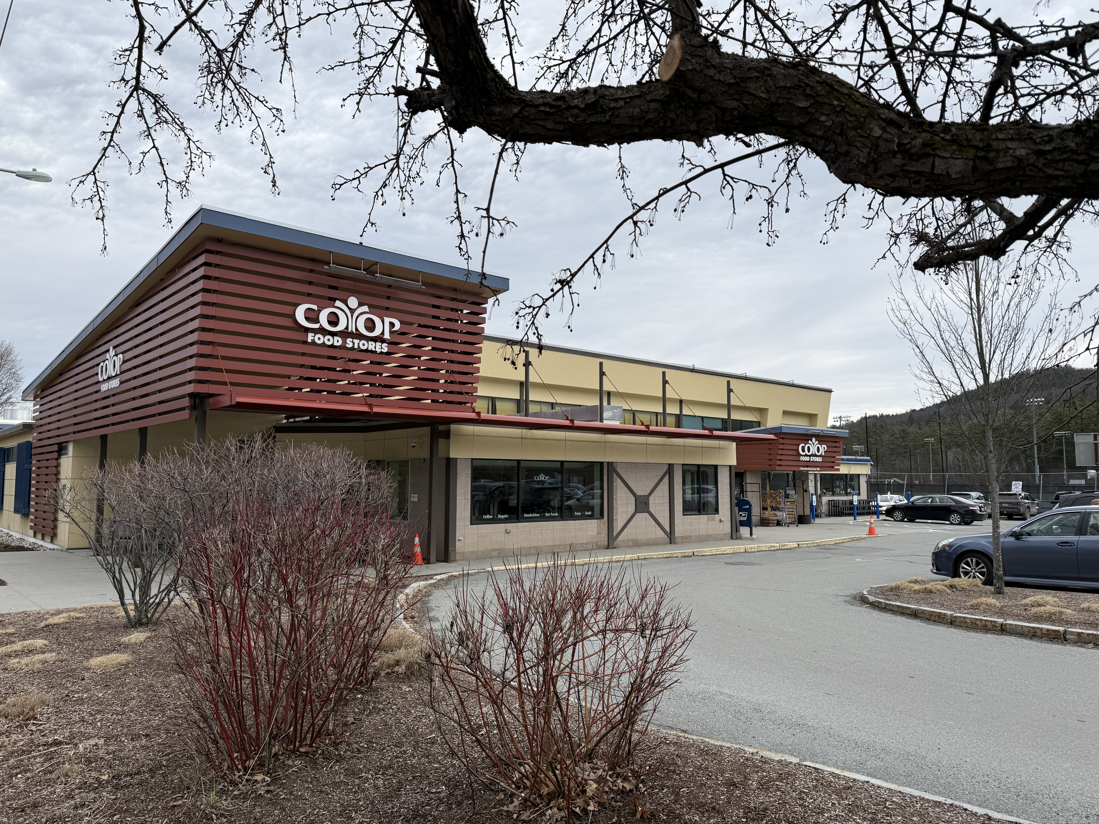
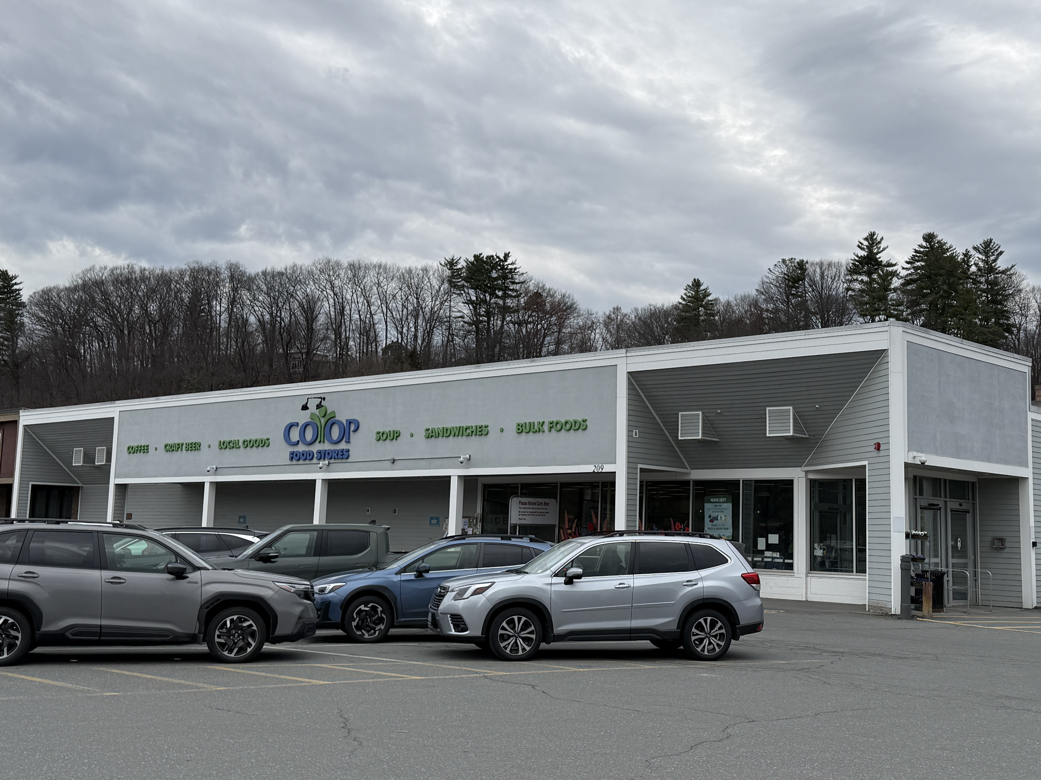
Hanover’s size & history, and the value of small
Our big stores are no better than a tiny independent store
Notes:
Quick history,
Founding, commies, 90-years, and $90 million
Store sizes. Shopper Counts.

Slide 5
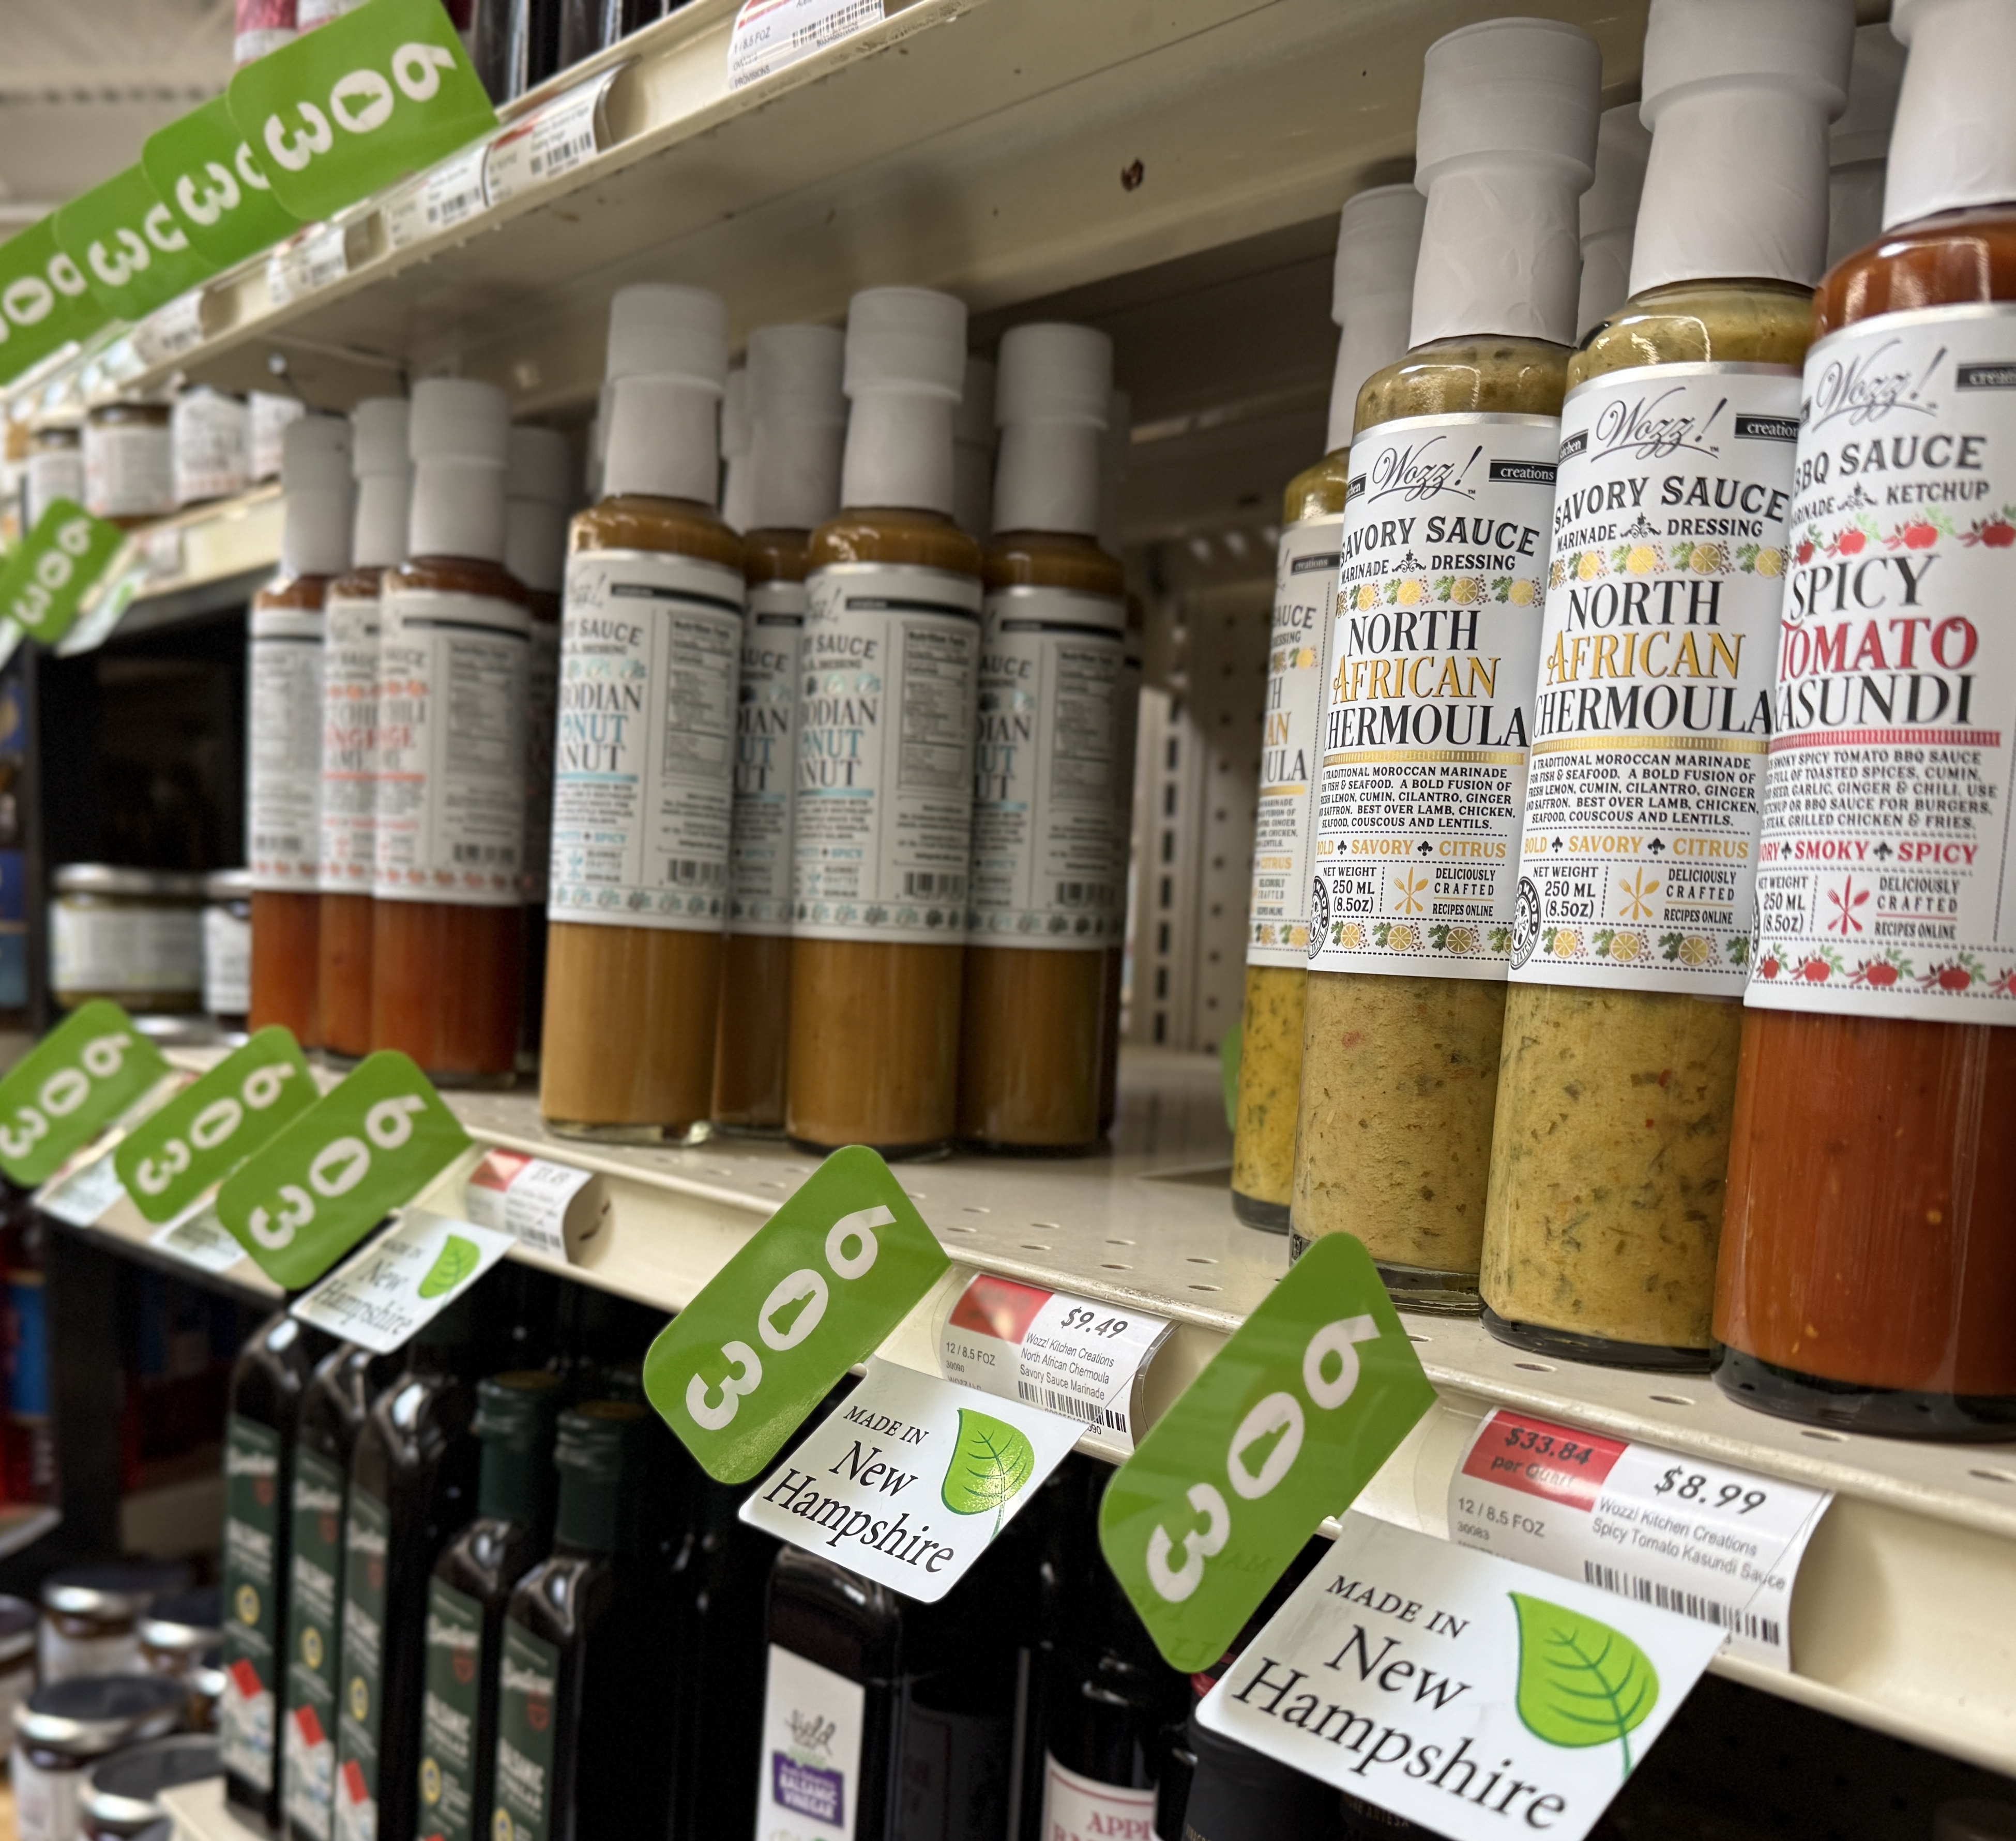
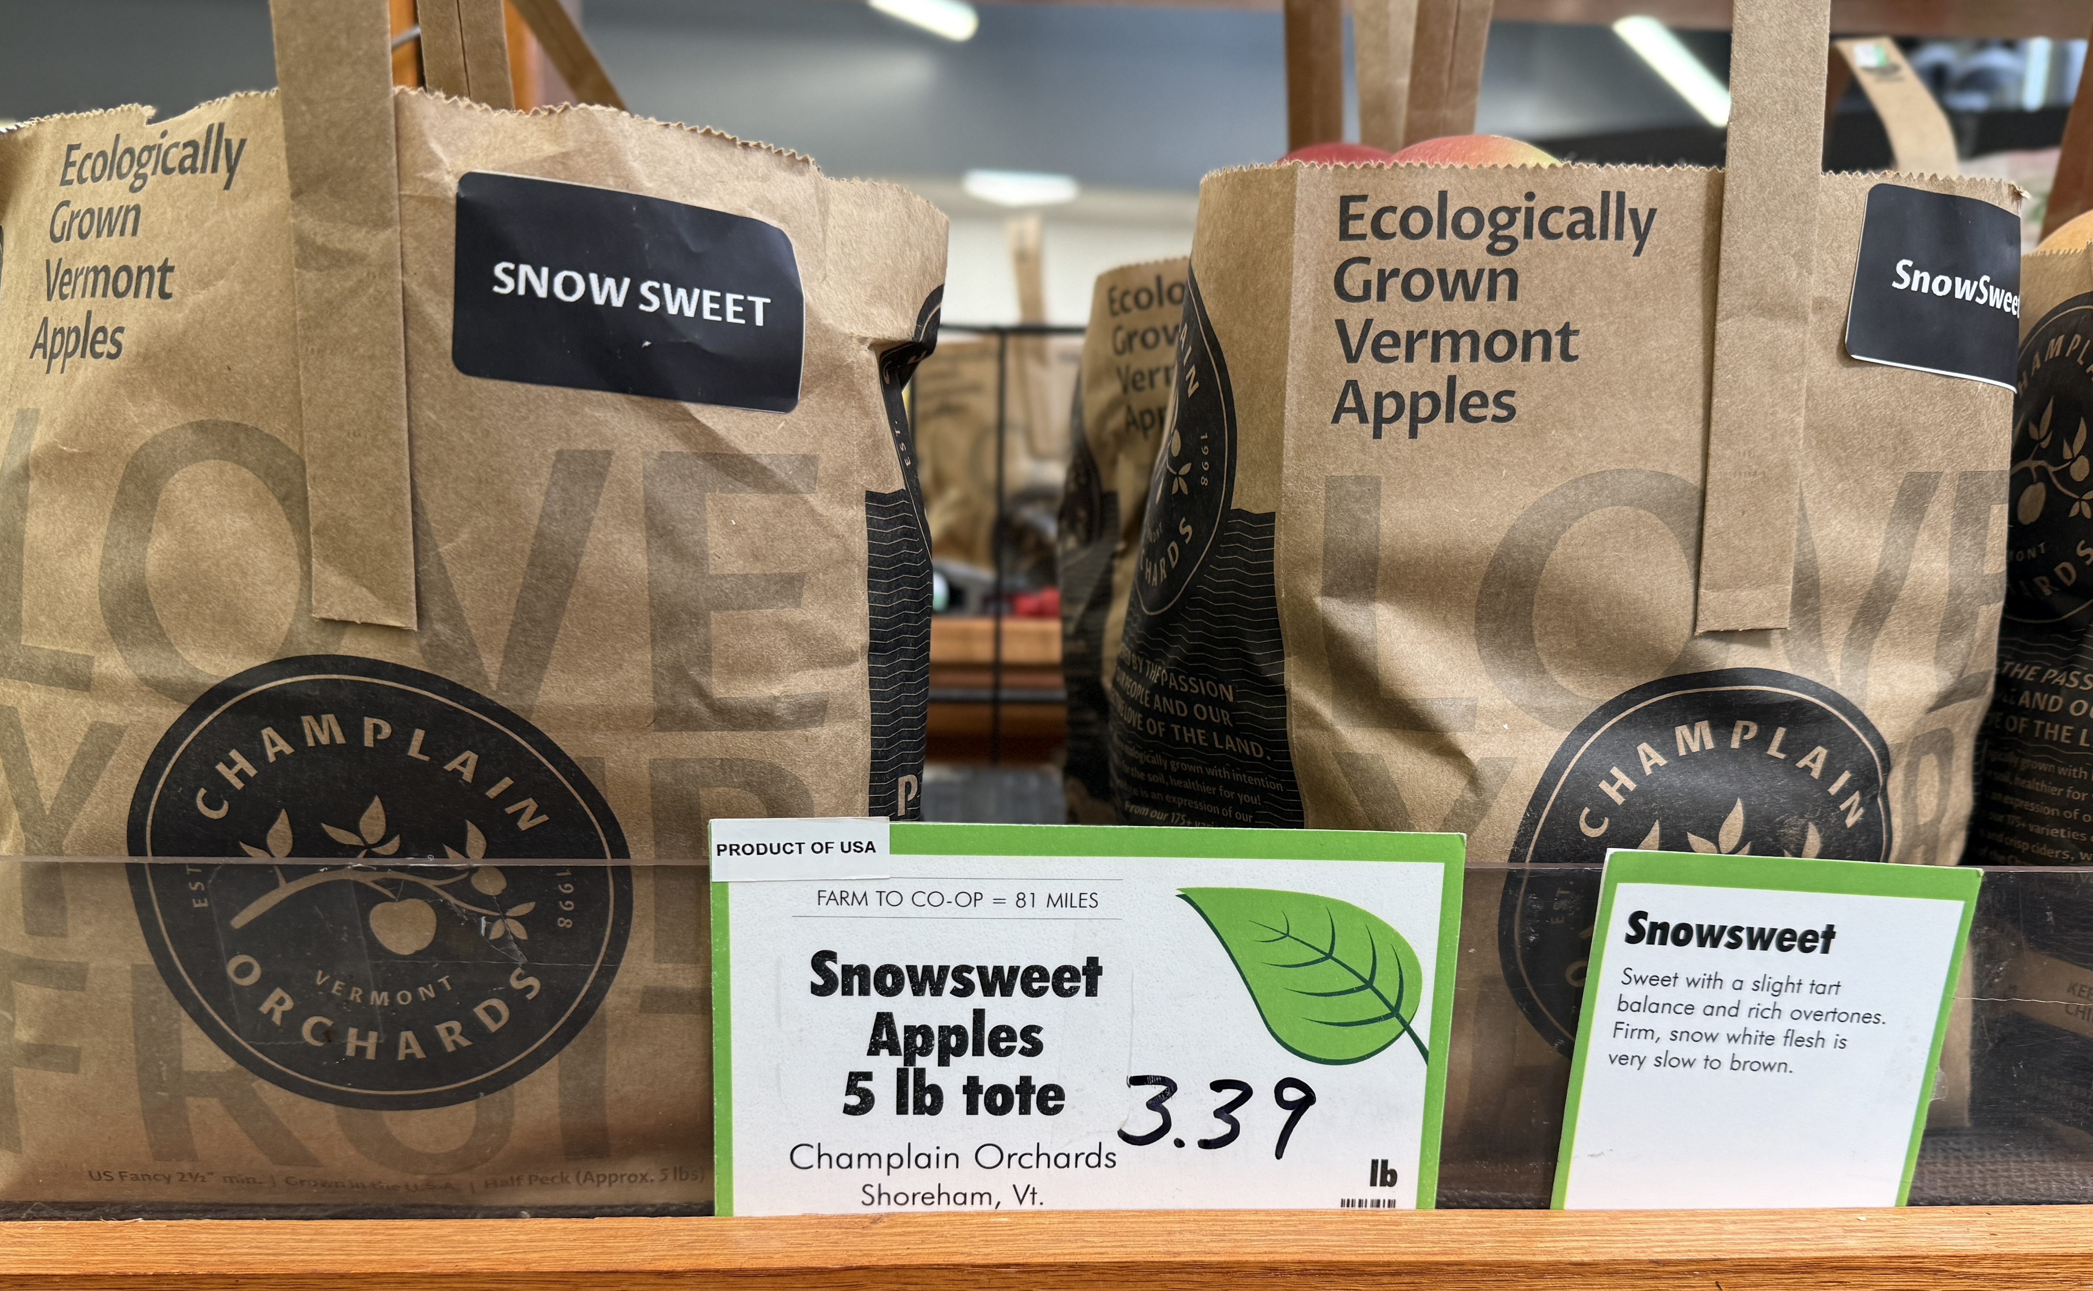
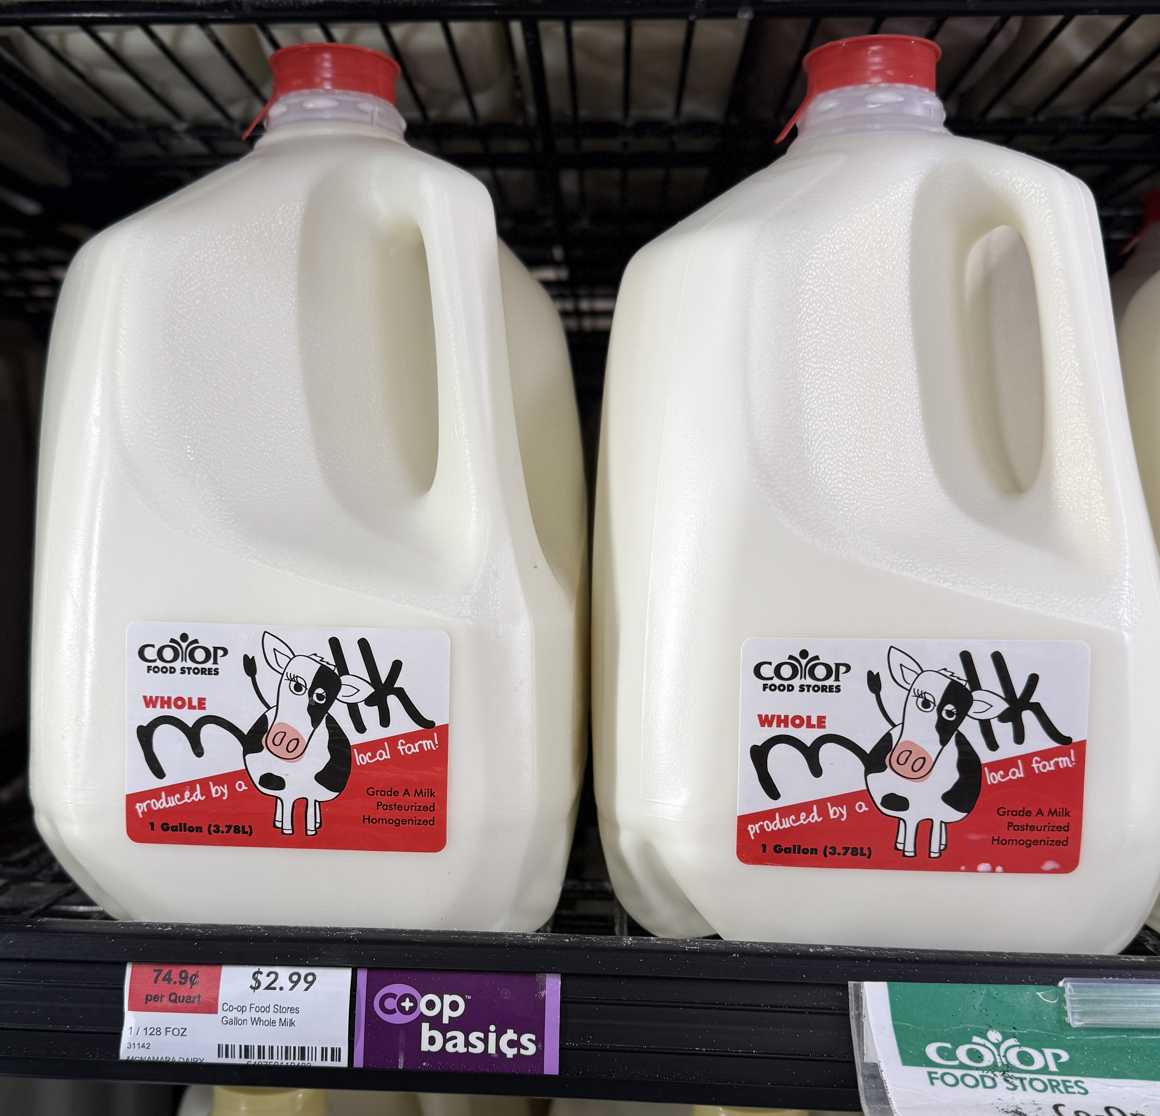
Local Statutes
In-state only, or with border-town exceptions
Notes:
We support Local statutes
Hanover Co-op team (“We”) helped revise Vermont’s current law
The results are value and milk at $2.99 a gallon
Green leafs help tell our 603 and 802 story

Slide 6
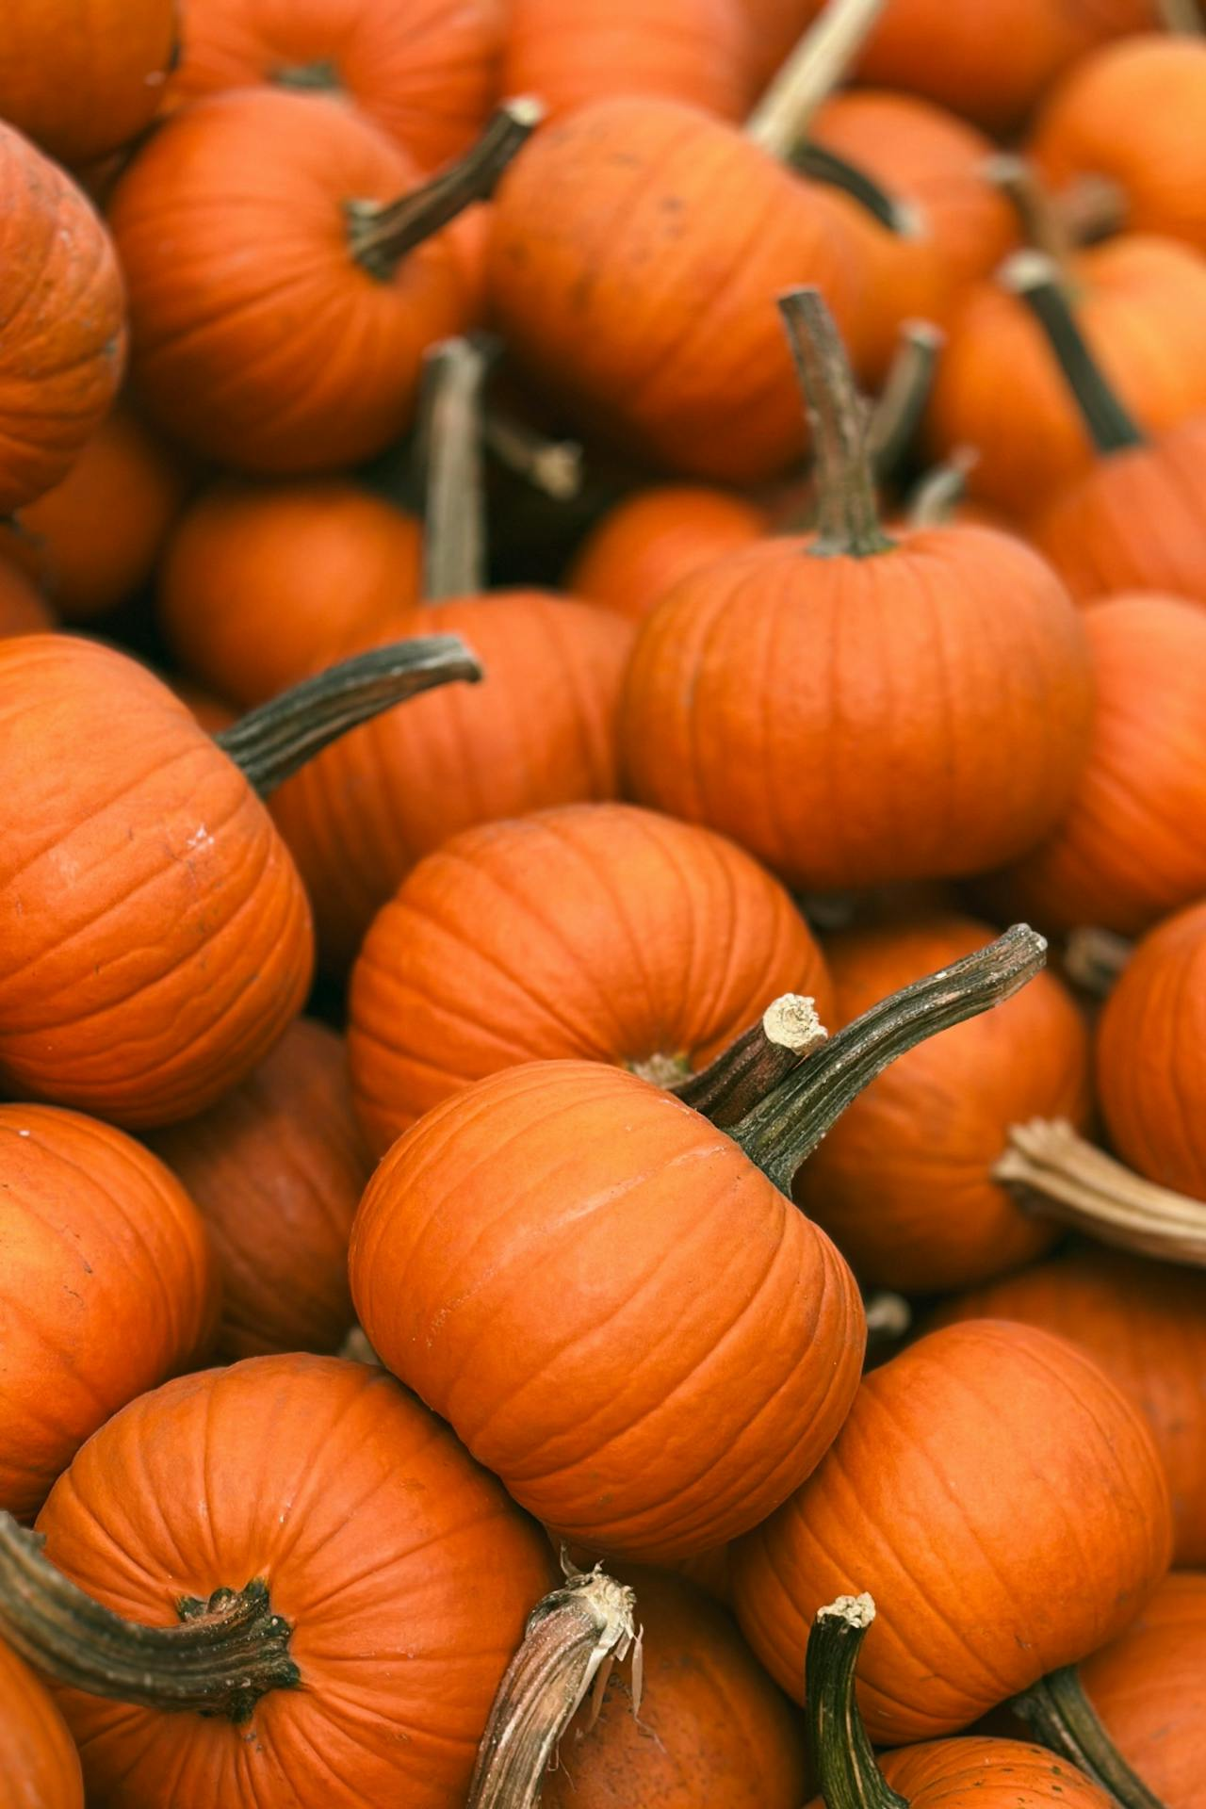
Locally grown race to the bottom
It ended with the pumpkins
Notes:
WHAT’S UP WITH ALL THESE PUMPKINS. No local lettuce?
Patronage refund was so good, people overlooked quality concerns
How low can you go?! Lower next week?

Slide 7
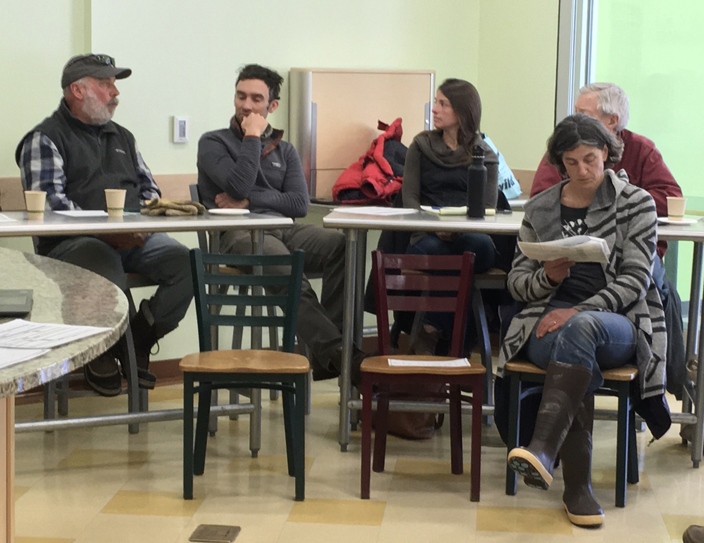
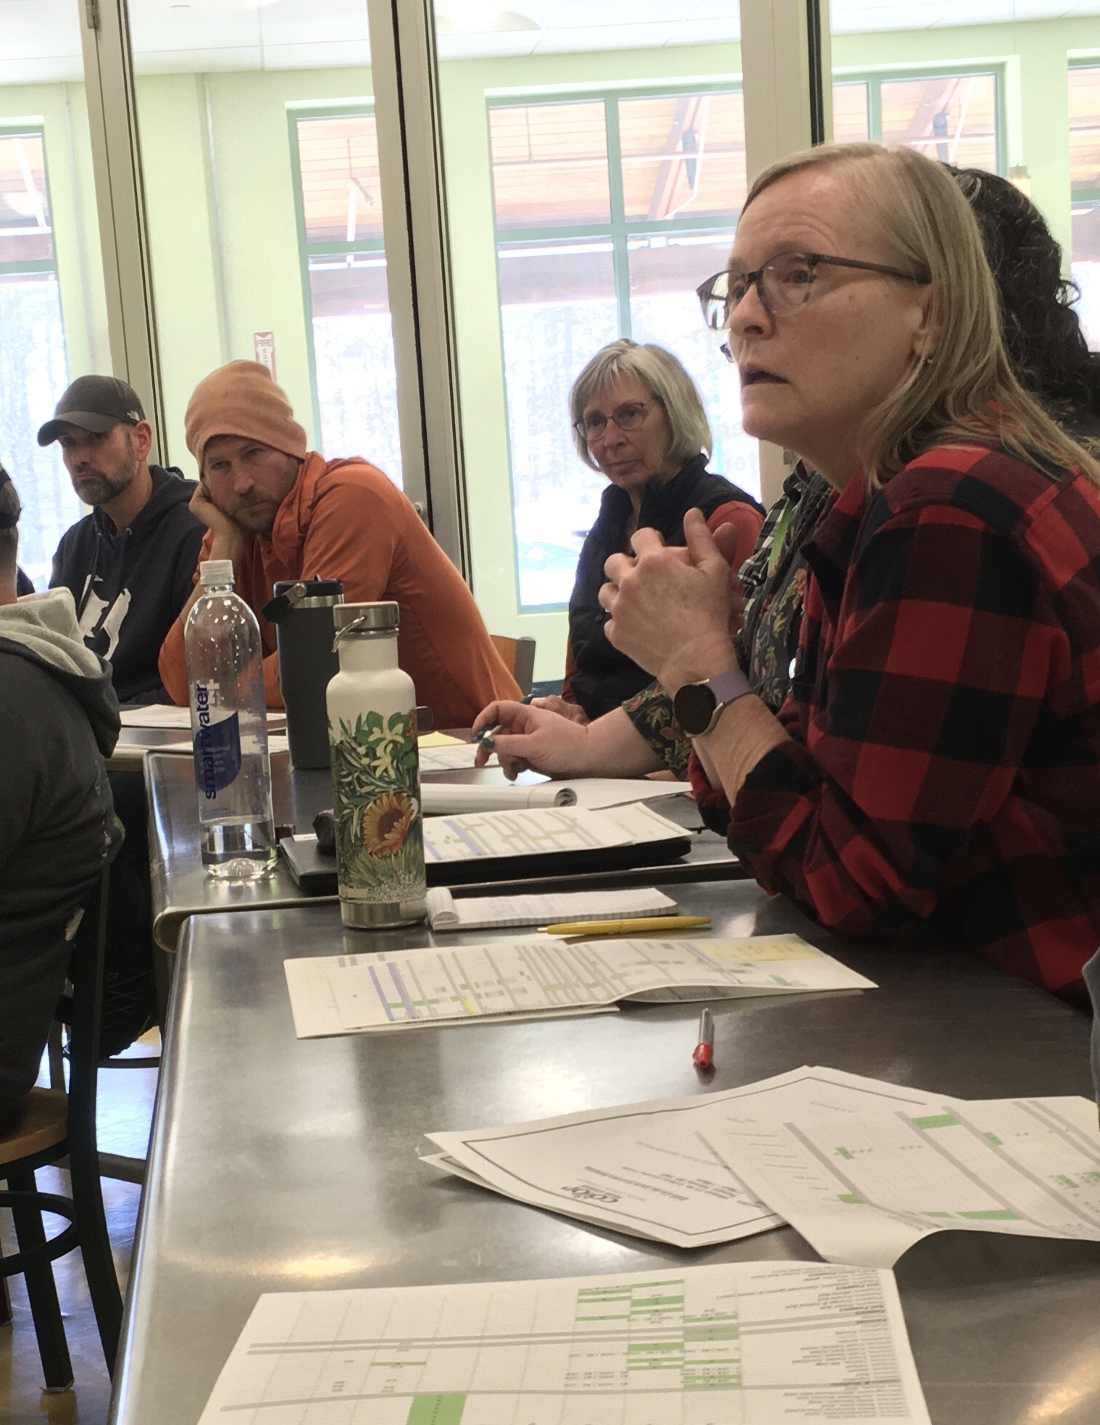
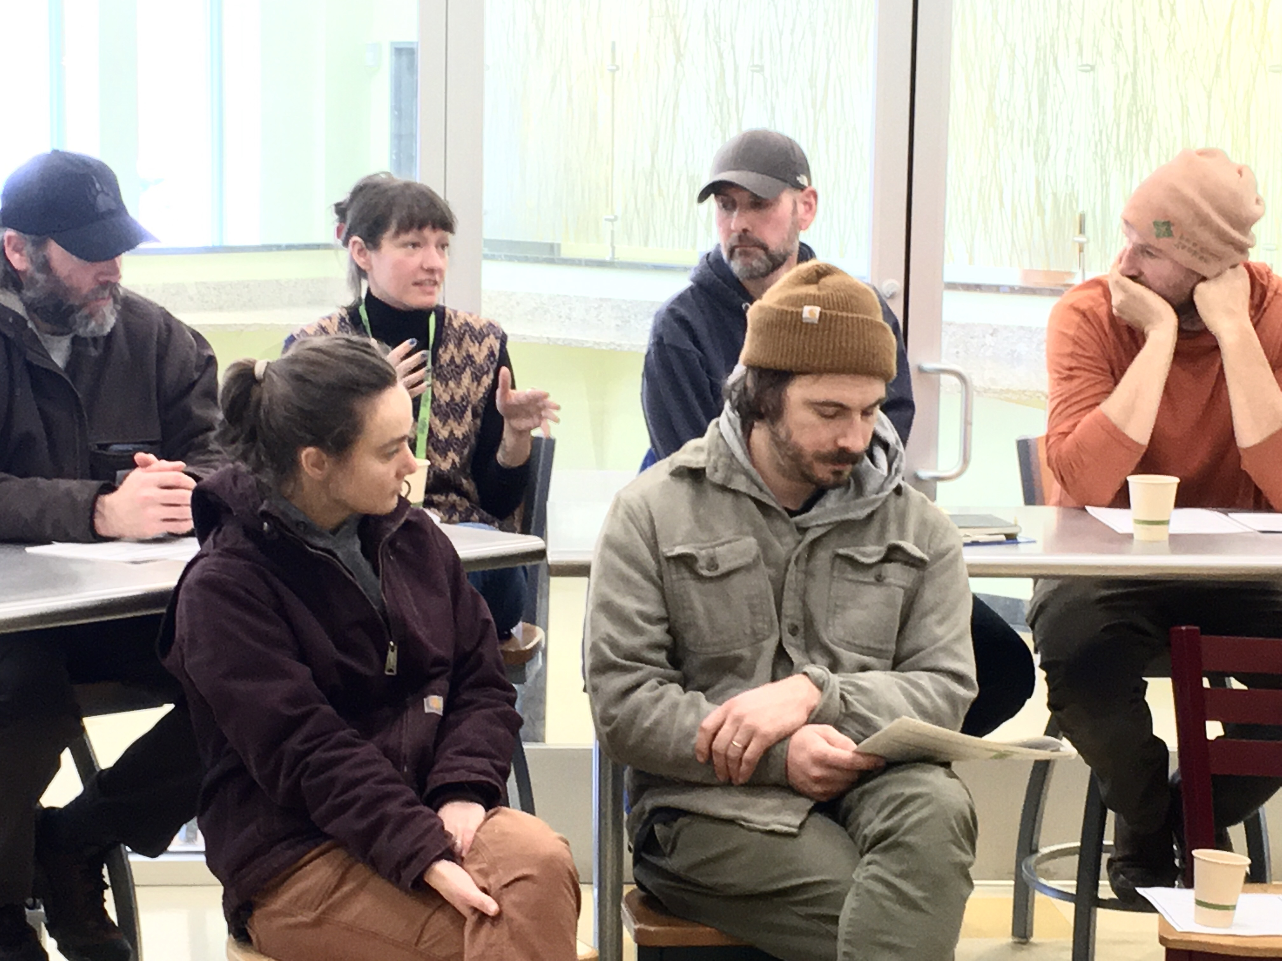

Growers Meeting
Patience, persistence & practice
“Hey neighbor, can you cover me?”
Notes:
Brussel Sprouts Run movement and history—Is it worth growing
AUDIO The early years of hard feelings
Persistence refines the patience, and it comes through practice
The story of the crates

Slide 8
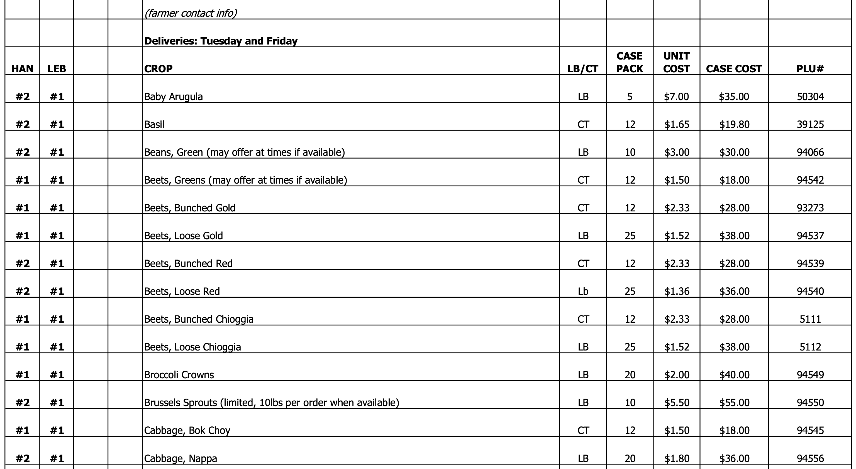
The long road to local asparagus
And the history of Brussel sprouts
Notes:
INTERNAL COCUMENT
Alex’s story: Corn…Green Beans…Raspberries…Asparagus
Three year commitments for berries and asparagus
Raspberries during growers meeting…Bob Gray
Brussel Sprouts. We’ll run movement and history for you.

Slide 9
Buyer Insights
Portal, Packaging, and Pricing
Post-it Note Co-ops (somedays we wish we were one)
Blended margins make local pricing work for everyone
Think through the entire path for products; from back door to front door
Create an environment for honest discussions, not take it or leave it!
Change for the next pandemic or other supply disruption
LEADERSHIP IS BEING EXCITED, EVEN IF YOU’RE THE ONLY ONE.
Notes:
Post-it note. Reality of being bigger does not mean we’re rude
Blended, Specialty versus nutritional basics (milk) vs. Gelato
Helping Vendors hit a price point VT TOFFEE
Small change? Change what do. Big change? Change vision and consider how the community will benefit.

Slide 10
Receiving
It’s not “just another pallet or crate”
Receiving through the eyes of a producer
Make the transition easy whether your space is big or small
Lend a hand, have a cart nearby
Help your team know the vendor’s story, and show care
Don’t grumble, have conversations. A negative tone spreads.
Notes:
Jon’s story
Have a cart ready, lend a hand up those steps
Care for the product that may have taken a year or more to make
STORY OF PLASTIC CRATES AND SUBSIDIZING COST

Slide 11
Are you finding what you need?
  Sixty-second segue
Sampling of vendor relationships and product preferences
Lessons from a little store
Vendor relations and the value of small
Food Hubs
A consultant’s view
Grains Grown Here — A success story
Notes:
ASK FOR OTHER POINTS

Slide 12
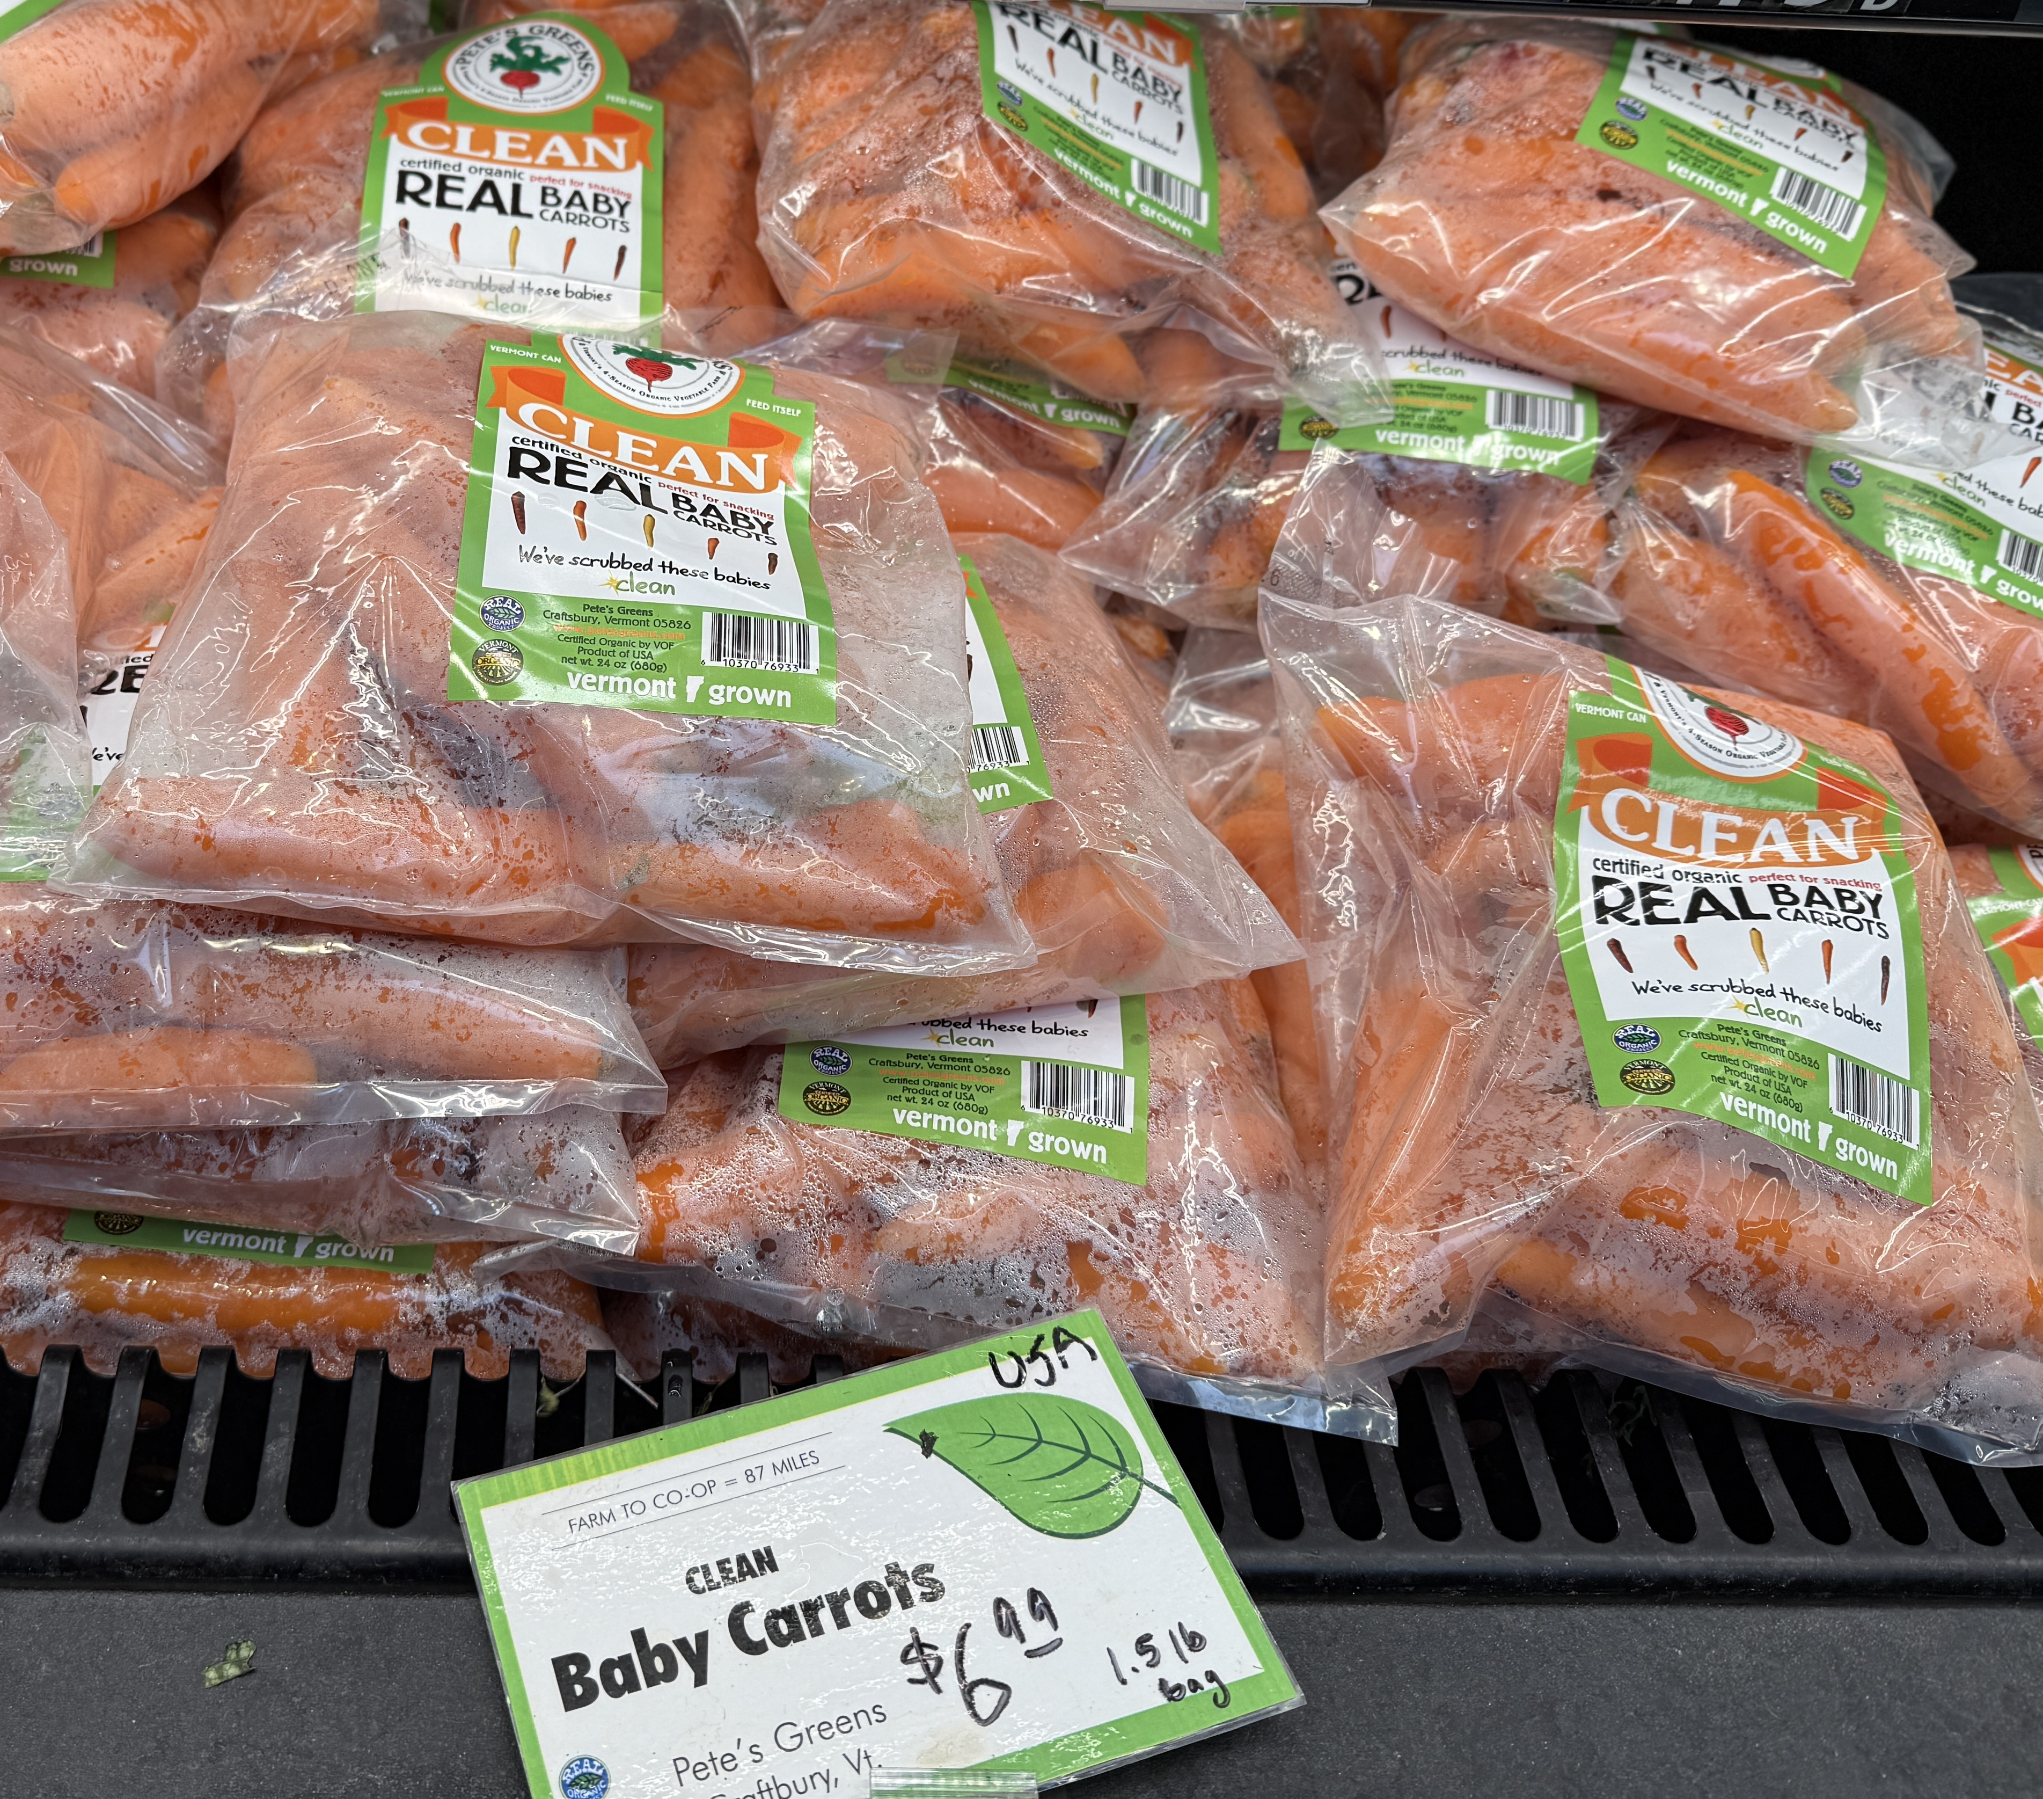
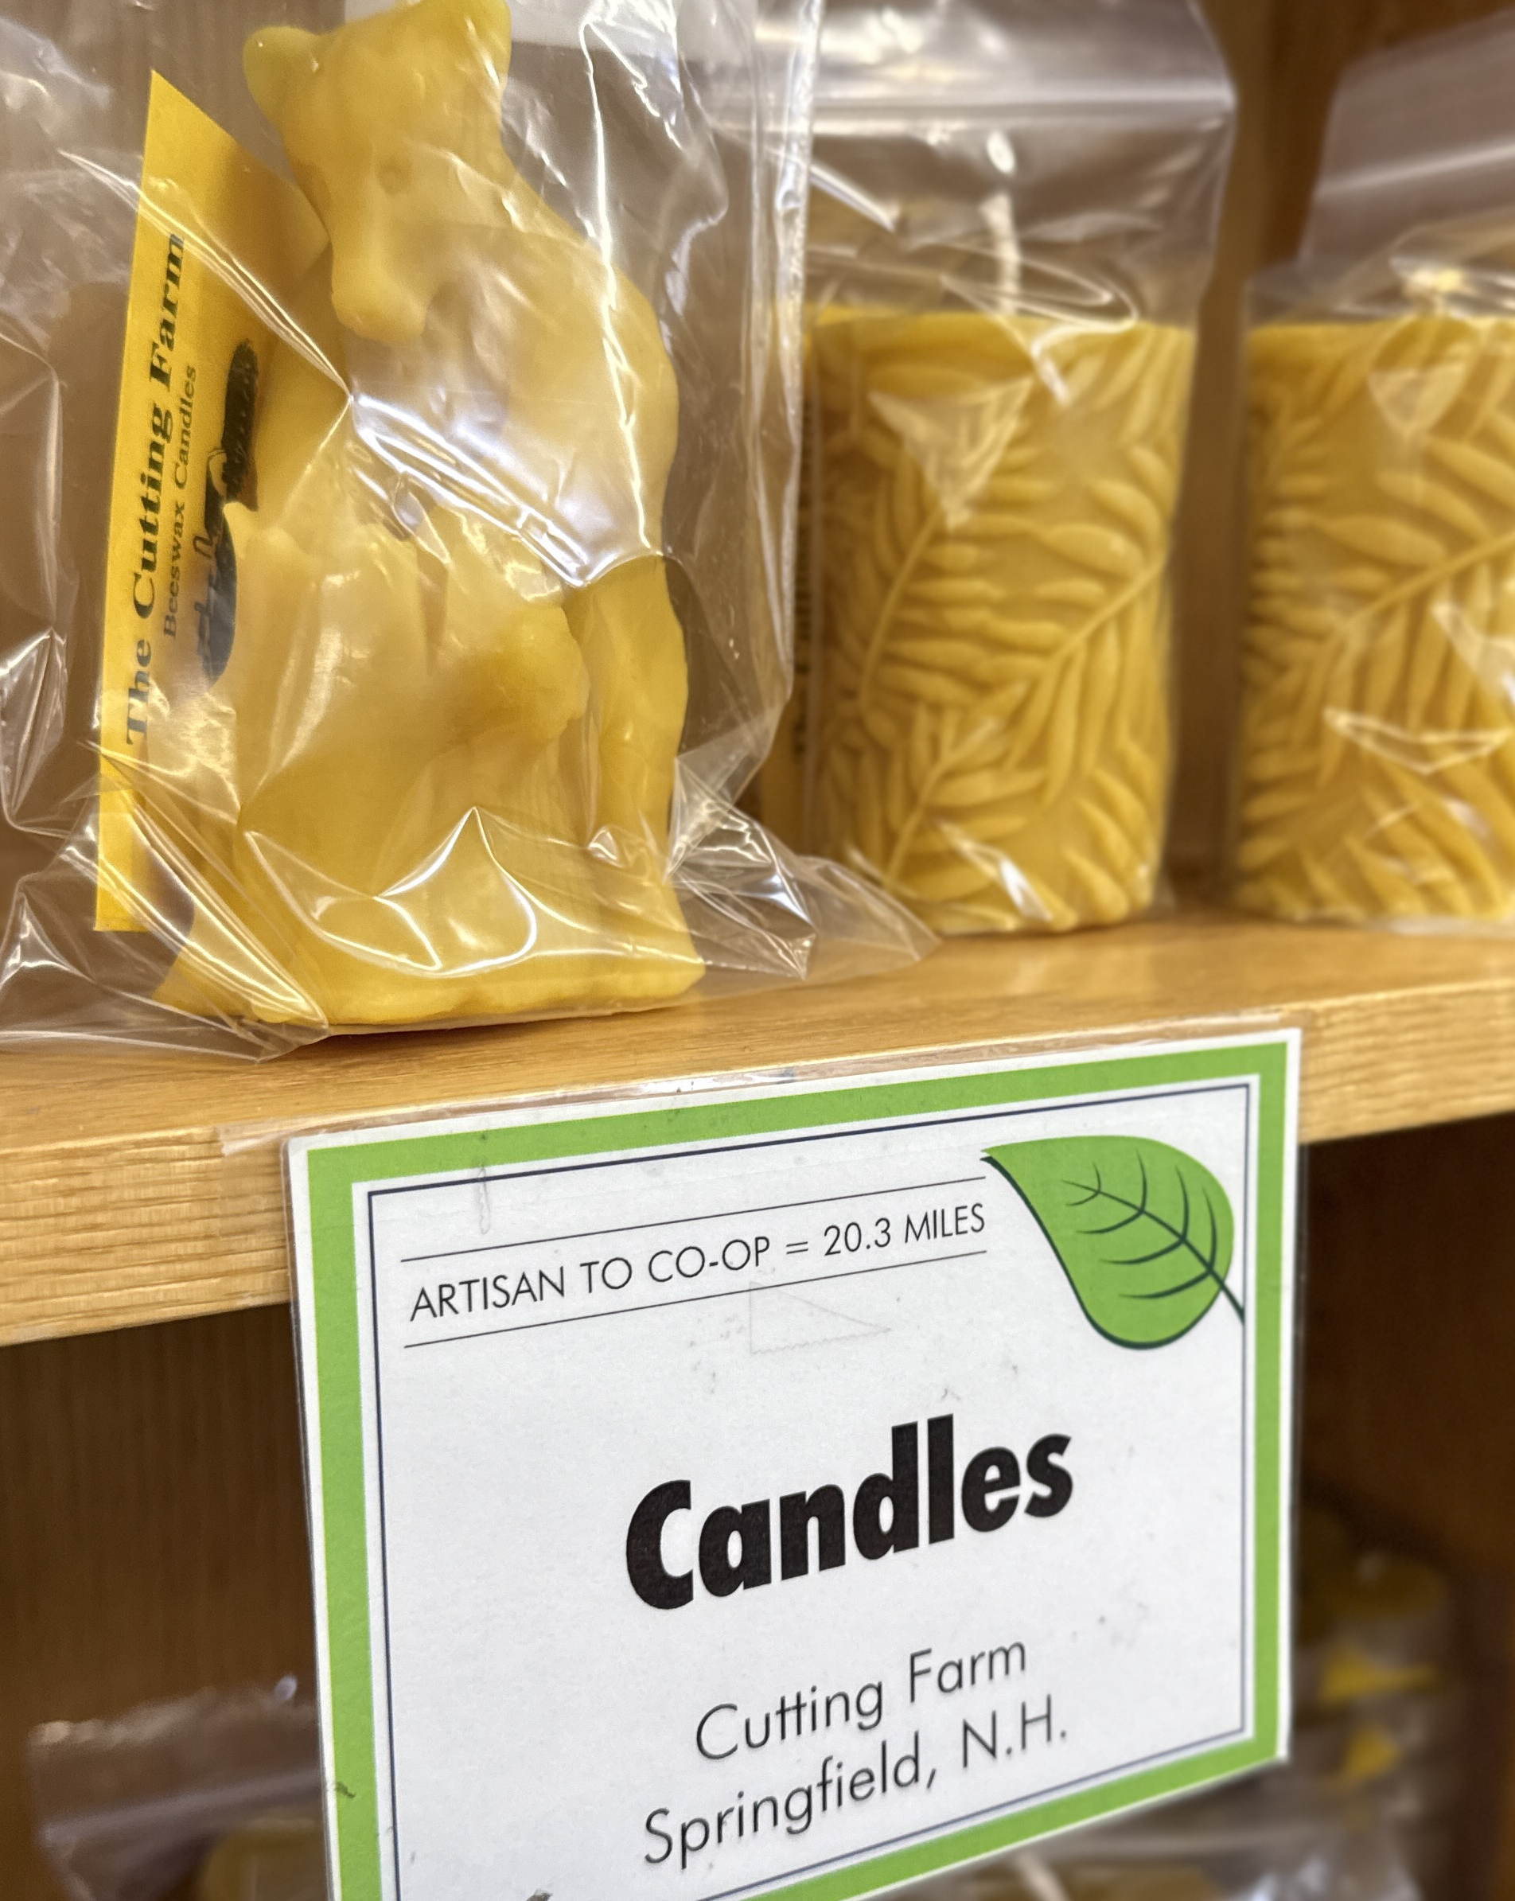
The butcher, baker, and candlestick maker
And local carrots in March??
Robie meat; it started with cheese
Dairy, the risks and considerations
Opportunity: Here’s what WE want.
Locals come first, then regional
The Stonyfield & Olivia’s story
Notes:
Another day in the plant or another truck on the road
The risk of growth, Liz McNamara’s story
Women-owned, veteran-owned, LGBTQIA,
Carrots in early March — layers of agreements
Candlesticks STONYFIELD AND OLIVIA’S…Little friends grow

Slide 13

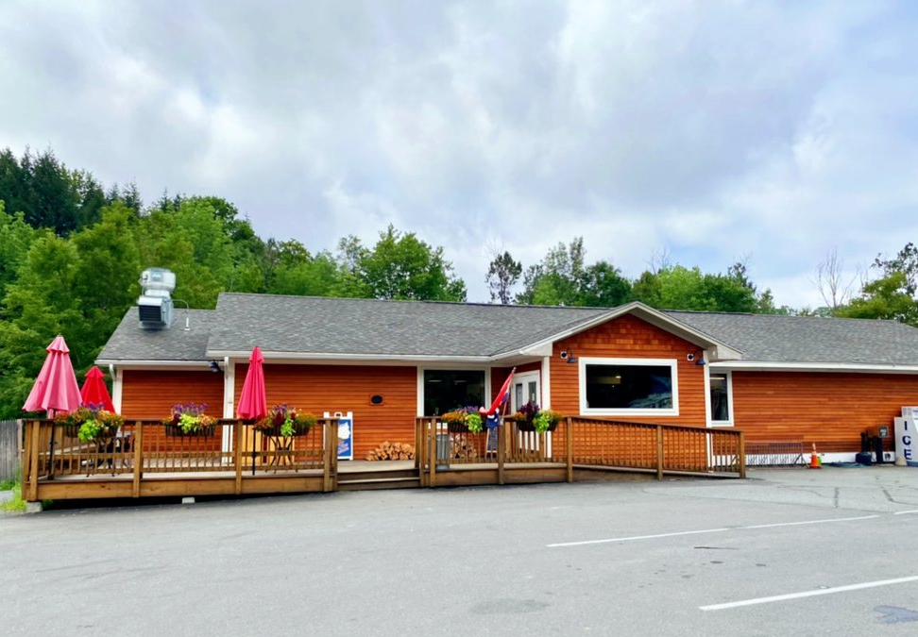
The Start-up
Brownsville Butcher & Pantry (town population, 560*)
The realities of competing on cost and buying power
Help new producers improve their process
Define what makes a great spec sheet
Can you lower your price by 10 cents if…
We’ll commit to this many head to help you
schedule your slaughter dates
Lauren makes the refer truck pay
*Total surrounding population, 1,300
Notes:
Lean into personal relationships. How was that steak?
Care for community and employees in ways chains can’t
Guide small vendors, you may be their big chance.
Meat is BB&Ps specialty. It works for livestock producers, too

Slide 14
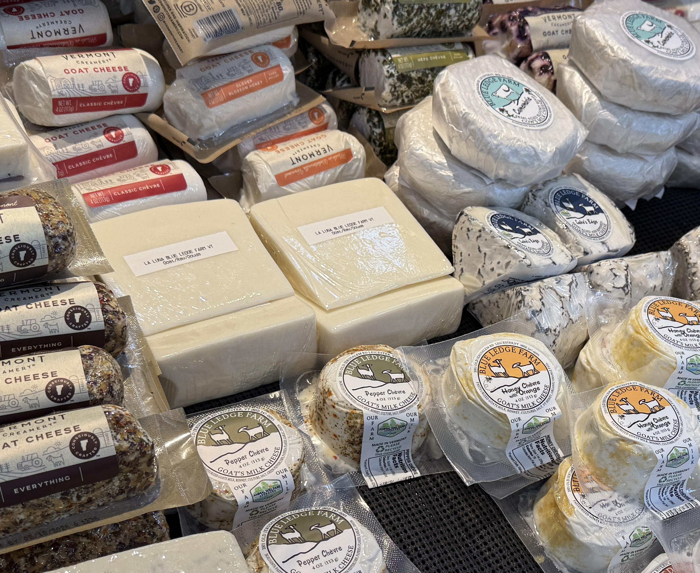
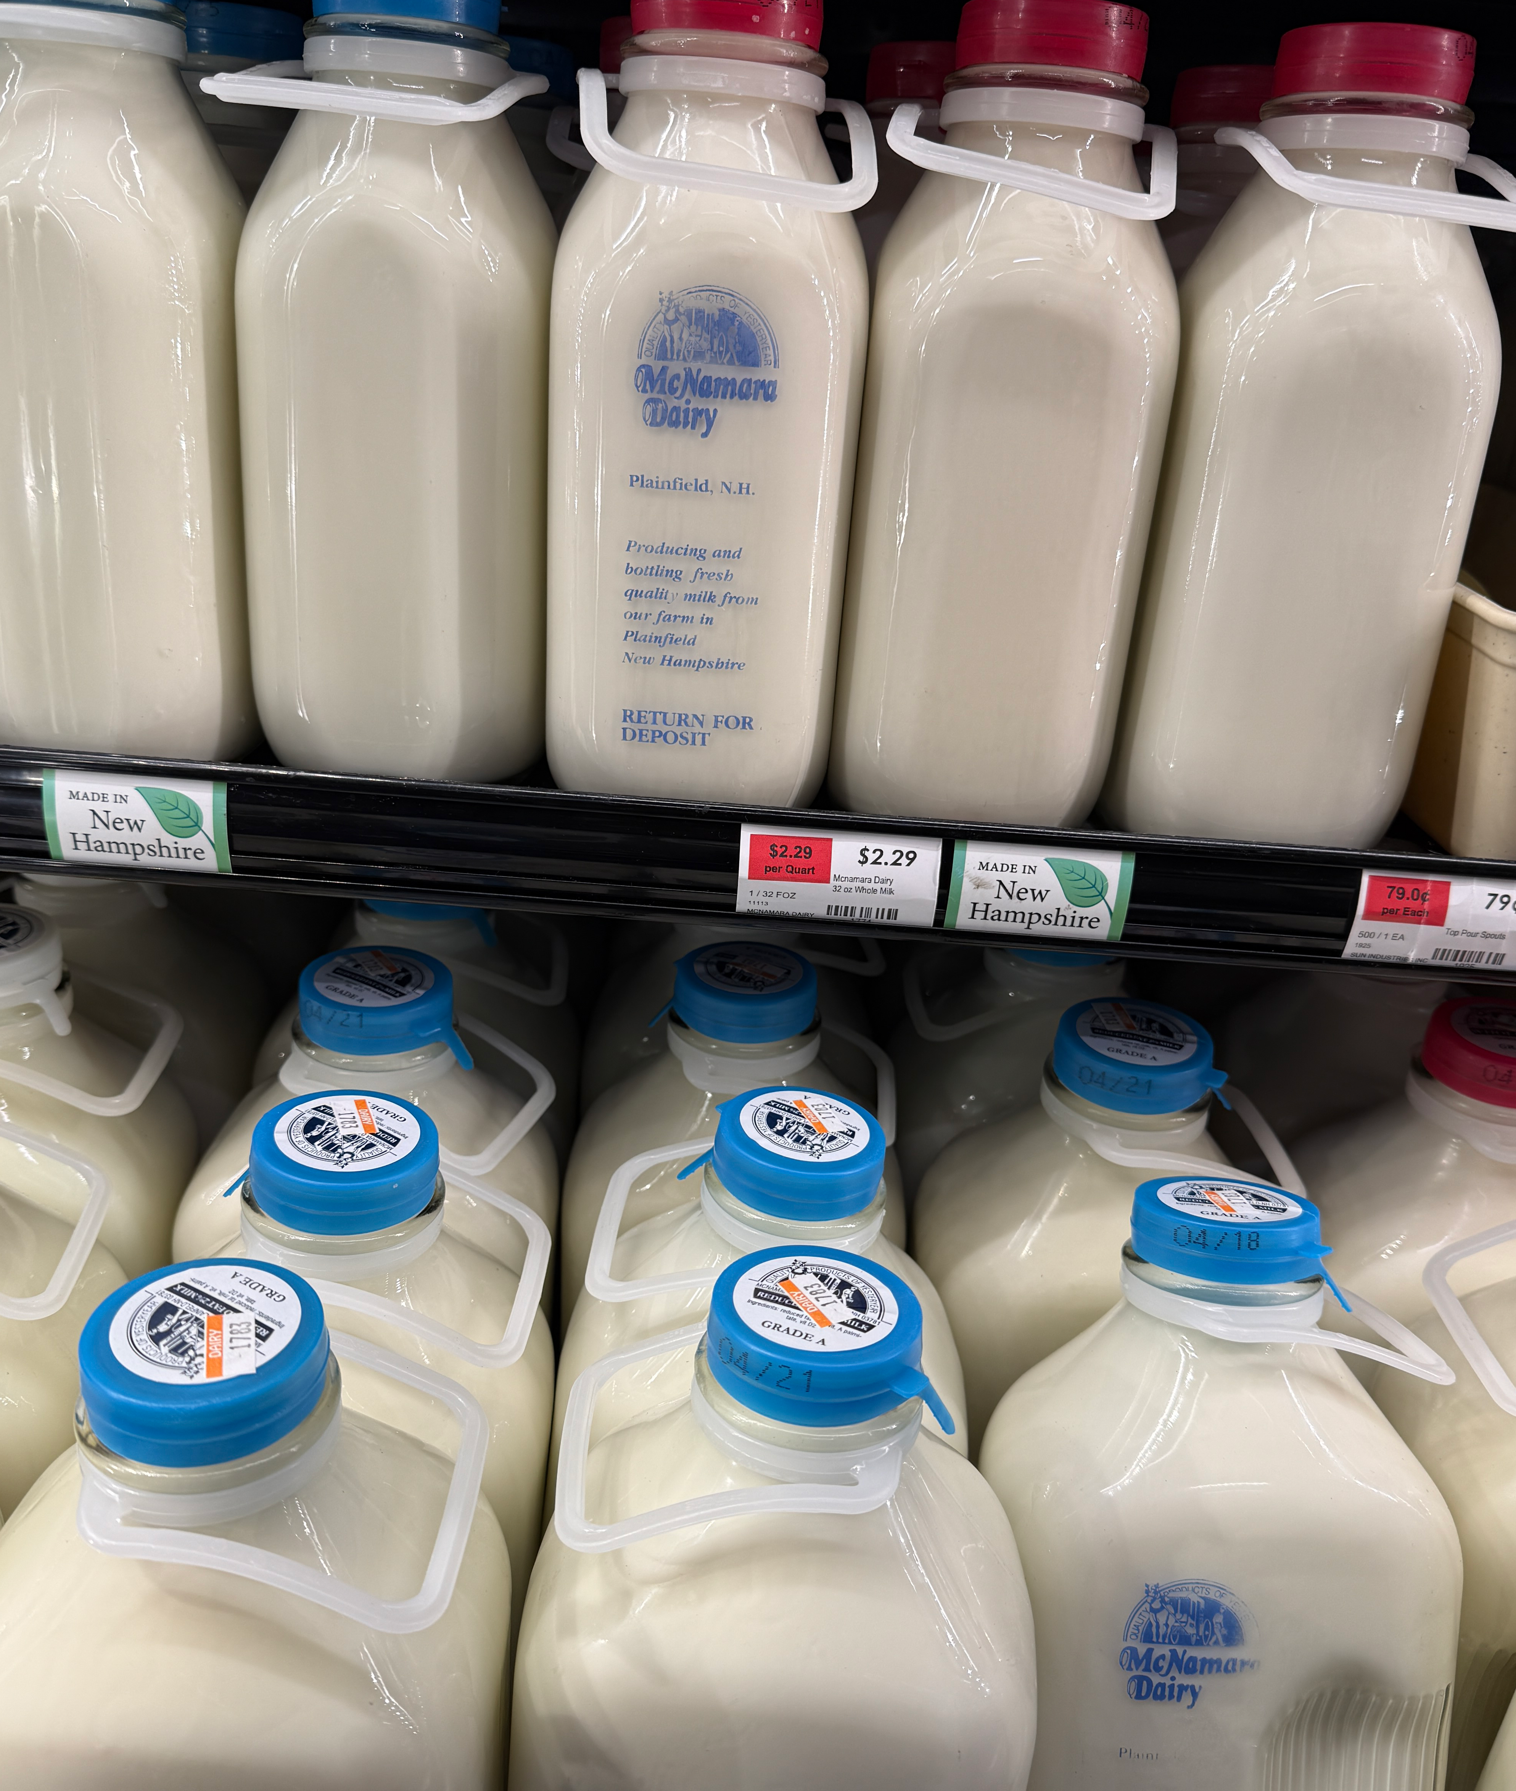
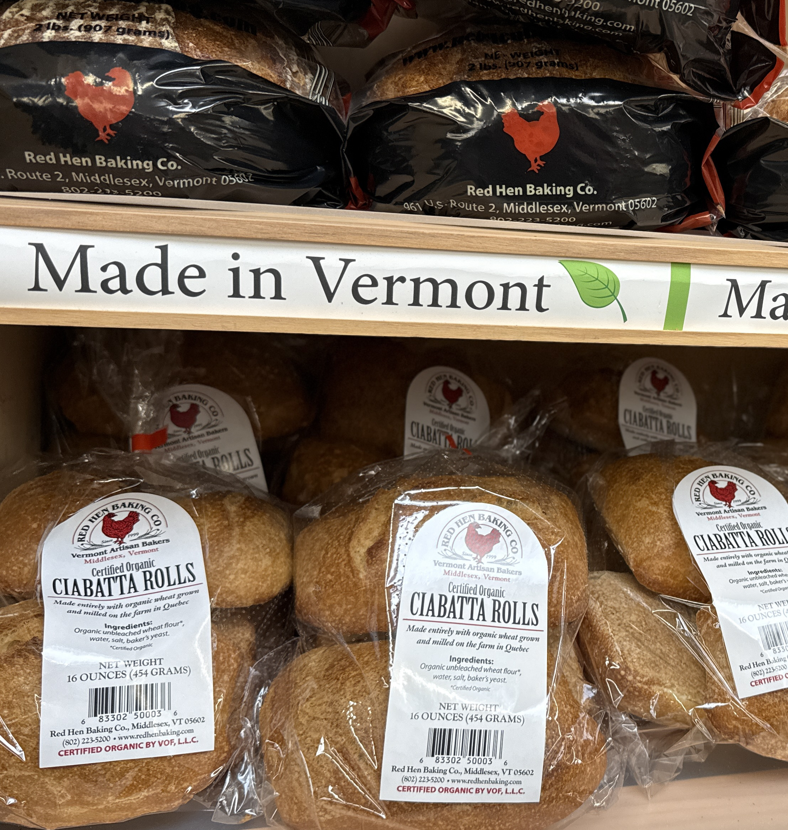
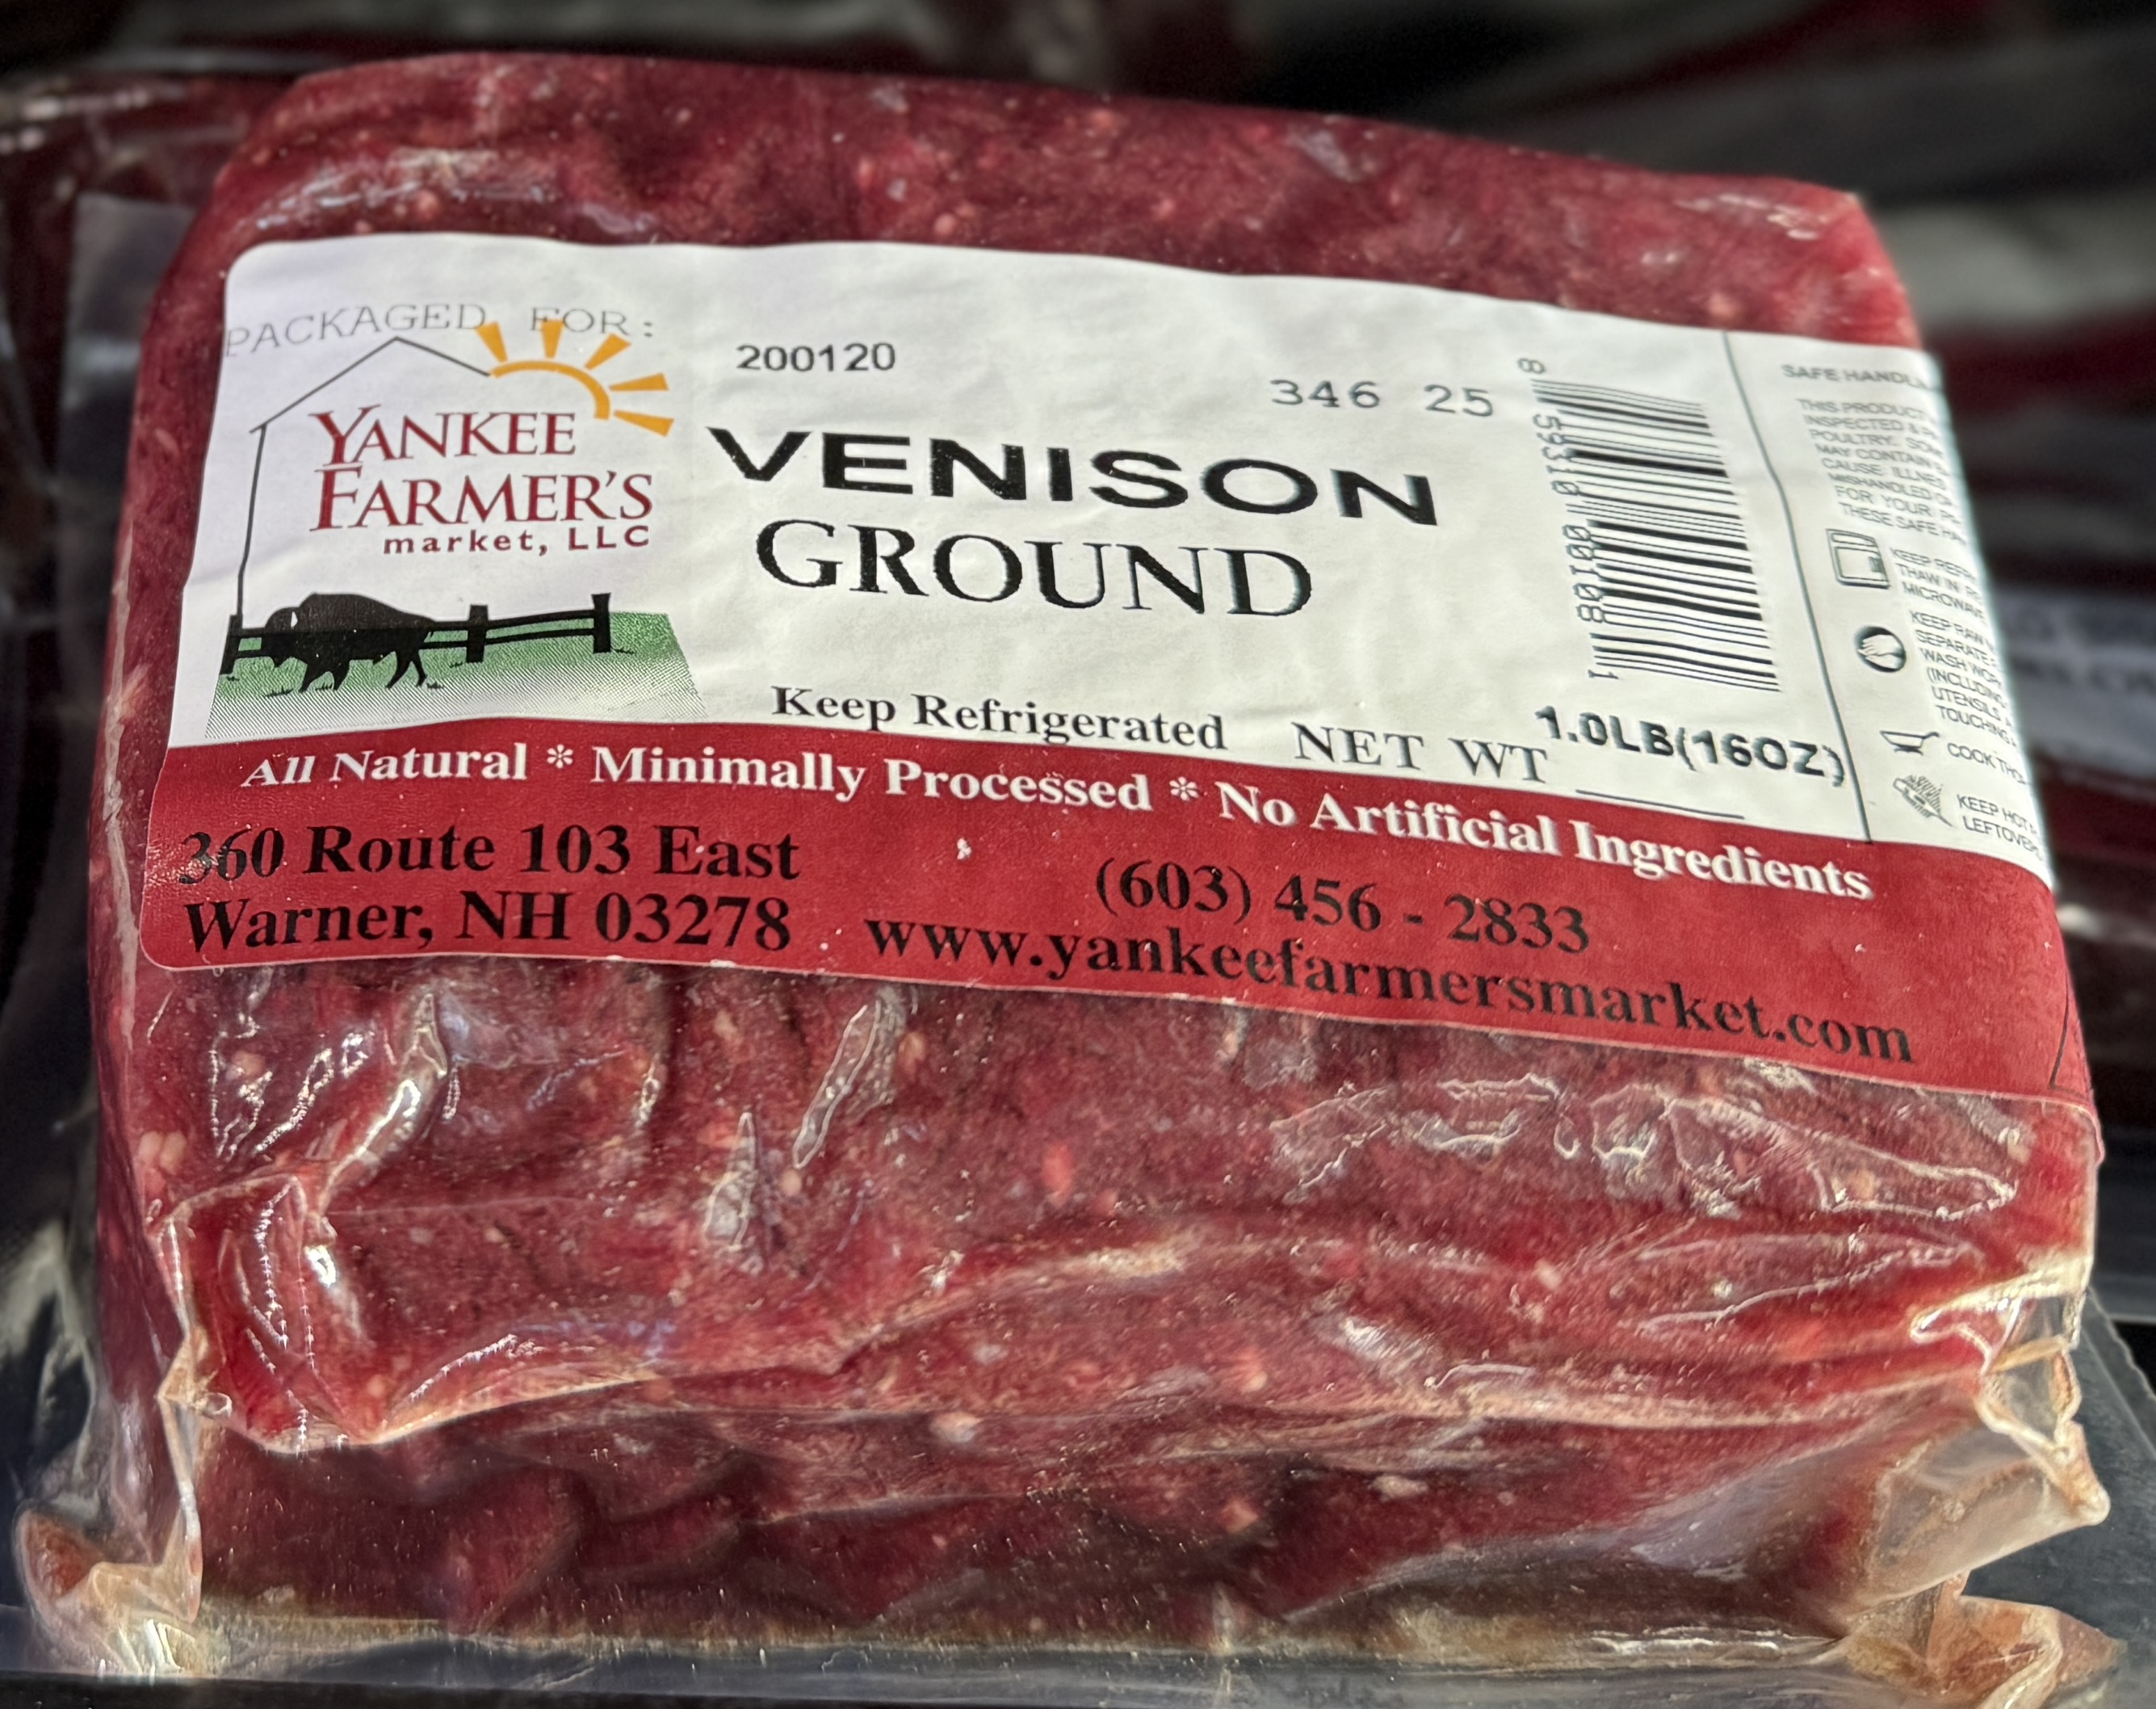
Vendor’s View
You know what it’s like
Handle with 3-years of care
Growing is not so easy
One SKU for 30-years
Pay on scan
Set realistic expectations
Vendors are your growth partners
Notes:
QUOTE:
Jon, Liz, Yankee & Liz,
Set realistic expectations. Growth challenges quality. We all need support and a partner with whom we can build a local economy.

Slide 15
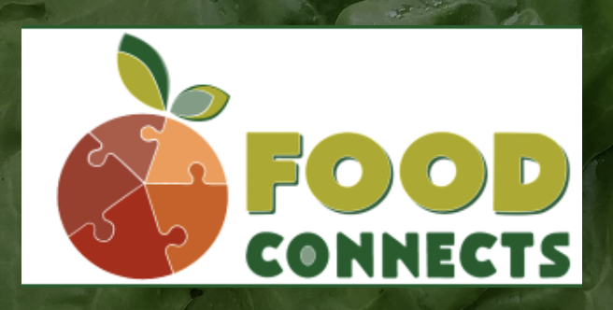
Food Hub Lessons
Food Connects, Brattleboro, VT
Vendors, Grocers, Institutions…and amazing people who care
Big impacts are often pushed back onto the vendor
Be nice. Ask in a calm open way.
PAPERWORK HERE ;-)
Can I interest you in a U-Boat?
Notes:
McKenna Hayes, Hub Manager at Food Connects
“We may need to have these washed differently, because…”
“Can you shift the label to the side of the crate instead of top”
**How does that land with you?**
Yours may be the first receiving area they’ve been in.

Slide 16
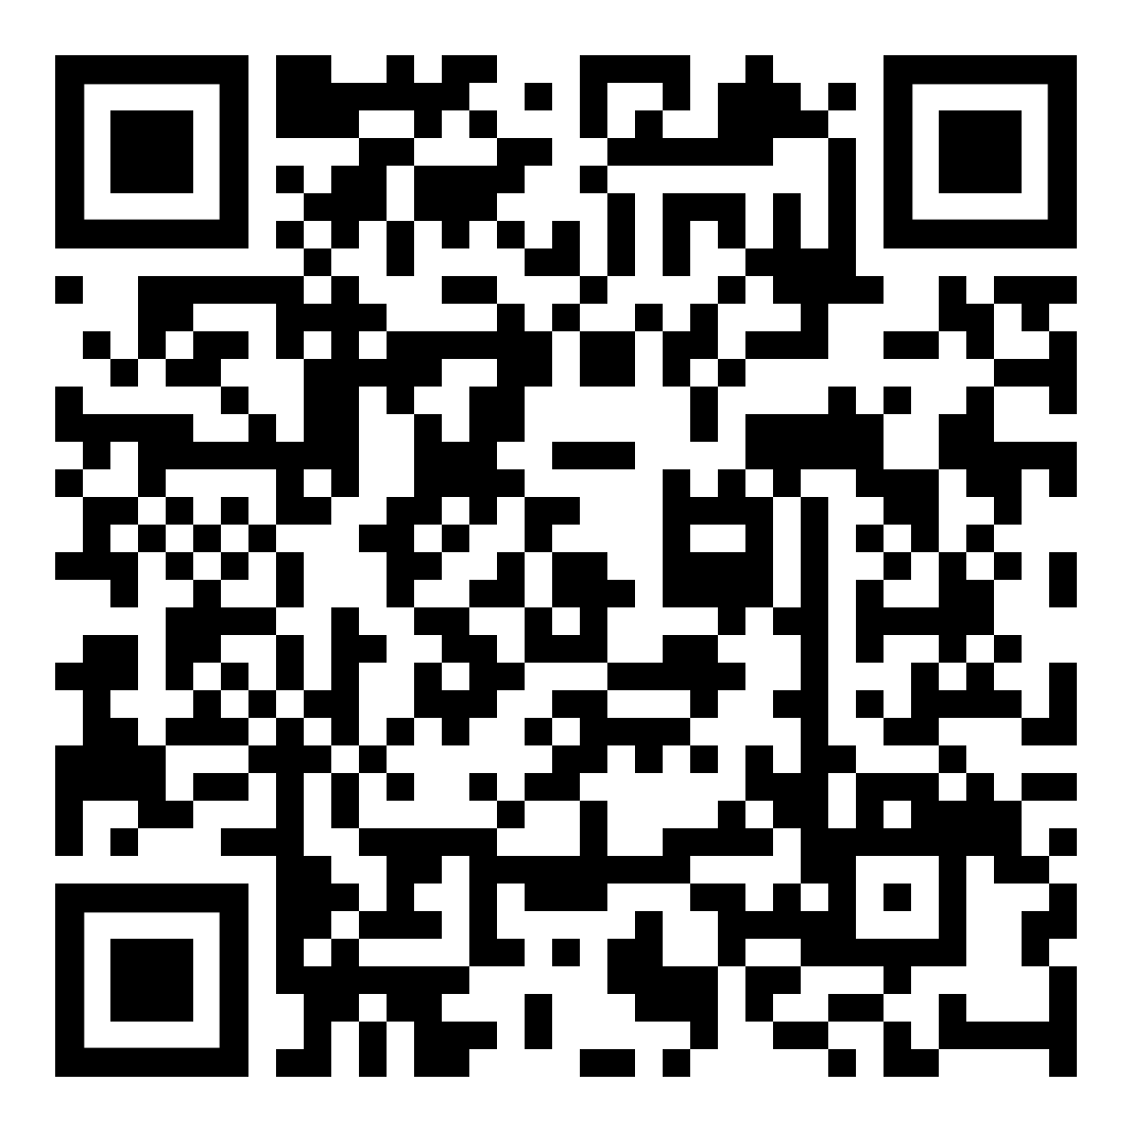
A Consultant’s View
Annie Harlow and Small Bites
Subscribe to Annie’s Newsletter
Every inch of the store matters
Visit other stores…big and small
Find colleagues in other places
Scale down what the big players do
Be that community store
Small Bites Newsletter
Notes:
Annie Harlow. SCROLL
Your store is a Monopoly Board. Everything needs to pay rent.
The little things matter especially at at the loading dock
Learn from the good, bad, and ugly…including your own
Establish a regional peer group and commit to it
Are store decisions meeting community needs?

Slide 17
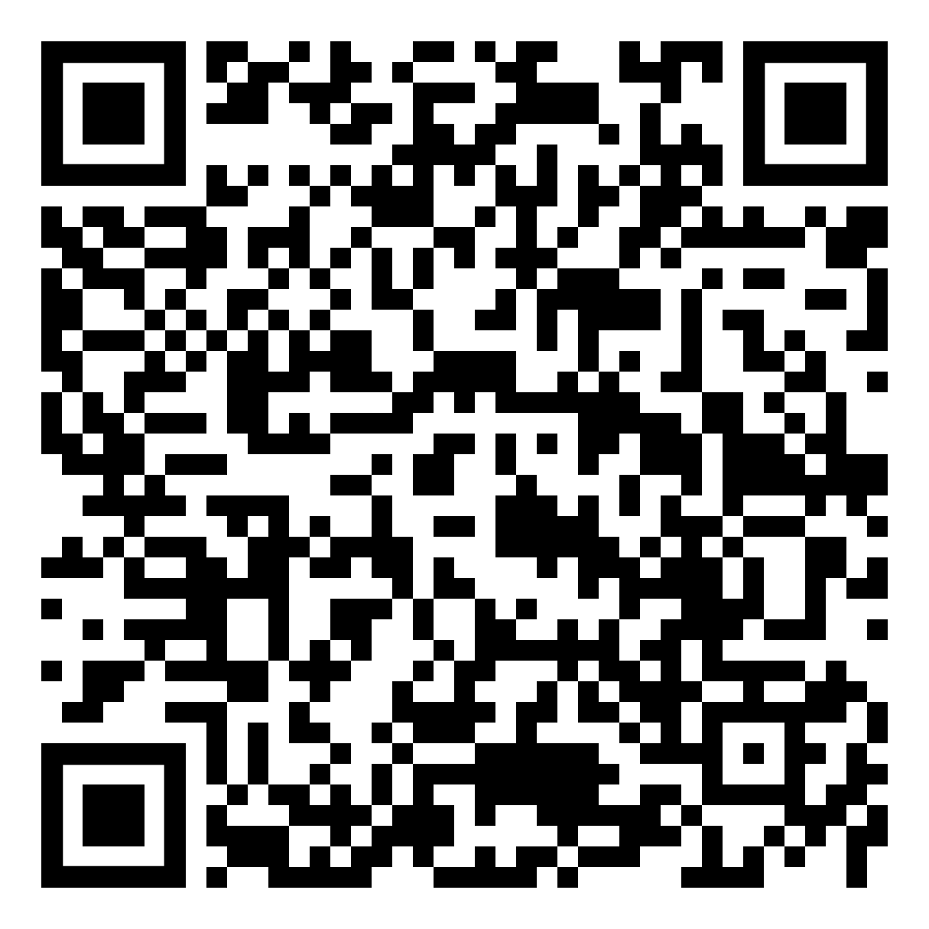
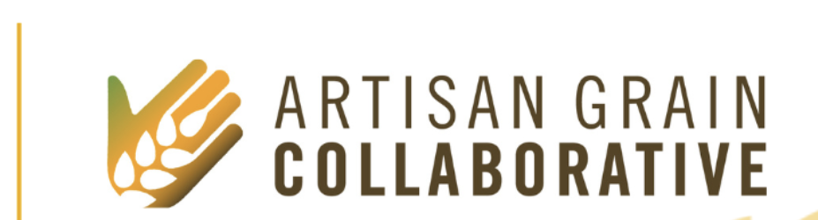
Grains Grown Here
If those shelf-talkers could talk
Campaign Goals:
Highlight grocers support for local grain farmers/makers
Help shoppers identify products made with local grains
Educate shoppers and staff about the benefits of local grain
Notes:
MISSION: To create a diverse regional grainshed in the Upper Midwest built upon regenerative agricultural practices that steward the health of communities, local economies, and natural resources.

Slide 18
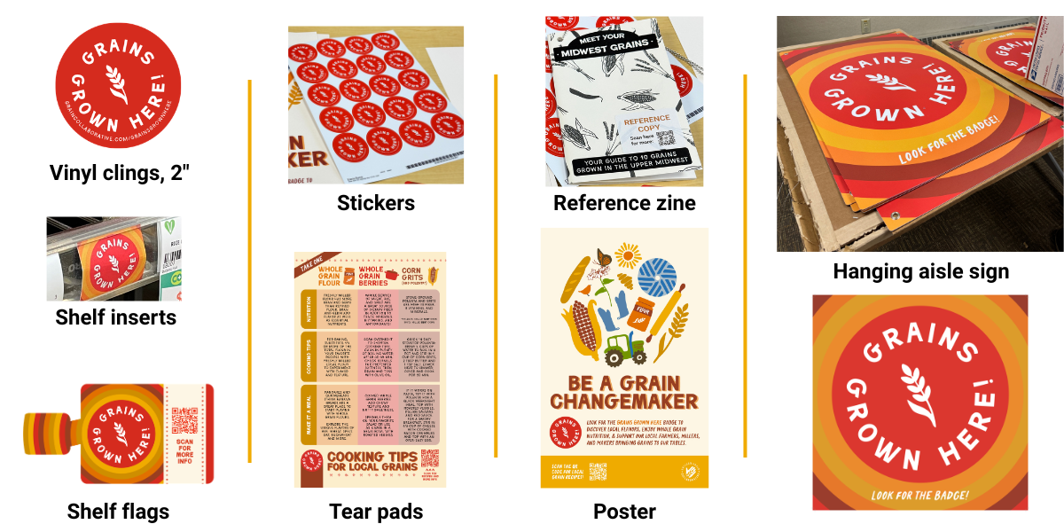
Grain Success
If those shelf-talkers could talk
Campaign Toolkit:
Shelf talkers
Vinyl clings
Hanging cardstock signage
“Be a Grain Changemaker” poster
Tear pads with cooking tips
QR code to a campaign landing page
www.graincollaborative.com/
Notes:
Thirty-six participating stores and delis
75% of reporting stores saw an increase in gross sales of local grain products during that month.
90% of consumers would use the grain again. The other 10% wanted more information.
WHY WE BUY

Slide 19
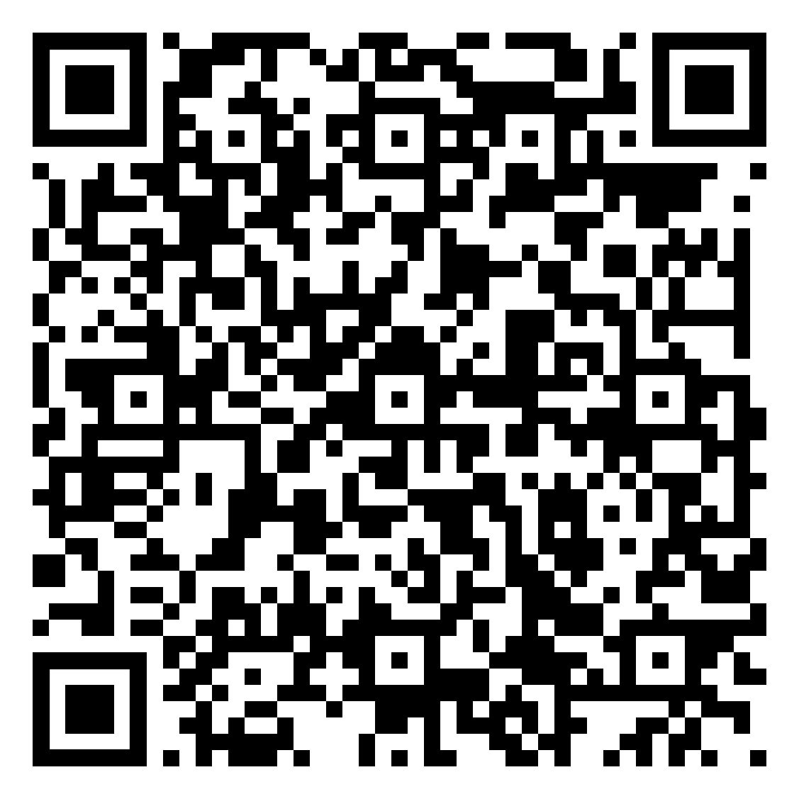
Odds & Ends
Plus Q&A and Crowd-sourcing insights
The viability of independently owned businesses and regional supermarkets committed to increasing local sourcing is in turn critical to farm and food business viability.
Two minutes of Q&A
Five minutes of solution sharing
www.vtfarmtoplate.com/plan
Notes:
BEFORE WE WRAP-UP, ONE MORE QR CODE [2 more slides]
Vermont Farm to Plate’s Food System Strategic Plan
200 page comprehensive document. Available online
Second edition / 2021-2030 GROCERS BRIEF
Time to land the plan: Q&A // Name your issue, offer to connect

Slide 20
The Beginning
Change how you see things.
The term “local food” refers to the attributes of a given food item—How far did this tomato travel?—rather than the more systemic issues: What type of food system brought food to us? What is its impact? What kind of food system do we want to build? Framing this work as building community food systems is more effective.
Ken Meter, Building Community Food Webs
Notes:
ONE MORE PAGE

Slide 21
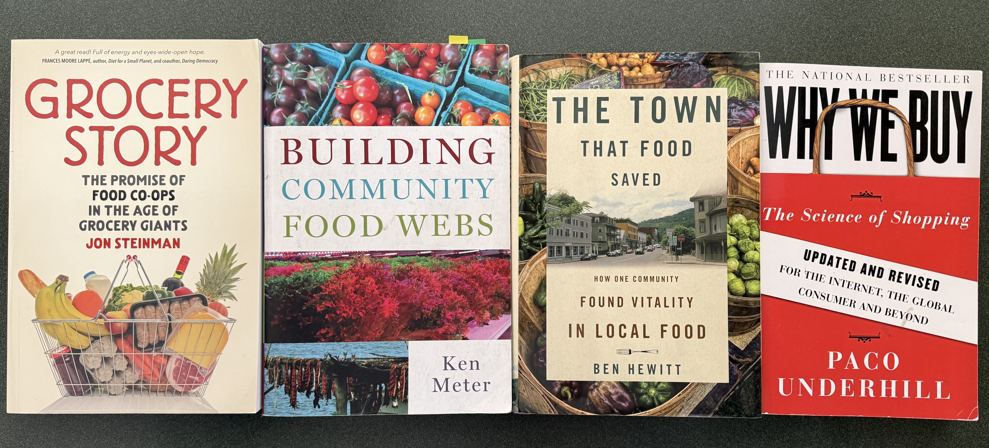
Recommended reading
Purchase from your local bookseller or ThriftBooks.com
Allan Reetz allanreetz@outlook.com +1-603-469-3141

