Slide 1


Cold Chain Wholesale Distribution:
Results from a Northern Wisconsin Study
May 6, 2026
National Rural Grocery Summit
Fargo, North Dakota
Michelle Miller
University of Wisconsin
Center for Integrated Agricultural Systems
Intelligent CI with Computational Learning in the Environment
ICICLE.OSU.EDU
CIAS.WISC.EDU
Notes:
Miller, M., Chang, J., Hirsch, R., Shi, J., Long, D. 2024. “Transportation Issues Affecting Independent Grocers and Fresh Food Distribution: A comparison study of urban and rural communities in the US”. Prepared for the US Department of Agriculture, Agricultural Marketing Service. https://doi.org/10.21231/3z69-mk36

Slide 2
OR….
Why fresh produce is harder to stock in rural stores.
This isn’t just your store. It is a systems problem…

Slide 3
Your daily constraints are structural, not managerial.
“A customer calls in and orders 50 cases, but it's 50 different items ...it takes the same amount of time as if a customer calls in orders 50 different items, but takes five to 10 cases, you know, because all it is a different digital keypad yet one is extremely more profitable than the other.…And so the more profitable we can be, the cheaper the cost of goods is for the stores.” –midsize distributor
“When grandpa was here there were five grocery stores in [town]. Now there's one…Our biggest problem is Dollar Stores. Our grocery store sells perishable items; that is more labor intensive because we need skilled labor. Dollar Stores sell milk and frozen food, but not fresh. We take a big hit in our health and beauty and paper products from them.” -- large independent grocery store owner
The story:
Mutual customers would make an infrequent trip to the supercenter to stock up on shelf stable and frozen products.
Each month, the same customers would purchase about five smaller baskets from the independent grocer, primarily perishable products such as meat, dairy, bakery and produce.
“And these Dollar Generals are really giving them that opportunity to put some, at least the basic fundamental items into their houses, at a cheaper cost.” --large distributor
Notes:
Blue text = quotes from grocers and distributors

Slide 4
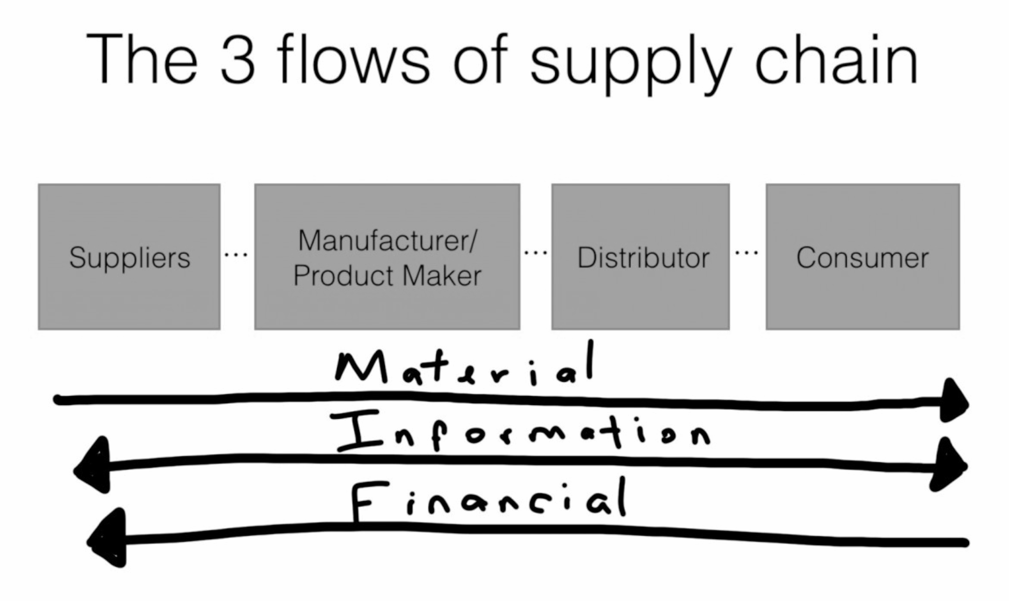
Five Flows in Supply Networks
waste/oversupply
waste/oversupply
waste/oversupply
waste/oversupply
Materials
Information
Costs (risk)
Benefits ($)
Power
Notes:
We focus on materials movement, but the movement of information is key.

Slide 5
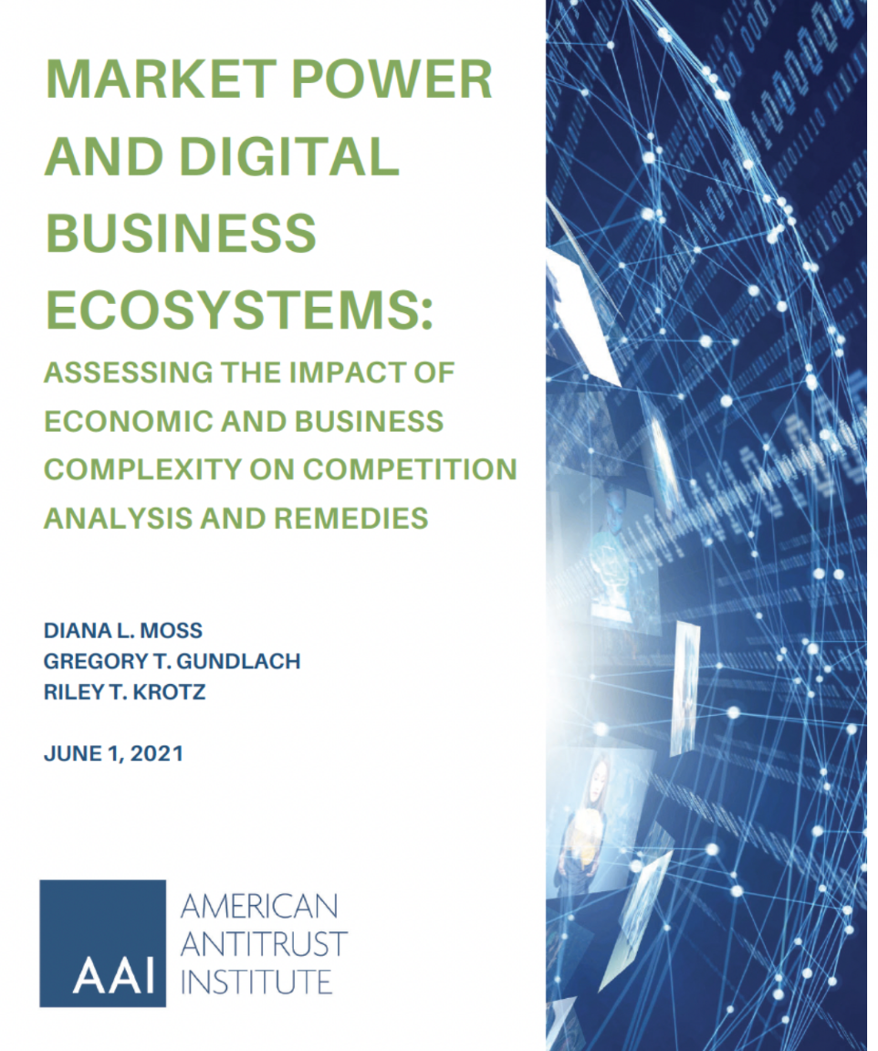
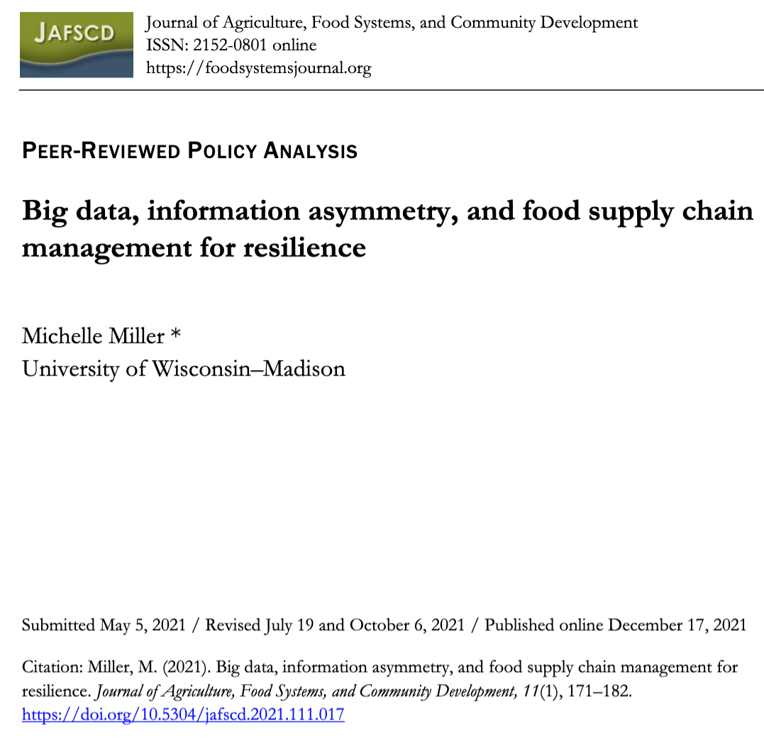
Information shapes materials flow
Notes:
Digital business ecosystems are used by all the big companies. POS in the 90s gave vertically integrated companies a huge advantage in operations and logistics management, while investment in public data withered.

Slide 6
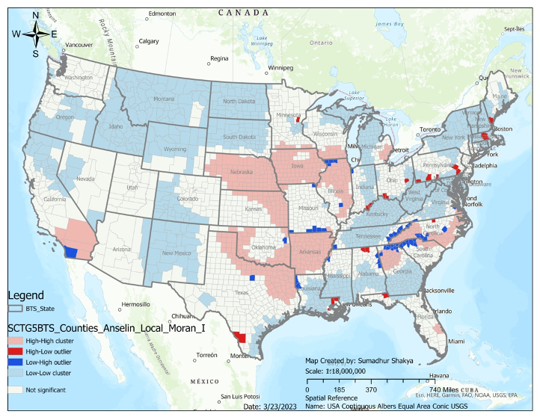
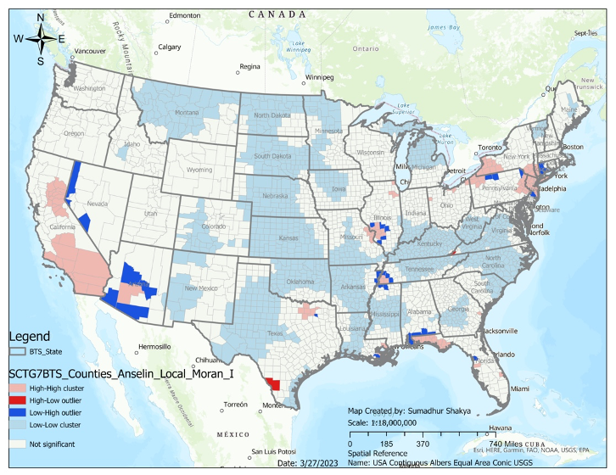
Why food logistics matter: Information shapes materials flow
National networks for perishable meats and prepared foods. Blue = periphery, pink = core
Miller, M., Konar, M., Peterson, H., Court, C., Shakya, S., Stevens, A. (2025) “Network centrality in perishable food distribution networks in the United States”. Environmental Research: Food Systems, Special Issue: Focus on Trade and Food Systems. https://iopscience.iop.org/article/10.1088/2976-601X/add01c
Notes:
Network centrality reveals: Vulnerabilities, Bottlenecks, Concentration risks. Perishable meats, prepared foods (mostly dairy), bakery, produce.

Slide 7
Cold chains in low income regions
Food Access
Geographically Specific
Energy Access
Sustainability Transformation
Food Cooling
Financial Access
Trotter, PA, Becker, T., Renaldi, R., Wang, X.,Khosla, R., Walther, G.. 2023.The role of supply chains for the sustainability transformation of global food systems: A large-scale, systematic review of food cold chains. Journal of Industrial Ecology, 27:1429–1446. DOI: 10.1111/jiec.13445
Notes:
Not just the US, but worldwide.

Slide 8
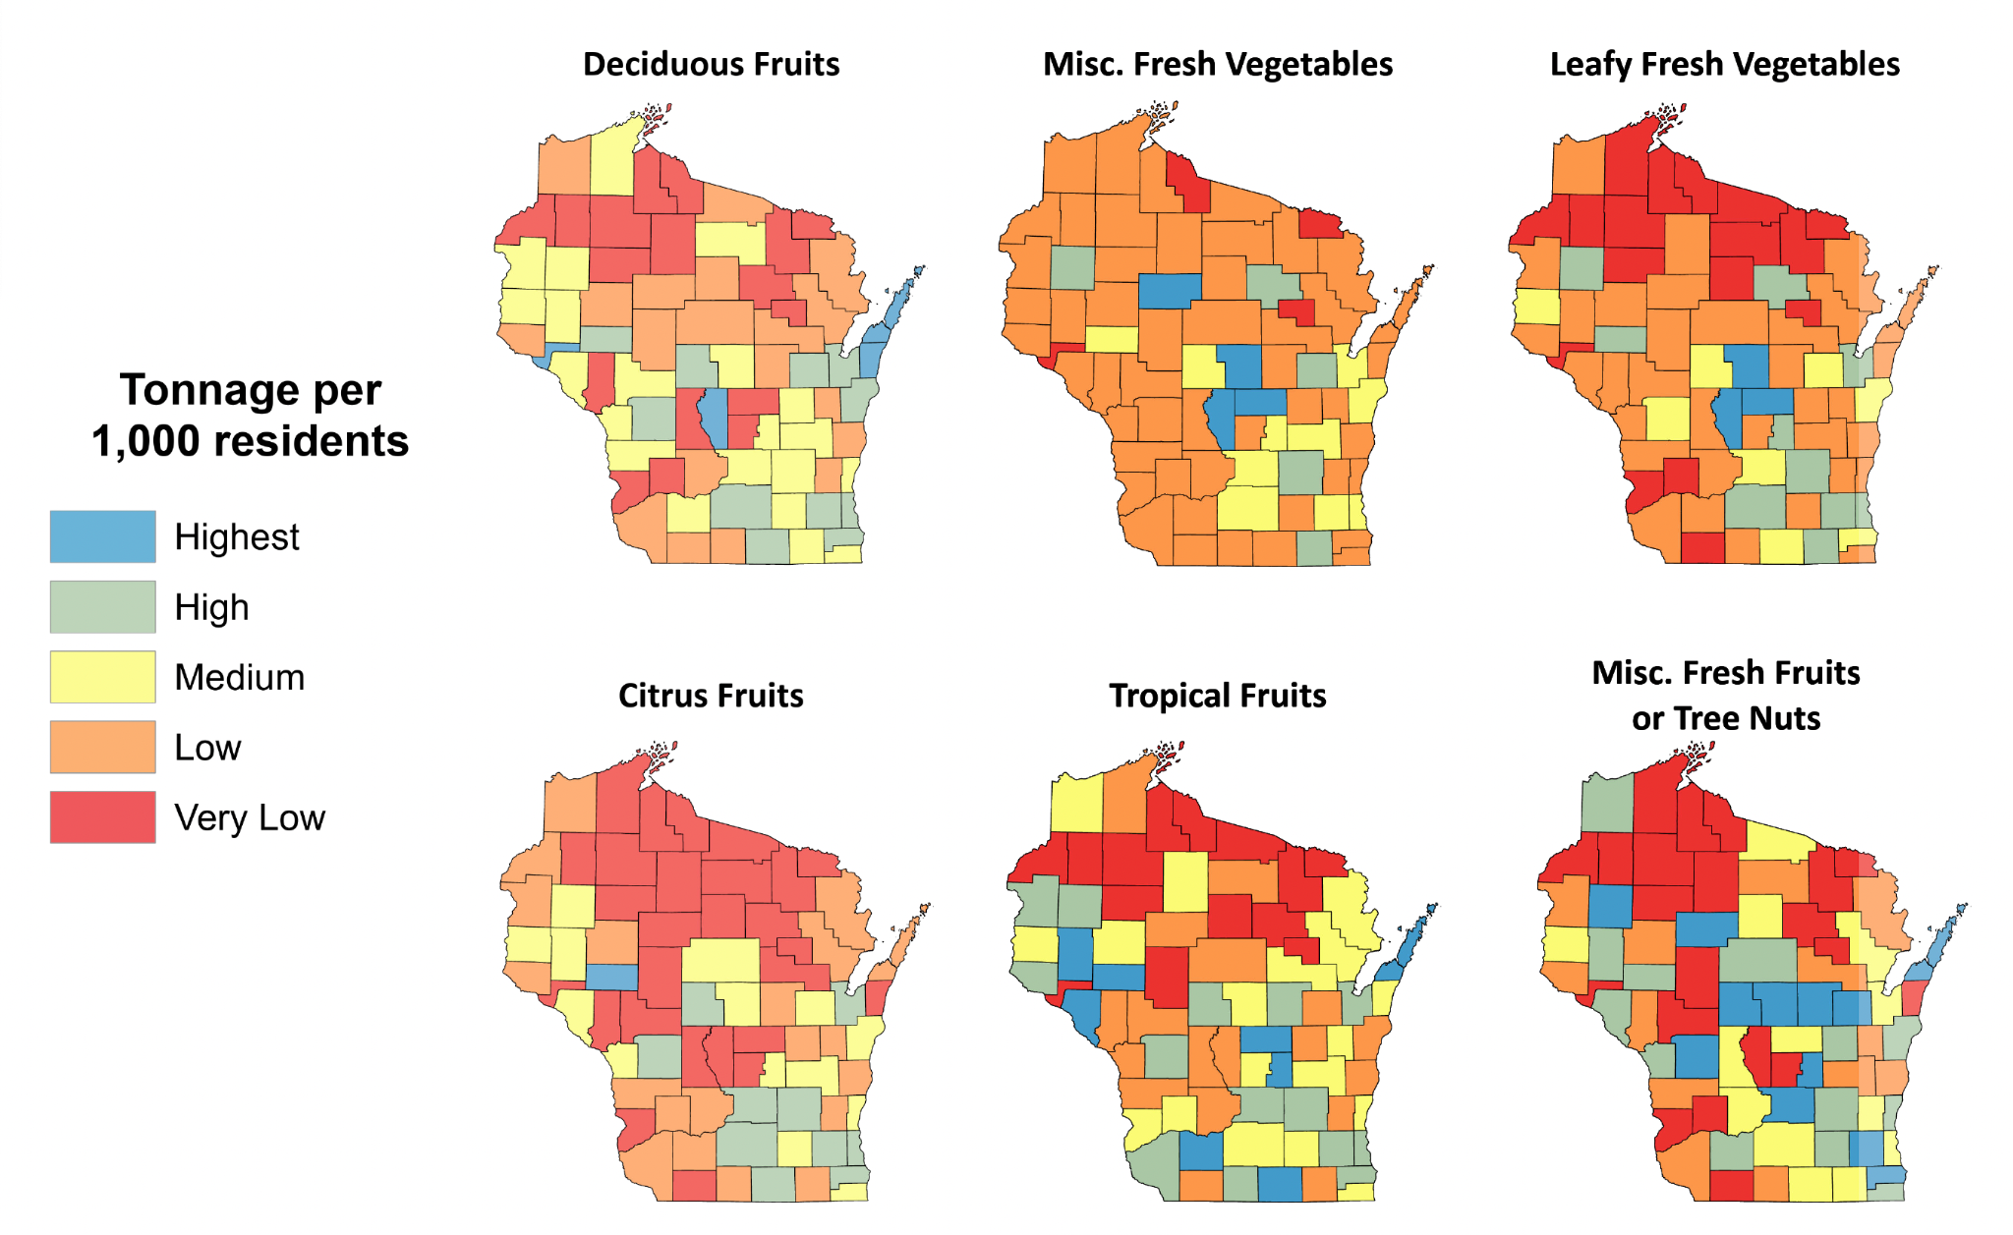
Rural counties get less fresh food - by systems design
National distributors don’t penetrate rural markets because the system rewards ‘urban first’ service
2019 TransSearch data courtesy of the Wisconsin Department of Transportation
Notes:
Another try at produce availability. Orange and red of grave concern.

Slide 9
Rural at the thin end of national distribution systems
Produce Type | % WI Counties with Low Market Penetration | Low Range #/Person
Leafy Greens | 71% | <1 – 9.2
Misc Fresh Vegetables | 73% | <1 – 135
Citrus | 65% | <1 - 9.6
Deciduous Fruit | 49% | <1 – 13.6
Misc Fruit & Nuts | 47% | <1 – 4.6
Tropical Fruit | 44% | <1 – 4.6
Note: US average per capita consumption of lettuces = 31.5#/person. Most WI counties receive less than 29% of the national average.

Slide 10
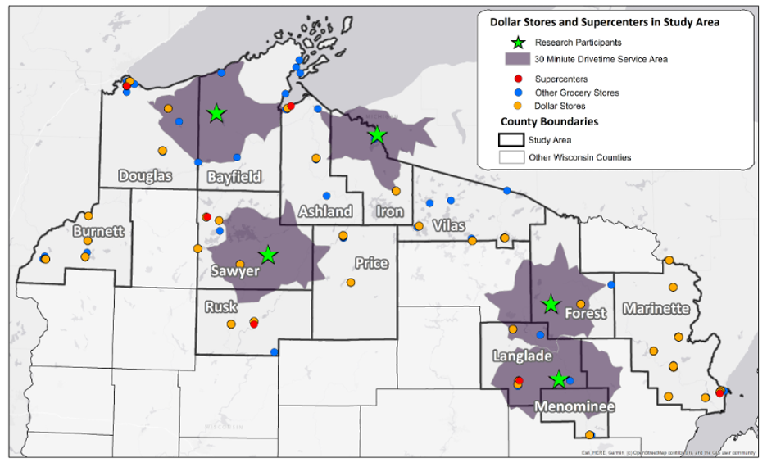
What is happening in rural Wisconsin?
County characteristics
Food insecurity >12%
Pop density 6-30 ppl/sq mi
Frontier And Remote ⅔ of zip codes
Level four FAR 55%
Store selection
Population under 1600
SNAP eligible
244 stores
6 superstores
47 groceries
~4/county
3 off major highway
Notes:
This map shows the thirty-mile radius around project stores and proximity to other local stores selling some fresh produce. 13 counties in the study region are Ashland, Bayfield, Burnett, Douglas, Forest, Iron, Langlade, Marinette, Menominee, Price, Rusk, Sawyer, Vilas.

Slide 11
Interviews with grocers, distributors, others
Market concentration in retail & wholesale
Access to capital
Dollar stores and supercenters
Few distributors
Power to negotiate terms
Cold chain & fleet constraints
Service thresholds
Infrastructure location
Road conditions
Refrigerated LTL regulation changes

Slide 12
Access to capital
“You know, the independent grocers, that concerns me the most, because I see the independent grocers just don't have the capital to stick back into their stores. And over time, the business that they do have doesn't have the value to be able to generate a new facility or the upkeep that's necessary. So, we see a lot more of those small grocers going out of business, or they're fortunate to sell to a larger group that actually has the capital that tried to stick into the facility.” --large distributor
The story:
No mention of financing, expansion
Improvements
Self-financed
Incremental
Capacity-driven
Capital access implicity constrained
Grocers cautiously optimistic for future
Distributors pessimistic
“Yeah, we'll have three vendors waiting to get to that dock on Thursday morning. So, it's hectic, but they're pretty good about waiting for each other, though we would like to eventually maybe upgrade our space.” – medium grocer
“...small towns need their own stores. They are a gathering spot for people and are part of the heart of the community.” –large grocer

Slide 13
Independent Grocers Have So Little Leverage
Concentration upstream and downstream squeezes independents
“Industry needs to adjust to communities and not communities to industry”. – Food bank CEO
The story:
2001 merger of a regional coop and family distributor (Copps & Roundy’s)
Sold to Chicago venture capitalists in 2002
IPO 2012
Purchased by Kroger 2015
Kroger is fourth largest grocer, behind Walmart, Amazon and Costco
Affiliated Foods Midwest
Merged with cooperative Associated Wholesale Grocers (AWG) in 2016
“...distant corporate store headquarters are driving decisions that affect our community’s access to food.” - a food pantry volunteer
“With the cooperative is a whole bunch of independence, we own the stock, and we're sitting on the Board, and we tell them how to run things. So essentially, we are the wholesaler in a way.” – large independent grocer referring to a cooperative distributor.
“One of my father's philosophies that I've tried to maintain is to keep two suppliers in as many places as you can, two in milk, two in meat, two in produce, because they keep each other a little more honest.”- large independent grocer

Slide 14
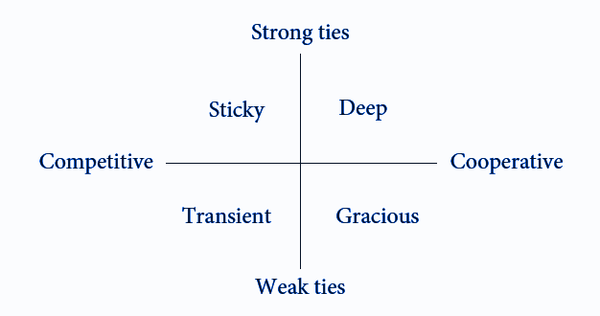
Power dynamics in network relationships
How are trade offs negotiated within the structure?
Non-competitive
(rural is here)
Choi, T.Y., 2023. The Nature of Supply Networks. Oxford University Press

Slide 15
Antitrust: Robinson-Patman Act of 1936
1890 - Sherman Act prohibits monopolies and anticompetitive business practices that restrain interstate or foreign trade, esp. oil and railroads.
1912 - Clayton Act defined prohibited anticompetitive practices: price discrimination, exclusive dealing, tying arrangements, and anti-competitive mergers.
1936 - Robinson-Patman Act to prohibits suppliers from offering better prices or services to large retailers over small businesses. Violations: unfair discounts, allowances, or services offered on commodities.
1940s-60s - Strongly enforced

Slide 16
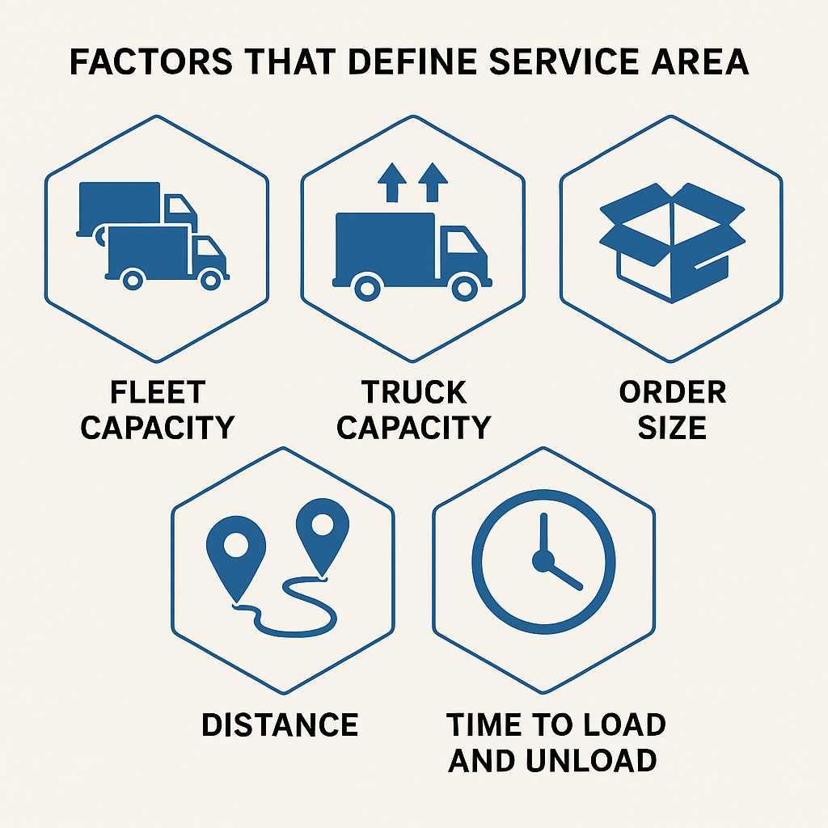
Distributors aren’t the villain - they are constrained, too.
“The driver has 11 hours of driving time to go round trip. And if we're delivering all the way up to like Bayfield, and then trying to come home, it's like, yeah, the driver could do that in one day, if that was the only stop on the truck. But to be profitable, we need multiple stops on the truck. So that's why a lot of those really far out ones, we're not really interested in, because they don't take sufficient enough volume to make it profitable for us, right? Because we work on a per case markup.” - midsize distributor

Slide 17
Rural wholesale markets differ fundamentally from urban markets. Low population density, long distances between distribution centers and retails, and limited transportation infrastructure reduce efficiency and asset utilization, increase delivery costs and drive an ‘urban first’ distribution strategy.
Almost 66 percent of Wisconsin freight traffic occurs off designated freight routes—far above the regional average of 44 percent, leading to a heavy freight burden on rural roads.
Facility and transportation infrastructure determine routing decisions for products flowing through freight distribution systems, with about 80% of transportation costs attributable to location within distribution infrastructure
Pre-1980 regional refrigerated LTL businesses were protected by federal interstate commerce rules. Today, massive supercarriers dominate.
Notes:
80% of distribution costs are determined by infrastructure. This includes roadways designated for freight and policies that used to protect smaller regional distribution companies from big companies.

Slide 18
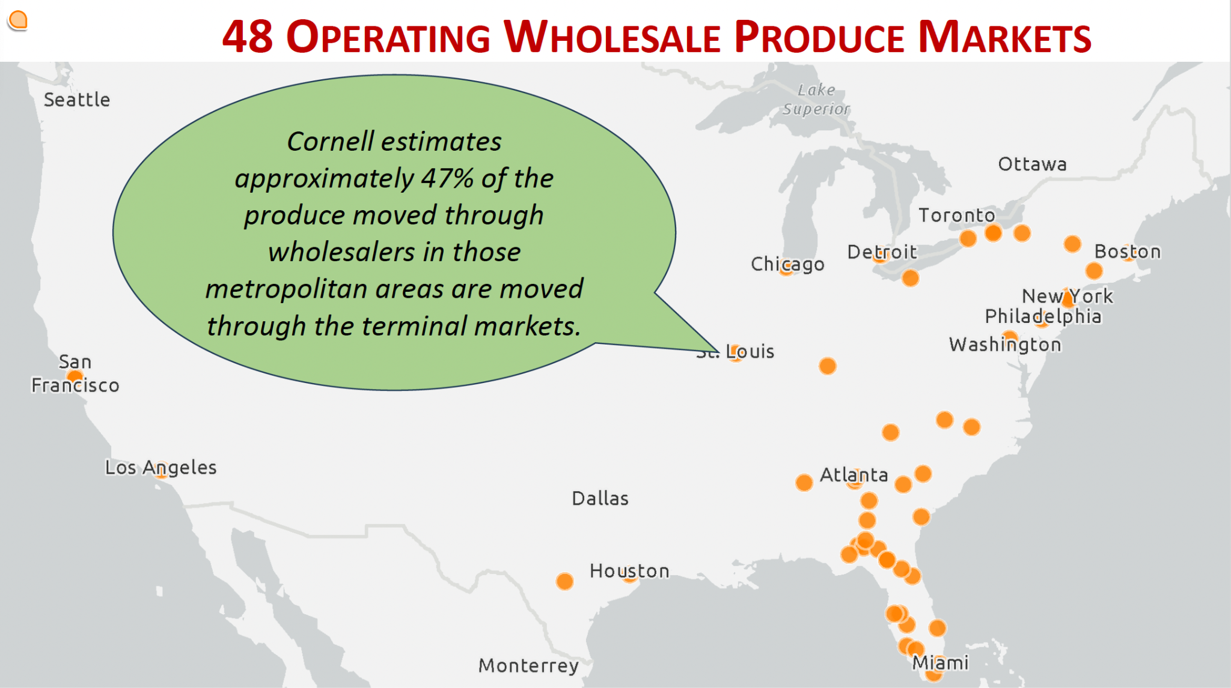
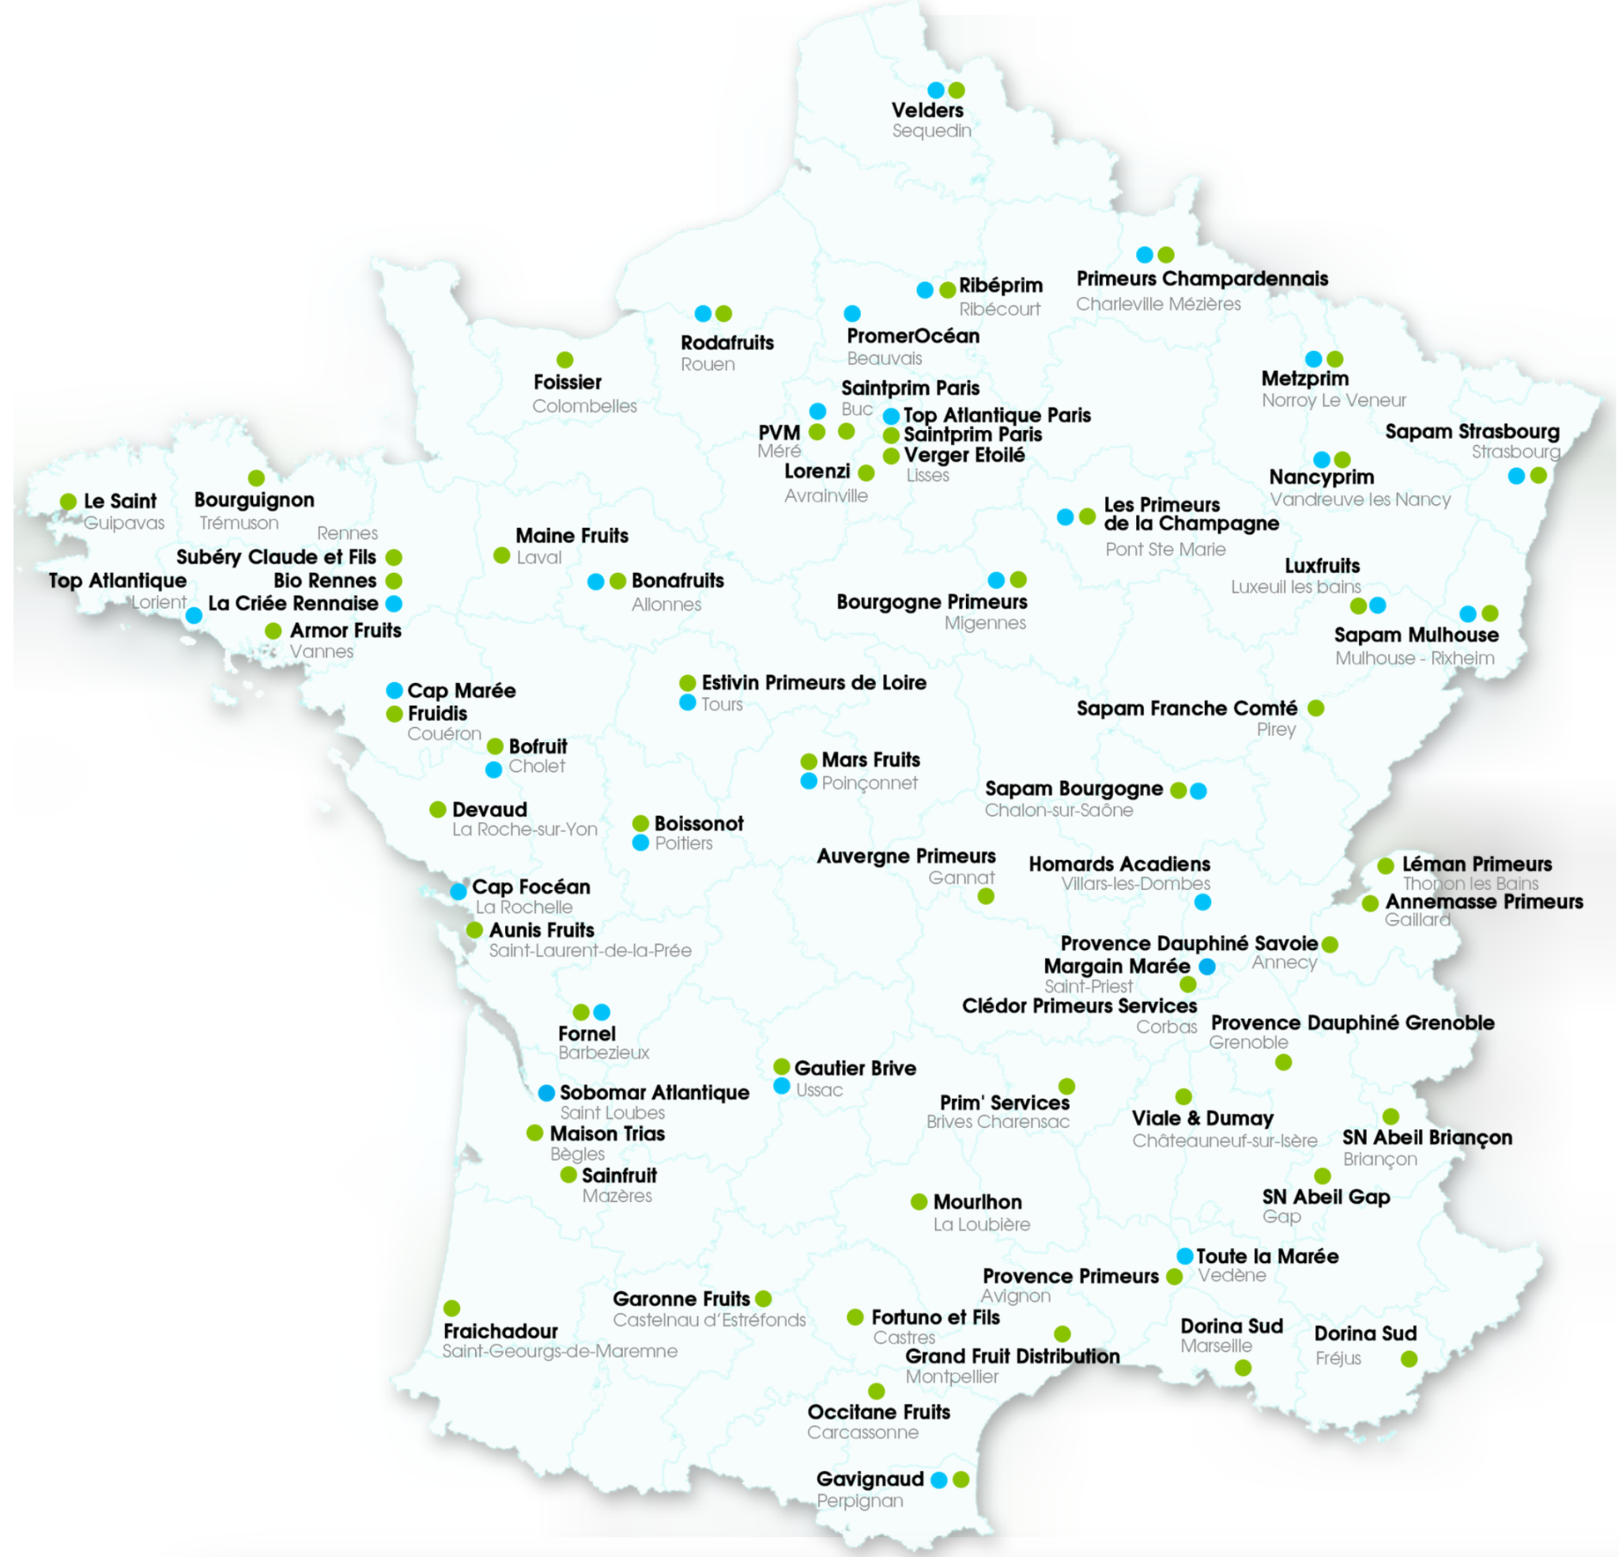
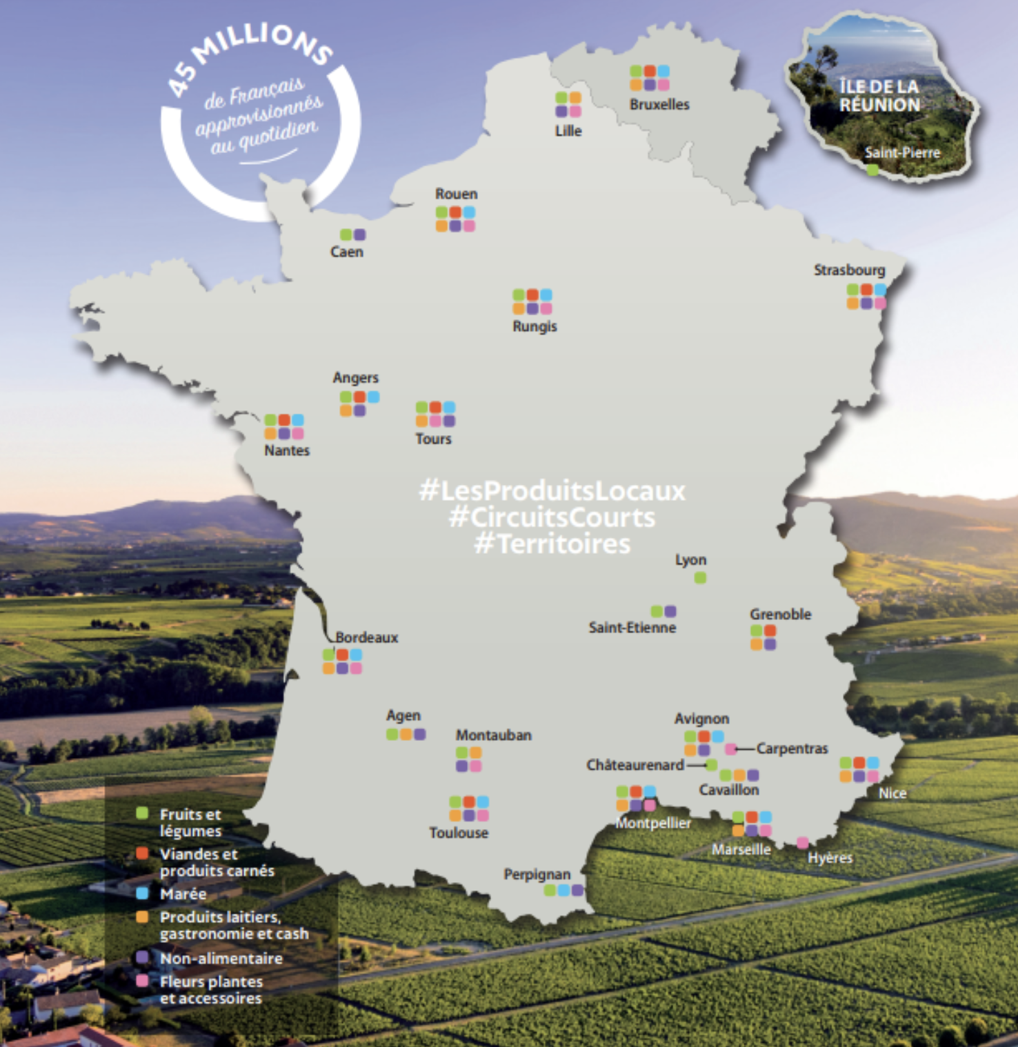

Public investment proof of concept
US vs France
4700 producers
2500 distributors
26 wholesale markets
63,500 buyers
137t jobs
14.7b EU in trade yearly
Vivalya Cooperative
Local food wholesale
16 companies
73 warehouses
Notes:
Park, K., R. Batcher, M. Gómez, A. B. Long, D. J. Mason, M. Petrella, and B. Tydings. 2025. “Wholesale Produce Markets: On-site Infrastructure Assessment.” Paper presented at the National Association of Produce Market Managers Conference, Detroit, MI, March 14.

Slide 19
Wisconsin DOT - state policy implications
Freight planners focus on freight traveling from rural regions to urban markets, not inbound wholesale freight movements to rural communities
Rural counties lack highway and transportation planning staff
County roads have insufficient traffic counts to be eligible for more lanes - need for better measures
Logging and milk trucks share county roads with summer residents and tourists who need bike and pedestrian accommodations
Rural counties with a low tax base lack resources to leverage federal funds for state and county road improvements
Notes:
State practices and policies shape rural freight capacity.

Slide 20
Antitrust: Motor Carrier Act of 1935
1887 - the Interstate Commerce Commission formed to regulate railroads, address antitrust issues
1935 + updates - added the Motor Carrier Act to regulate LTL & other freight businesses
1980 - deregulation of trucking industry
1996 - ICC dissolved
Notes:
See The Big Rig.

Slide 21
Adaptive strategies: Survival not systems change
Grocers
Fresh as a competitive advantage
In house bakery
Butcher services
High value local products
Deli value-added
Other services
Banking
Hardware
Optometry
Pharmacy
Liquor
Joint ordering
Collaboration with food banks, pantries
Distributors
Repack
Fresh cut
Commissary
Merchandising
Backhauling
Organic Valley
Kroger
City Brewing
United Natural Foods Inc
Emergency delivery
Bespoke delivery
Notes:
C: 2000, 17% of food was delivered via LTL. Today?

Slide 22
Fresh Food Access Is a Logistics Problem

Slide 23
What daily fresh delivery looks like – when the system is built for it
Amazon’s Rural Super Rural
$4 billion investment
200 micro hubs planned
Hub and spoke logistics
Digital operations platform
Reduces contract with USPS for delivery
ND: Grand Forks, Minot, Dickenson
MN: Mankato, Stewartville, St. Cloud, Duluth
MT: Missoula, Bozeman, Billings, Belgrade, Butte
SD: Aberdeen, Watertown, Box Elder
Kwik Trip / Kwik Star
Built from experiments with alternative fuel distribution
Digital operations platform
Regional routes
Domicile hubs full outbound - empty inbound
Food=70% of its in-store revenue
Commissary
Reusable pallets, totes, lids, crates
Euro-lift systems
WI (500+), MN (~200+), IA (~100+) also SD, IL, MI

Slide 24
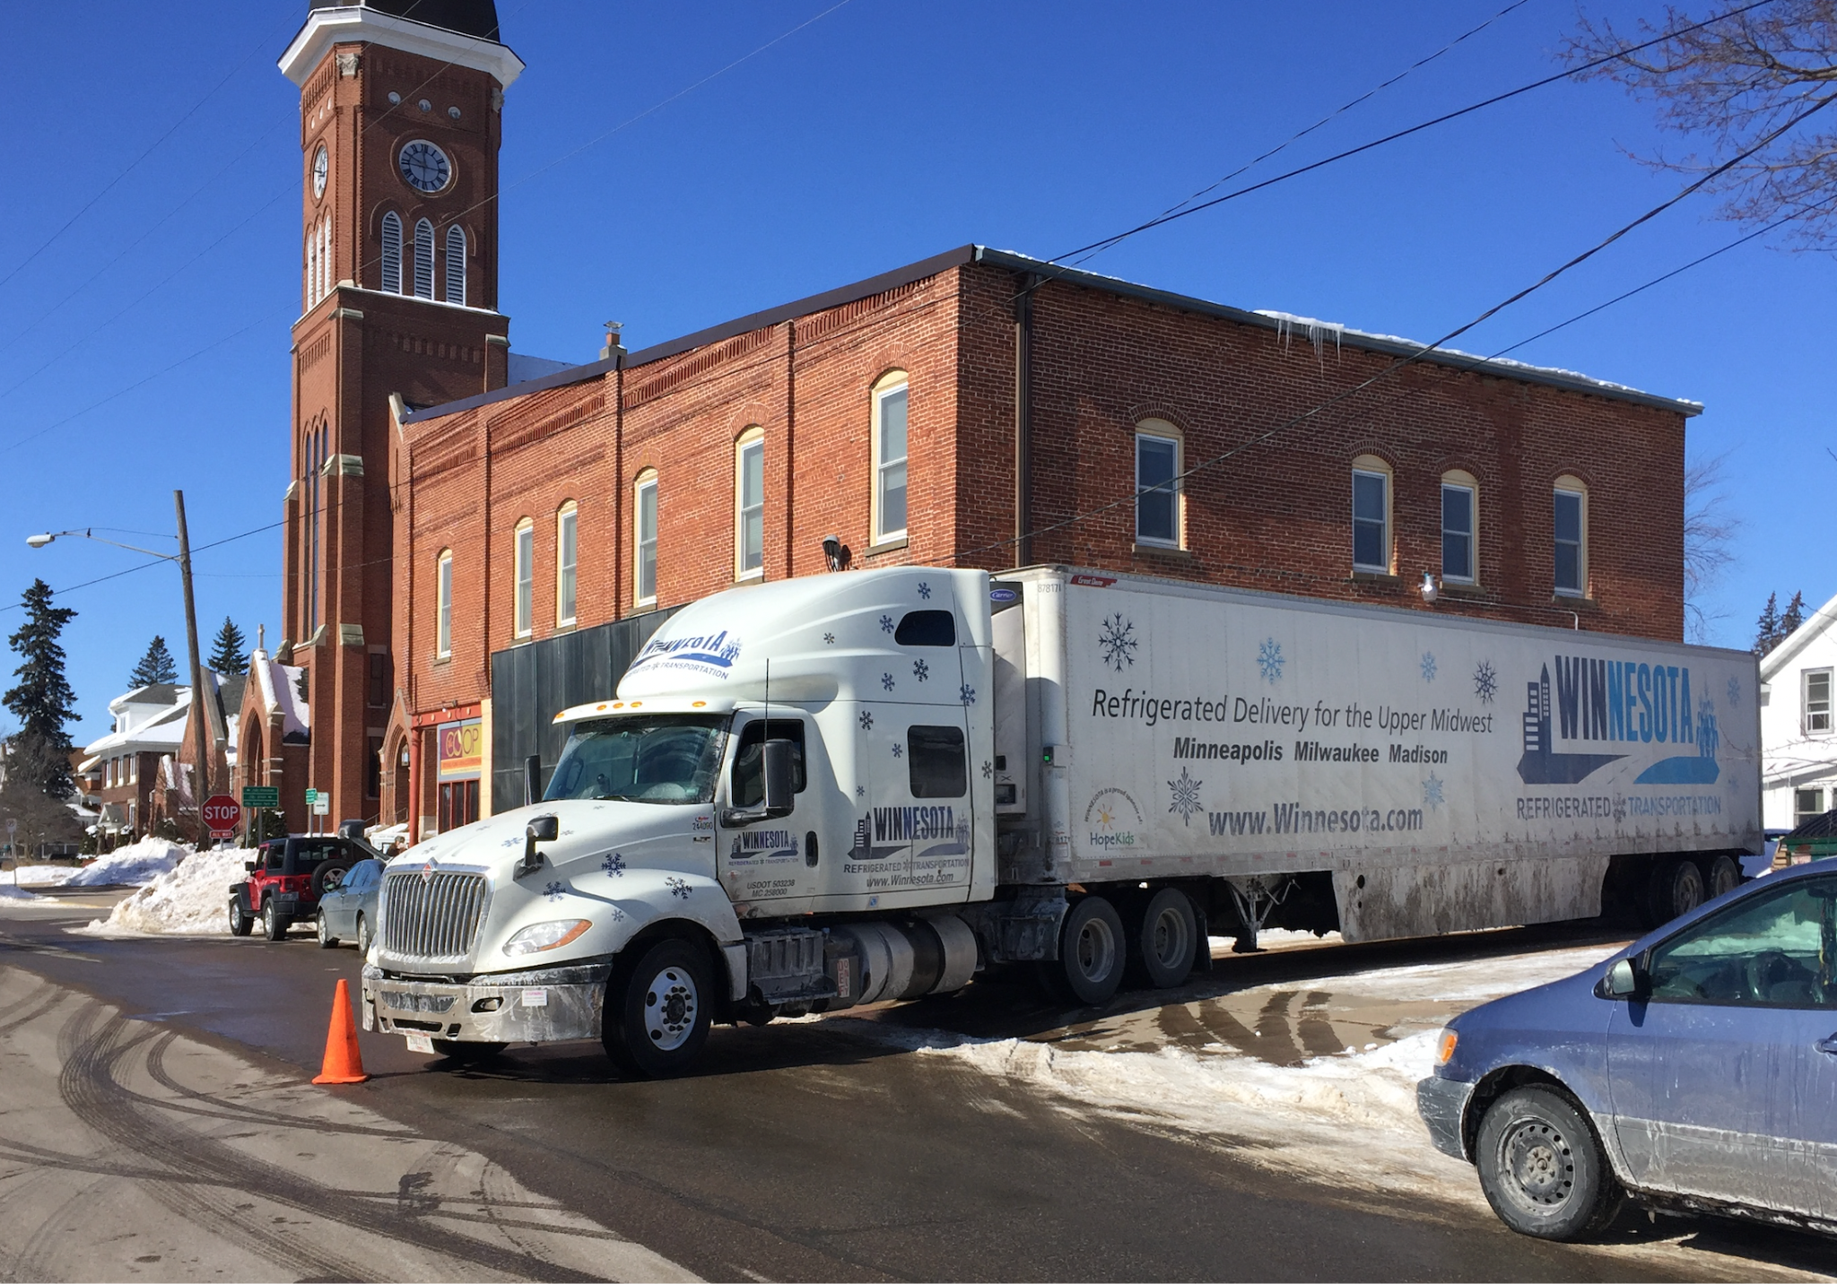
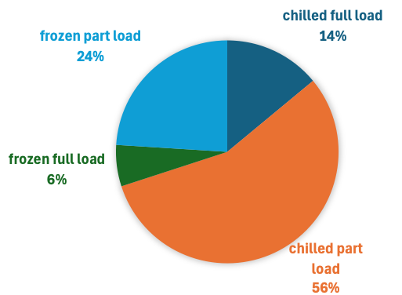
Right truck type for the route
Refrigerated Semi-Trailers (Reefers)
Straight Trucks (Refrigerated Box Trucks)
Reefer LTL (Less-than-Truckload) Vehicles
Insulated Vans/Sprinter Vans
Cold Chain Technical Brief: Transport Refrigeration. UN Environmental and IIR.

Slide 25
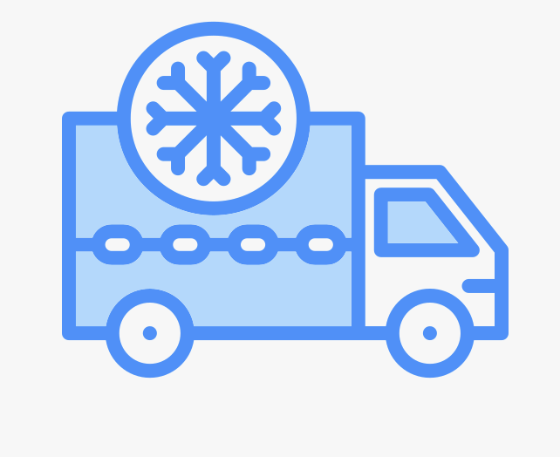

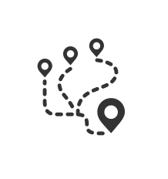


What Strengthens Rural Fresh Food Access Infrastructure + collaboration = lower costs, fair markets
Shared coldchain resources
Coop structure
Regional routes
Data & modeling
Antitrust rules

Slide 26
What can we influence – alone and together
Individual business actions
Collective high leverage action
Joint ordering
Cooperative business structure
Cooperation among cooperatives
Diversified services
Join organizations
Shared logistics
Right-scale warehousing infrastructure - minihubs
Collaborative market infrastructure
- multitenant
State transportation policy, investment in infrastructure
Antitrust enforcement and a new Motor Carrier Act

Slide 27
Your businesses are infrastructure for impact.
You are more than a business leader.
You create rural resilience.

Slide 28
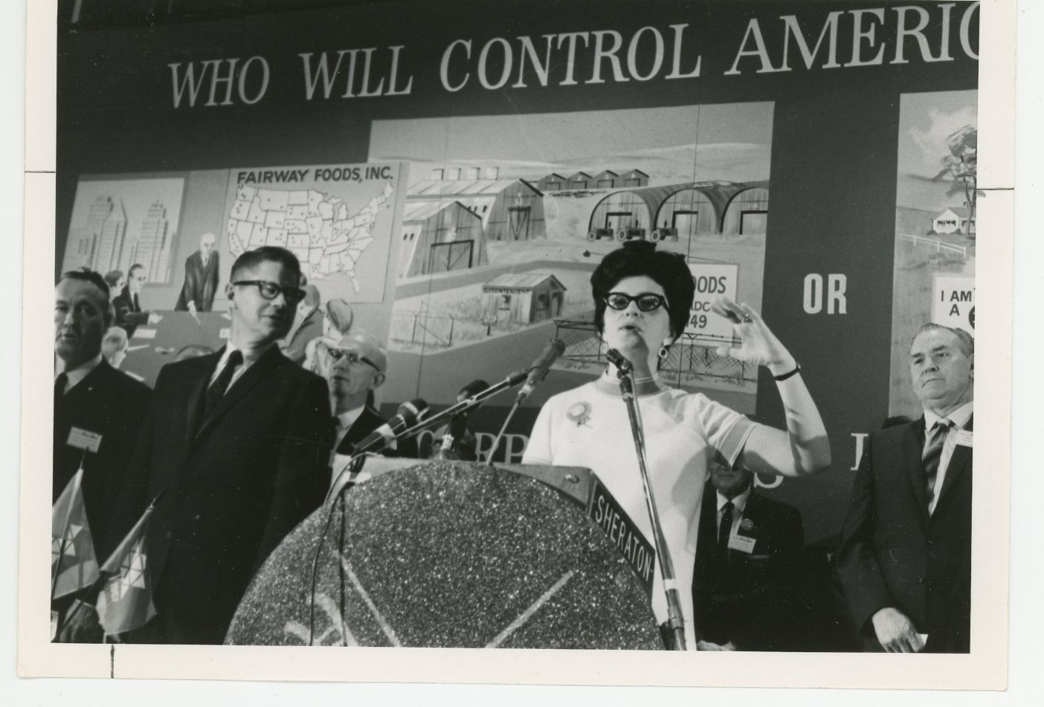
Notes:
1961 National Farmers Union convention Washington DC - Who will control American agriculture? Fairway Foods and corporate farms? Or Family farms and rural businesses?

