Slide 1
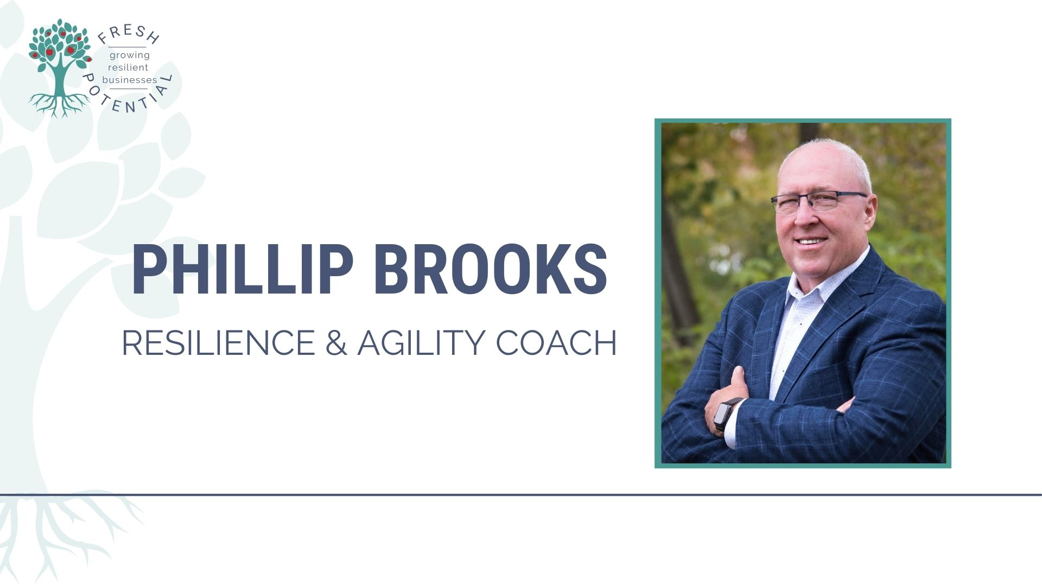
Notes:
Life cycles
The business survives or thrives
It will be sold to your family, a strategic buyer, an investor, or repurposed.

Slide 2
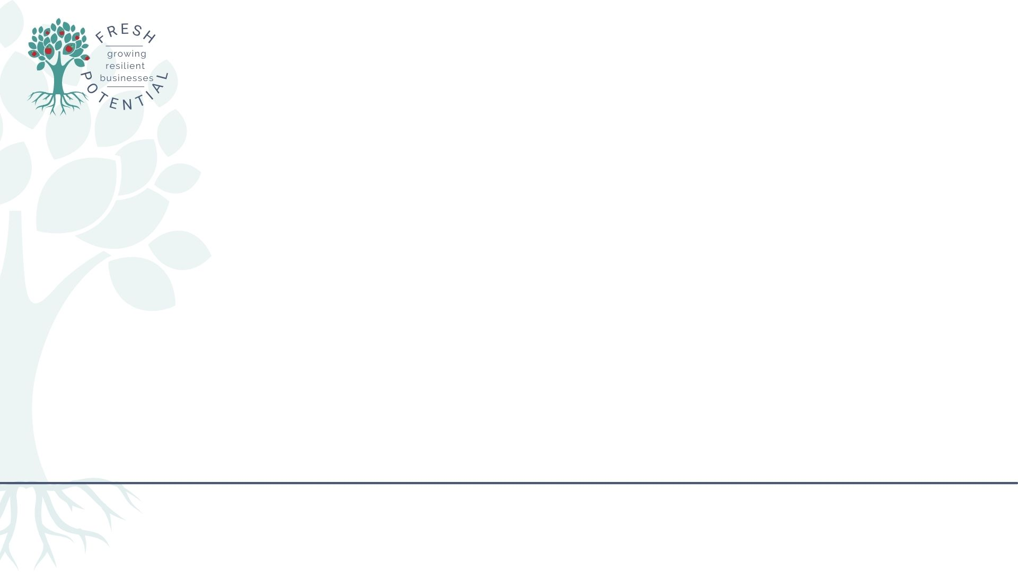

Restoring the Flow
Aligning Rural grocery for Growth and Succession
Notes:
Life cycles
The business survives or thrives
It will be sold to your family, a strategic buyer, an investor, or repurposed.

Slide 3
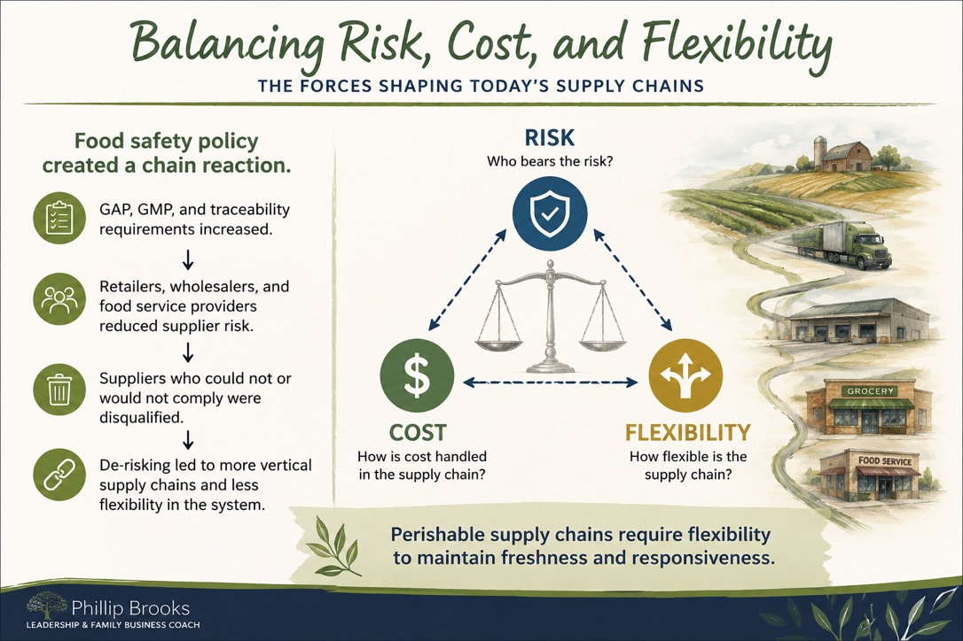
Notes:
Life cycles
The business survives or thrives
It will be sold to your family, a strategic buyer, an investor, or repurposed.

Slide 4
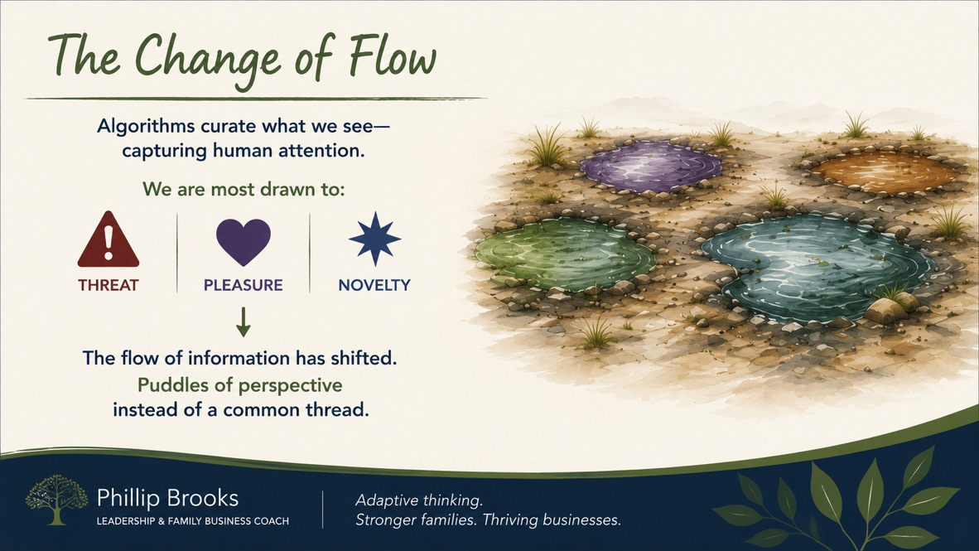
Notes:
Life cycles
The business survives or thrives
It will be sold to your family, a strategic buyer, an investor, or repurposed.

Slide 5

Sound Decision Making is overridden by the avoidance of future regrets
Notes:
Hesitation . Sound decisions are

Slide 6
ALIGN → CONNECT → FLOW
Adaptive systems survive by staying connected
to changing conditions.
Alignment restores connection. Connection restores flow.

Slide 7
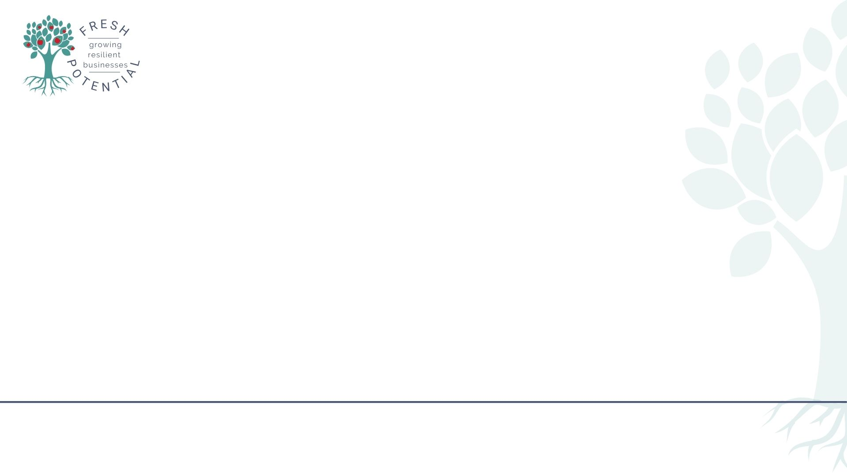
ALIGN – The ECHO™ Decision tool.
E - Will it Benefit End Users?
C - Will it Benefit Collaborators?
H - Will it Benefit the Helpers?
O - Will it deliver sustainable, values-aligned outcomes?

Slide 8
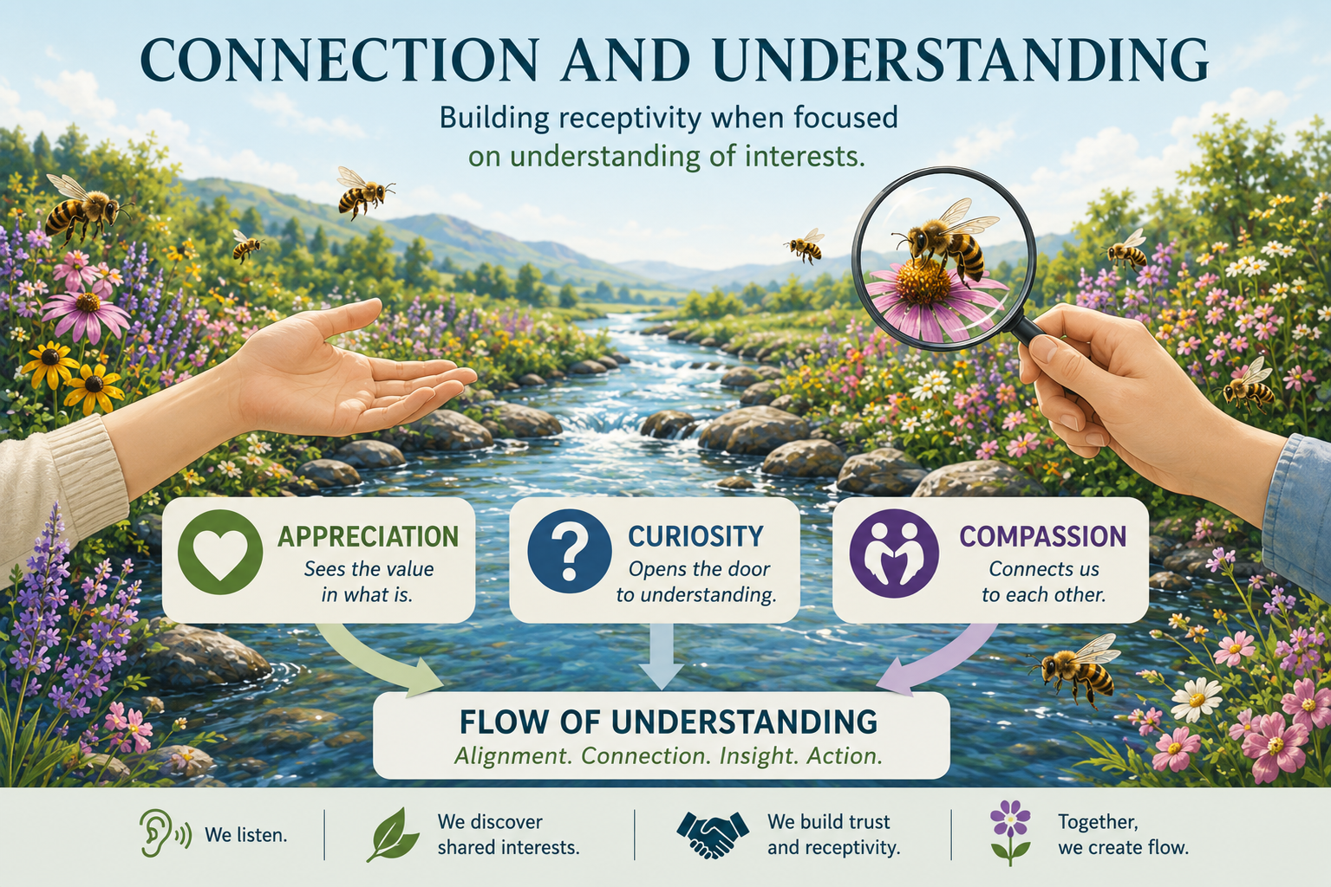

Slide 9
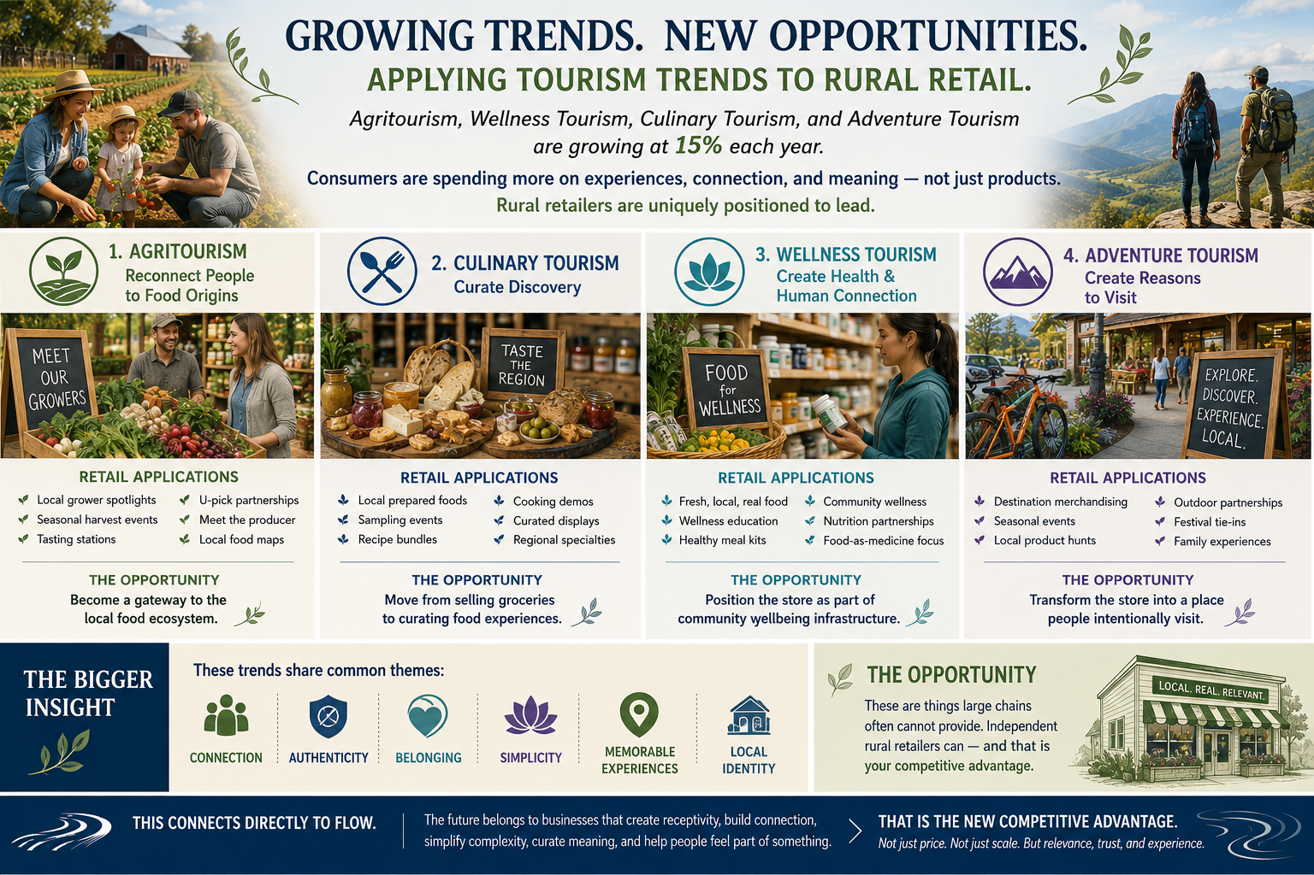

Slide 10

Reflection Questions- Alignment and Hesitation
1. Where in your business, family, or community, do you feel the greatest hesitation right now?
2. What important conversation or decision is being delayed because of uncertainty or fear of future regret?
3. What would better alignment look like between customer needs, your team, and the future direction of your business?
ALIGN → CONNECT → FLOW
Alignment restores connection. Connection restores flow.

Slide 11
Life Cycles
The business Fails, survives or thrives
Strategy and an operating system with alignment improves success and options
Family
Passed on to the next generation, preserving legacy and values
Strategic Buyer
Acquired by an aligned partner who sees value in what you built
Investor
Funded by an investor to scale or transition to new leadership
Repurposed
Transformed into something new that serves a different purpose
F
S
I
R

Slide 12
Causes of Unsuccessful Family Business Transfers:
Why do plans Fail?
60% - Breakdown in Trust and Communications
25% - Failure to Prepare Heirs
10% - No Clear Family Mission Statement
Notes:
Life cycles
The business survives or thrives
It will be sold to your family, a strategic buyer, an investor, or repurposed.

Slide 13
Typical Triggers
1. Appreciation (recognition)
2. Autonomy (control)
3. Affiliation (In or out)
4. Fairness (Why Me?
5. Status (up or down)

Slide 14
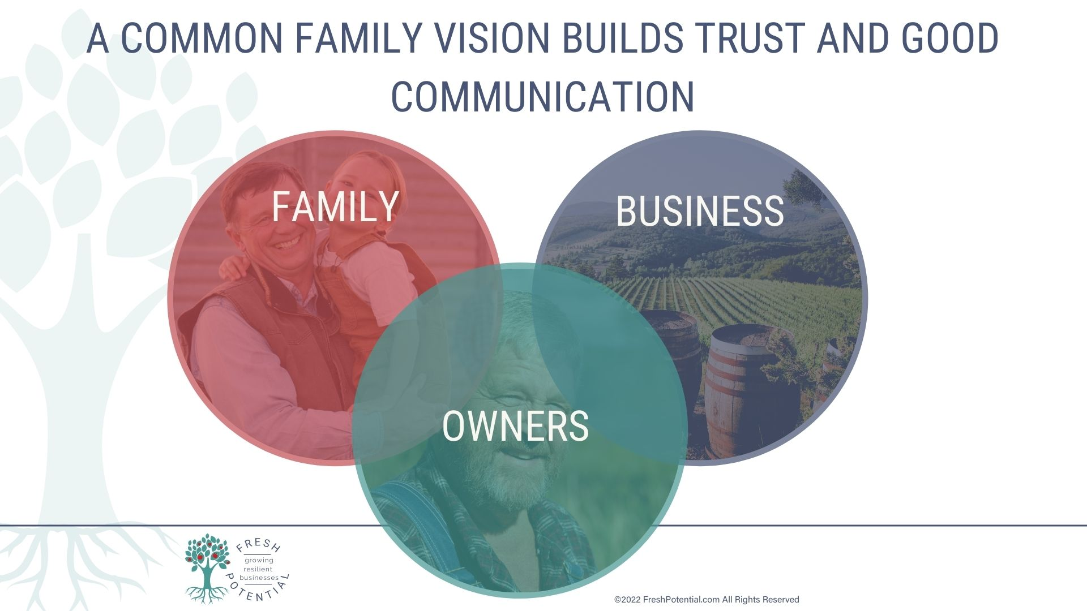

Slide 15
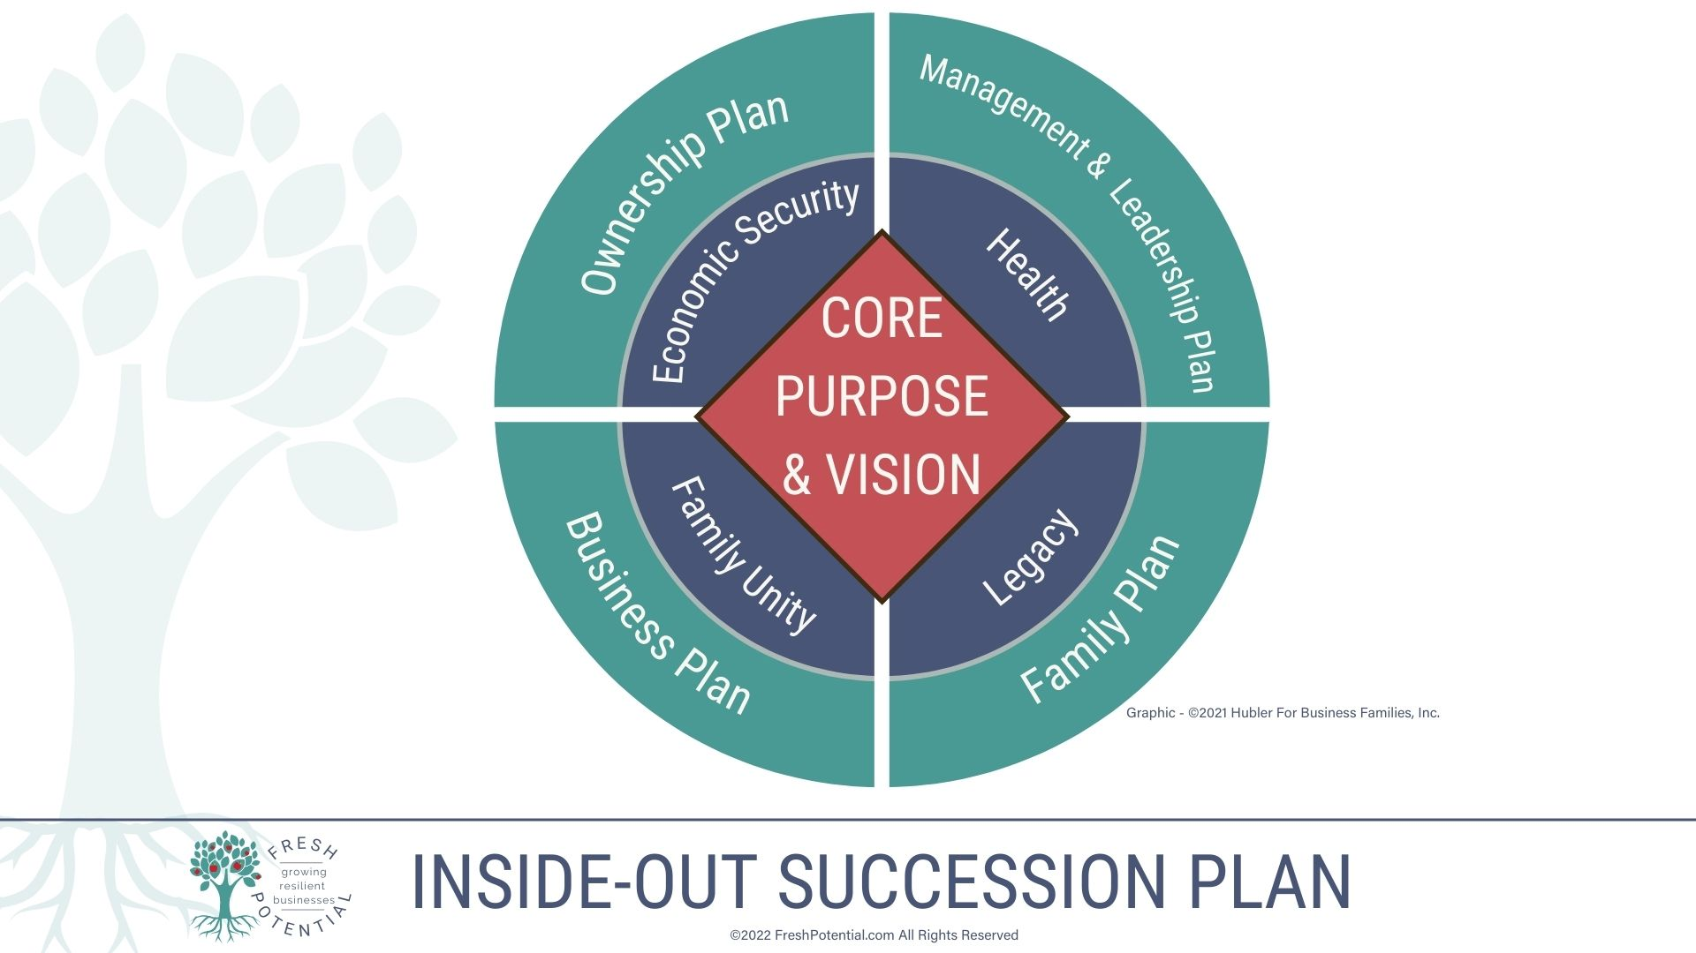

Slide 16
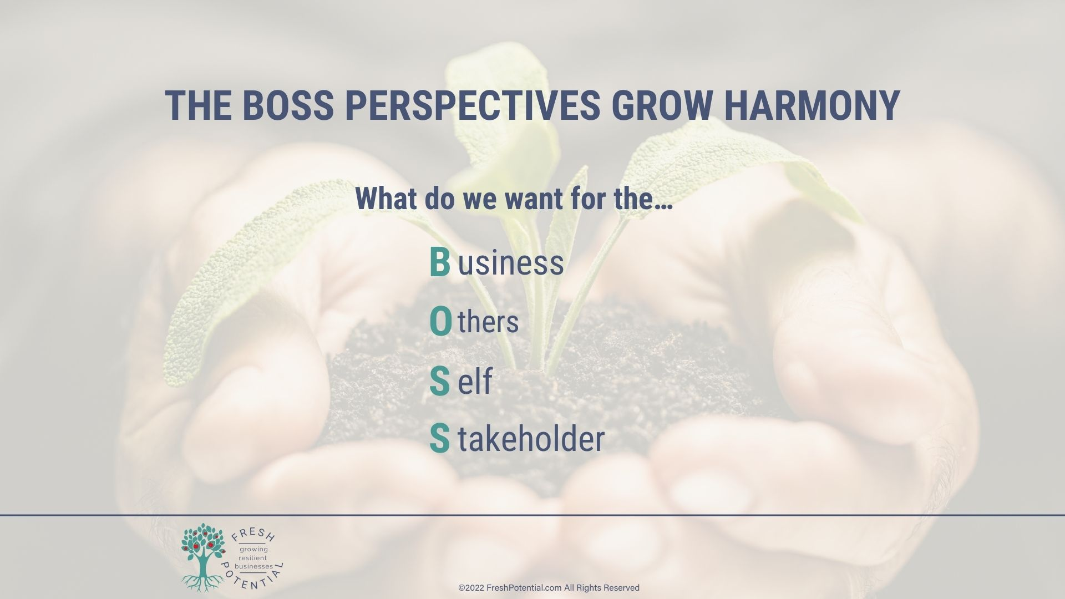

Slide 17
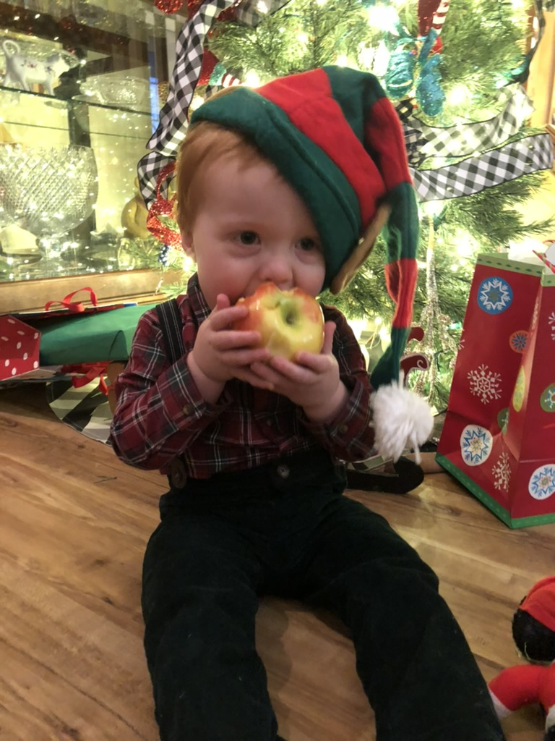
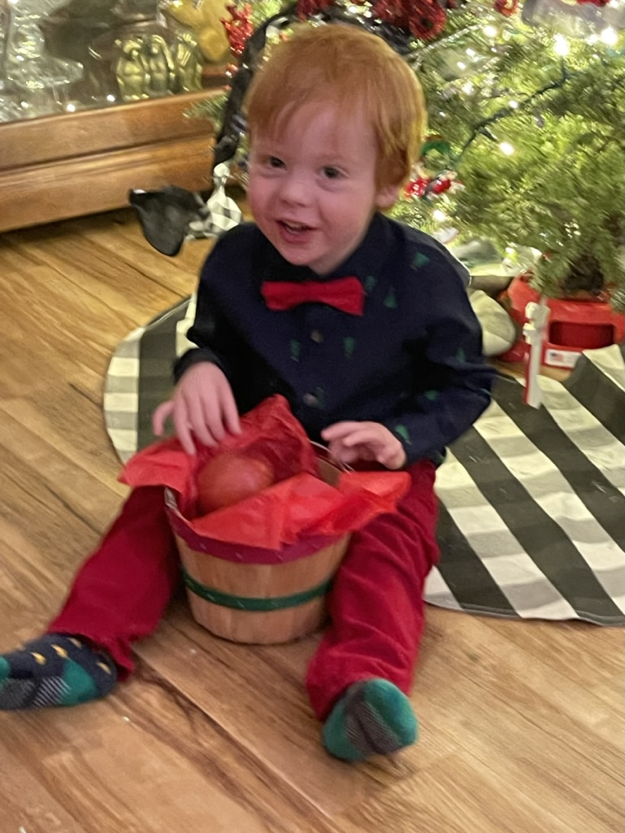
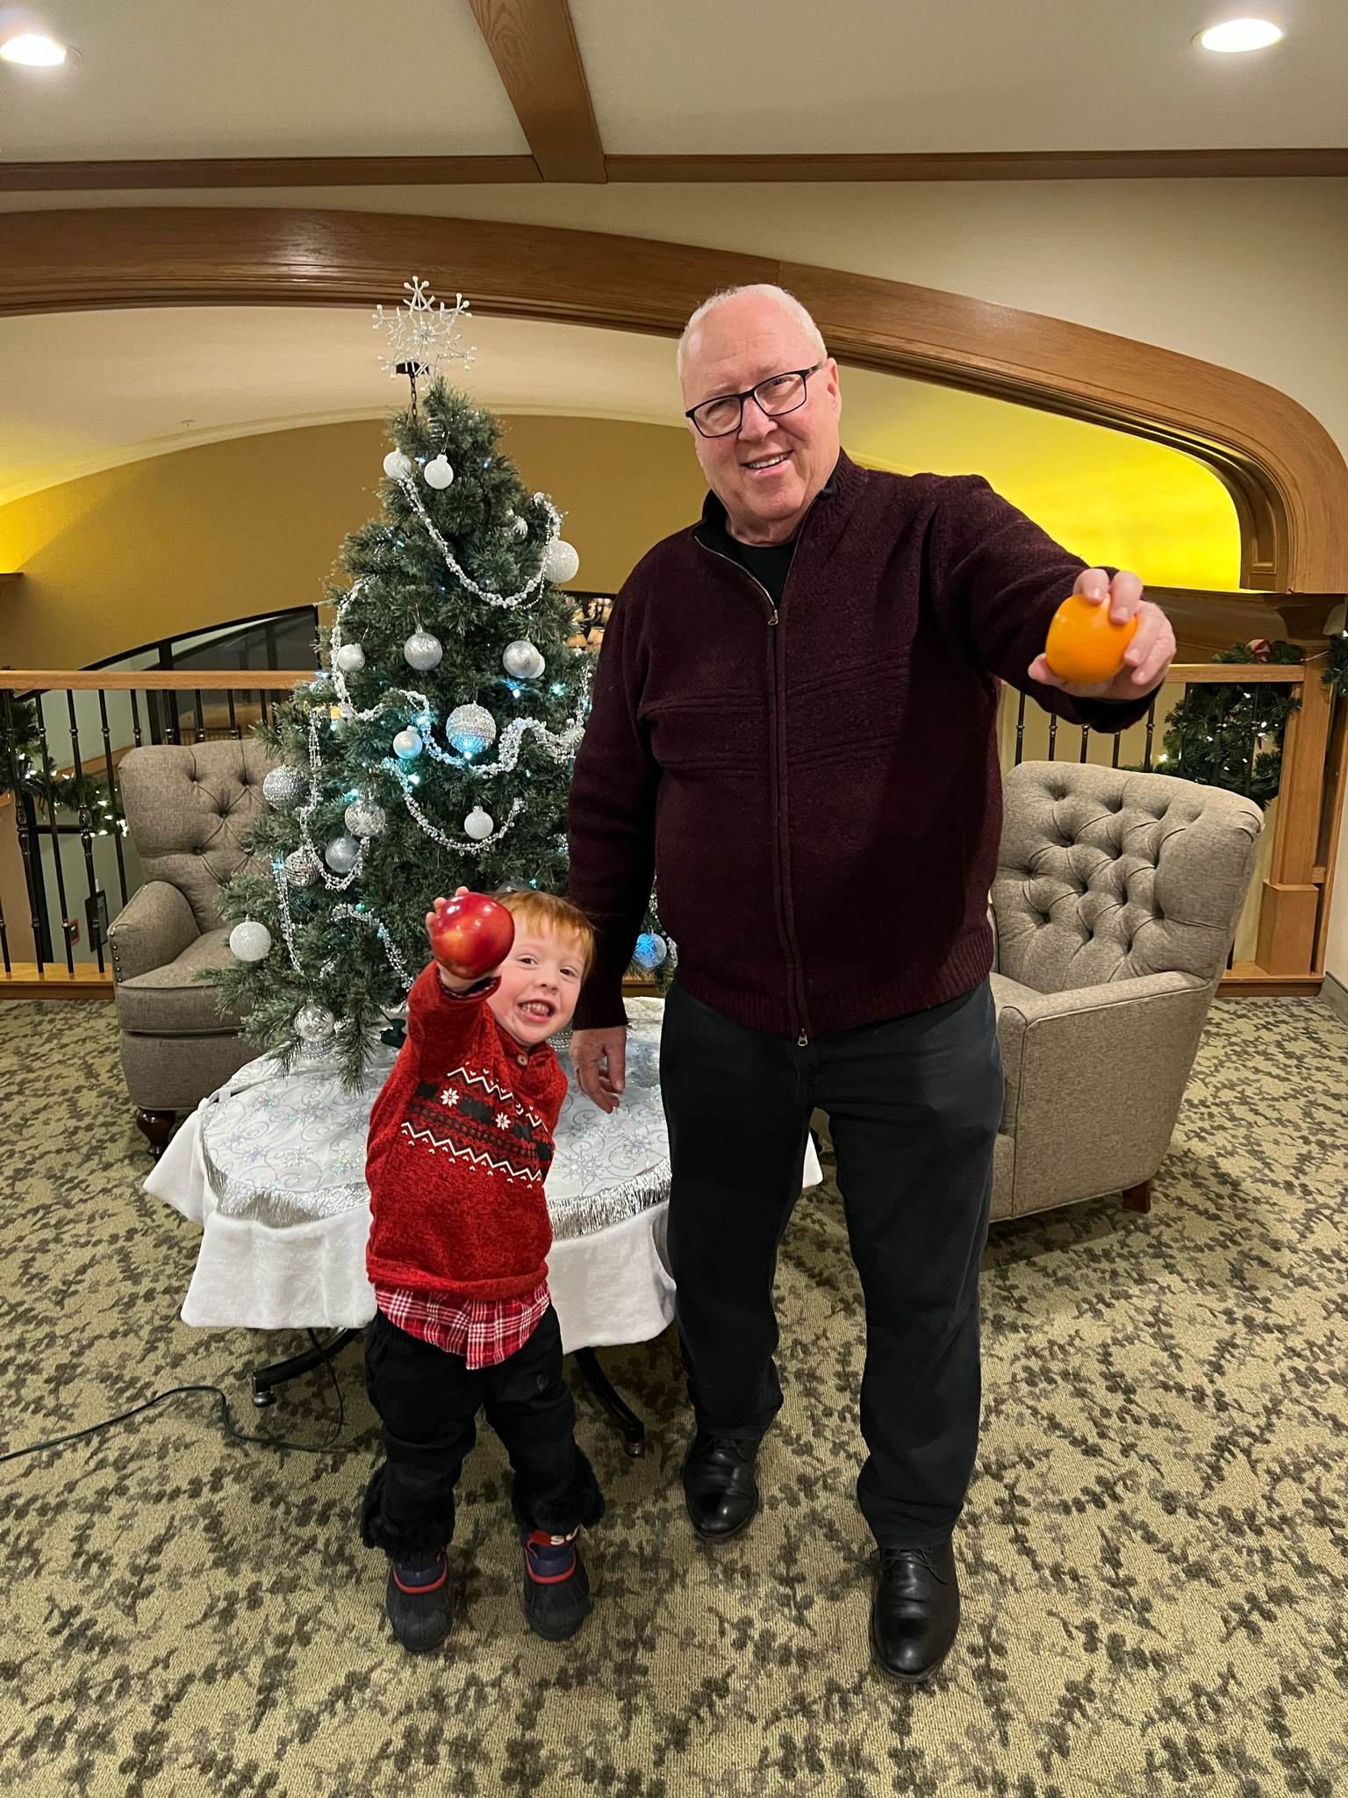
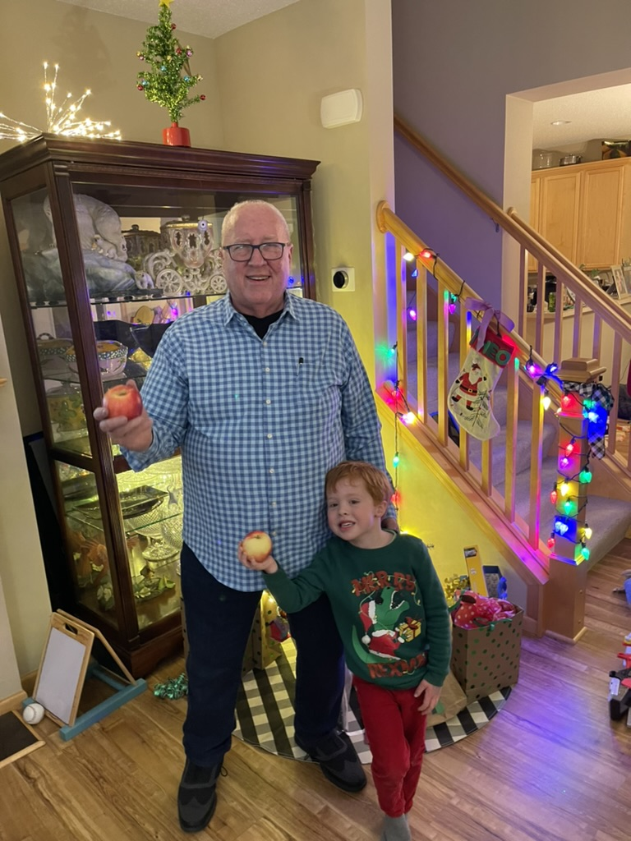
Theo - 2089

Slide 18
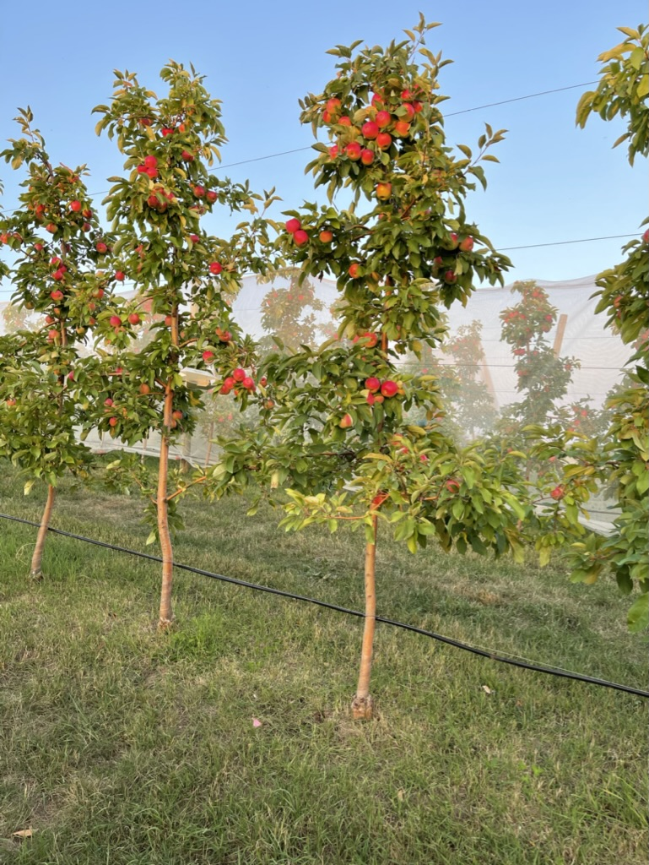

Slide 19
Leadership Development tips from an apple orchard
Treat every individual as a leader.
Cultivate with core values, tools of resilience, and a shared vision to enable opt–in instead of avoidance.
Create a support system that can be counted on.
Use decision guidelines to become an active and share organization.
Training

Slide 20
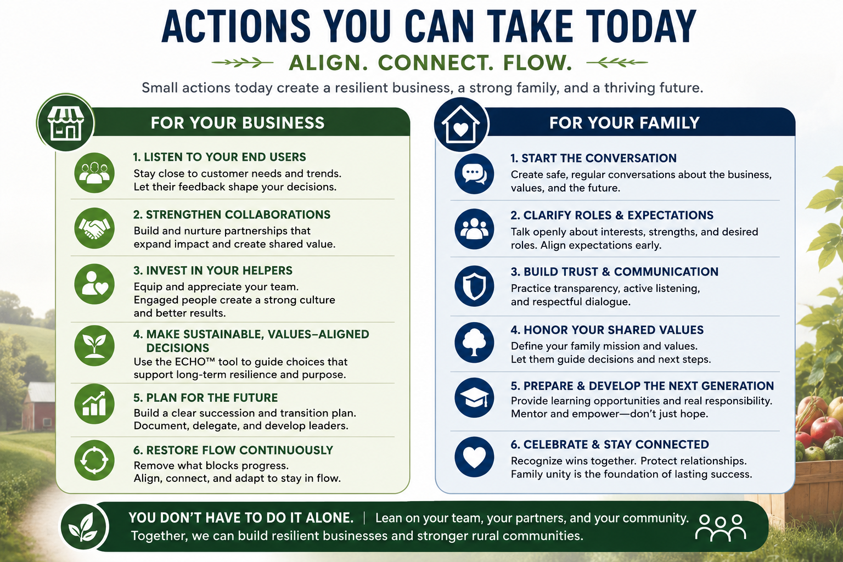

Slide 21
